Slide 1
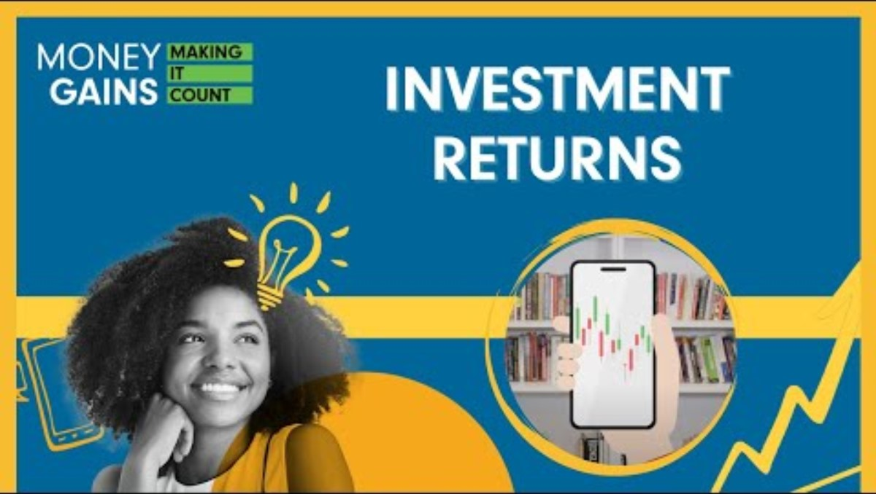
Understanding your investment returns

Slide 2
What is an IPO (initial public offering)?
An IPO is the first time shares in an company are sold to the public.
Trading then continues on the stock market; traders buy from and sell to each other.

Slide 3
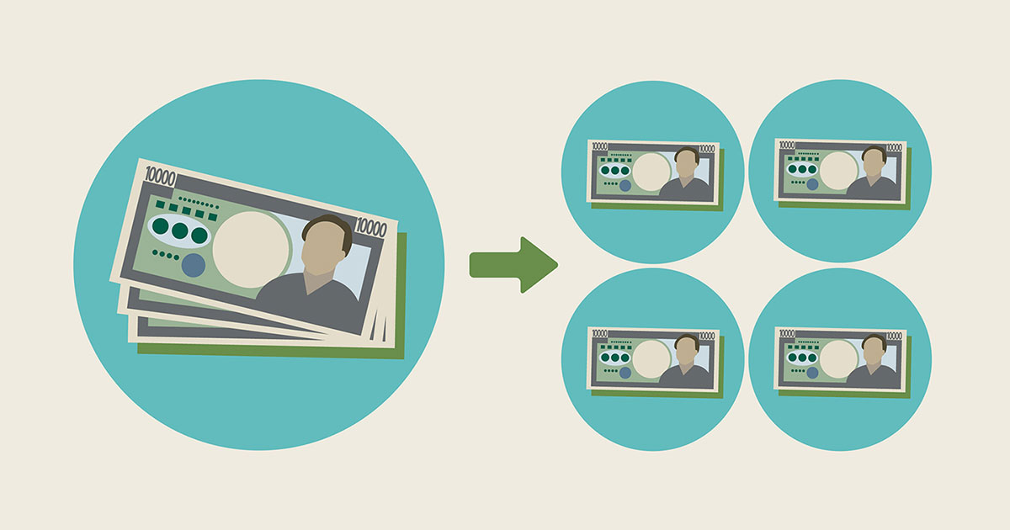
What is a stock split?
A stock split divides each share into several shares (usually to reduce the price
per share).
For example, in a 2-1 split (i.e., 2 for 1), each stockholder would receive 2 shares for every
1 share owned.
This results in an increase in the total number of shares outstanding for the company, but no change in a shareholder’s proportional ownership.
This is a common strategy used by companies to make their stocks more affordable.
Notes:
3

Slide 4
MINDS ON: What if you invested on day 1?
Nike went public in 1980 with a price of $23 per share, and the company has had 7 stock splits since then. When adjusted for splits, Nike’s IPO price was $0.18 per share.
Guess the share price now.
If you bought 10 stocks in the IPO, how much would you have now?
What if you bought 100 stocks?
Notes:
4

Slide 5
MINDS ON: What if you invested on day 1?
Amazon’s IPO was on May 15, 1997, and the IPO price was $18.00, or $0.075 adjusted for the stock splits that occurred on June 2, 1998 (2-for-1 split), January 5, 1999 (3-for-1 split), September 1, 1999 (2-for-1 split) and June 3, 2022 (20-for-1 split).
Guess the share price now.
If you bought 10 stocks in the IPO, how much would you have now?
What if you bought 100 stocks?
Notes:
5

Slide 6
What are investment returns?
  How much a security or portfolio goes up or down over a period, often shown as a percentage change.
What are the two components of investment returns?
Change in price:
  Unrealized capital loss: decrease in value.
  Unrealized capital gain: increase in value.
  Realized loss/gain: occurs when selling the security.
Earned income:
  Reward for holding a security.
  Dividends: distributions from company profits (usually paid quarterly, which is four times per year).
  Interest: earned on bonds or savings accounts.
Notes:
6

Slide 7
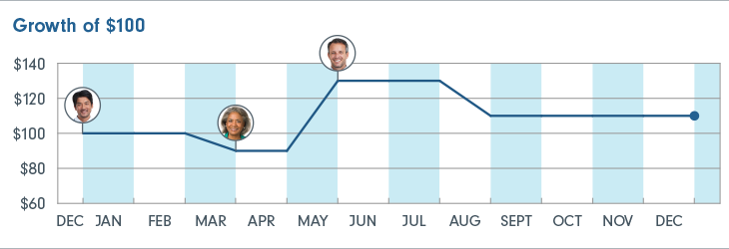
Time-weighted return vs. dollar-weighted return
Tom, Jill and Adam all purchased shares of a mutual fund (Fund A).
Fund A started the year at a price of $10 per unit. It then moved down and up before closing the year at $11 per unit. The Fund’s investment return for the year is 10%.
Time‑weighted return is identical for all three investors if they hold without selling (10%).
The dollar‑weighted rate of return varies for each investor according to the size and timing of their contributions and withdrawals.
Notes:
7

Slide 8
What are the two ways to calculate a rate of return?
Return type | What it measures | Best of evaluating | Answer the questions
Time-weighted (investment return) | Investment return for a specific period | The performance of the specific investment or portfolio manager. Comparing two different instruments. | How did the investment perform during a specific period? How did the portfolio manager perform?
Dollar-weighted (personal rate of return) | Account return, including changes in the account value, and the impact of the amount and timing of contributions and withdrawals. | Personal return factoring in the impact of contributions and withdrawals. | What was my personal return, factoring in the contributions/withdrawals that I made during a specific period?

Slide 9
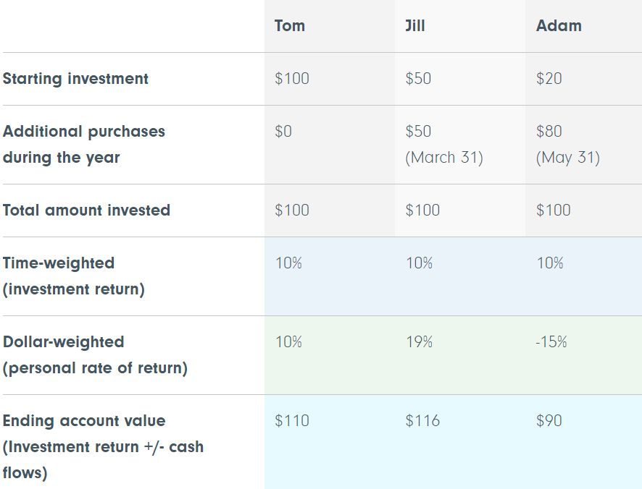
What are the two ways to calculate a rate of return?
Time-weighted returns:
  Measures performance over a specific time independent of further investments.
  Useful for comparing different investment options.
Dollar-weighted returns:
  Evaluates personal rate of return, considering additional contributions or withdrawals.
  Influenced by size, timing and ongoing transactions.

Slide 10
Comparison of returns
Cumulative return
Cumulative return shows you the total change in the value of an investment over a specific period. Over longer time periods, the cumulative return of an investment can be a very large number.
Annualized return
Annualized return measures how much an investment has grown on an annualized basis (over a one-year period). Reviewing annualized returns is common in the investment industry, as it simplifies comparing the returns of different investments.

Slide 11
Conclusion
Investment returns are crucial to understand when investing.
Time-weighted return is useful for comparing different investments.
Dollar-weighted return is more personalized, considering size, timing and transactions.
Notes:
11

Slide 12
Activity
Pretend that starting five years ago, you invested $500 each month in a security and held it for five years (so over the five years, you invested 500 x 12 x 5 = $30,000).
Choose a security using the Fidelity Investment Finder that has existed for more than five years, and create a PowerPoint presentation that answers the following questions:
What does this fund invest in?
Why did you choose this fund?
What was the value of your investment at the end of the five years?
What was your total return in dollars?
What was the time-weighted return after the five years?
Do you think that you could have earned more from putting your money in a savings account or GIC and earning interest? Explain.
Notes:
12

Slide 13
Examples

Slide 14
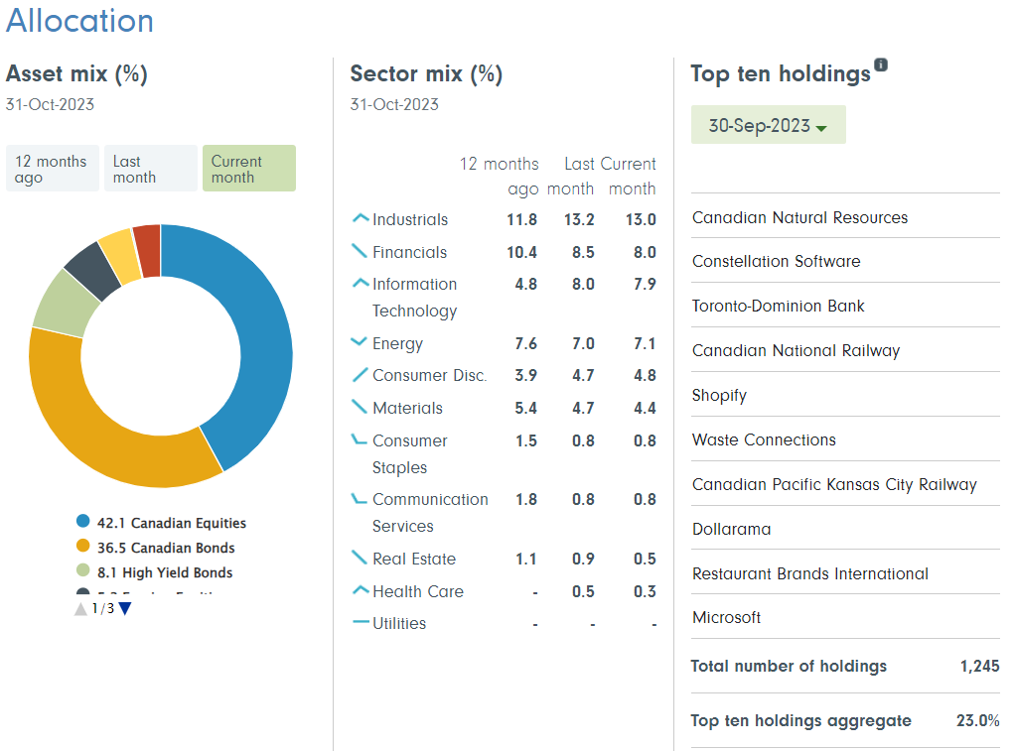
1. Choose one security using the Fidelity Investment Finder that has existed for more than five years. What does this fund invest in?
Fidelity Canadian Balanced Fund
A core holding with a neutral mix of 50% equities, 40% investment-grade and 10% high yield.
A Canadian focus, with the flexibility to invest up to 30% in foreign markets.
Notes:
14

Slide 15
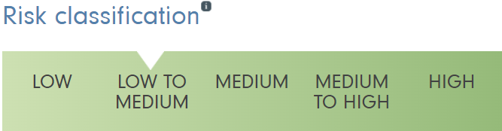
2. Why did you choose this fund?
  Fidelity Canadian Balanced Fund typically is low to medium risk, which is suitable based on my risk tolerance and time horizon (medium).
  It contains a mix of both equities (stocks) and fixed income securities (bonds). This balanced approach provides me with exposure to both asset classes, potentially offering diversification benefits.
  By investing in a Canadian balanced fund, I can gain exposure to the Canadian market and am supporting Canadian businesses, which is important to me as a Canadian.
Notes:
15

Slide 16
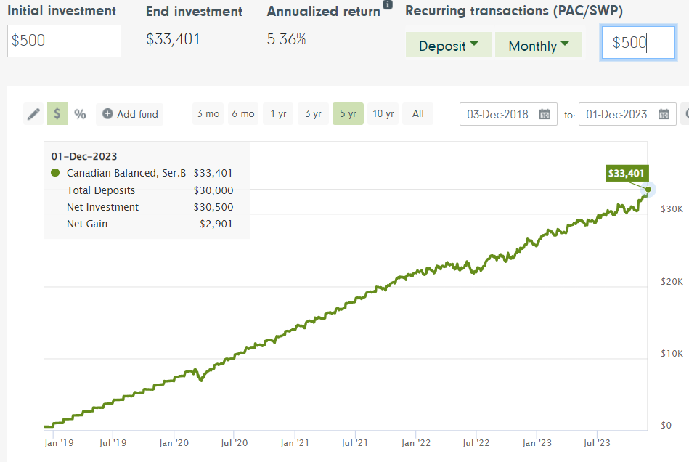
3. What was the value of your investment at the end of the five years? $33,401
4. What was your return in dollars? $2,901
Notes:
16

Slide 17
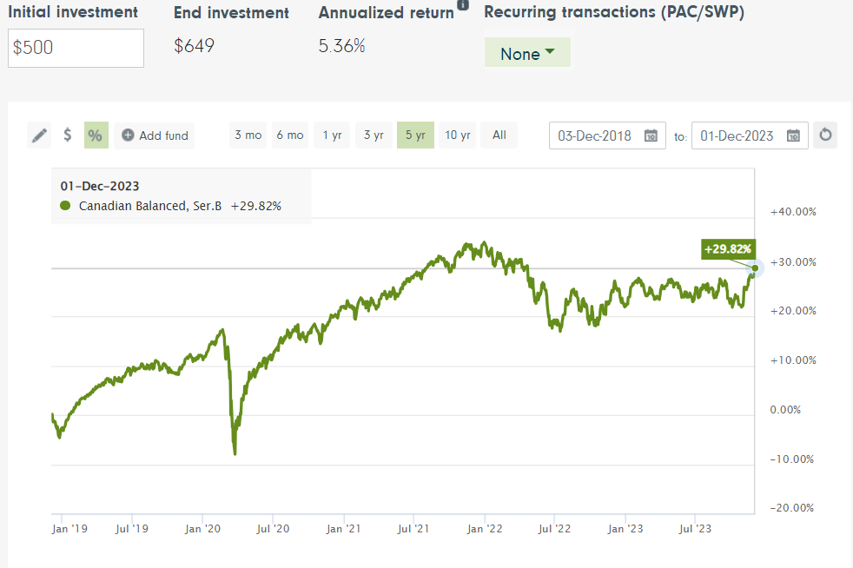
5. What was the time-weighted return after the five years? 29.82%
Notes:
17

Slide 18
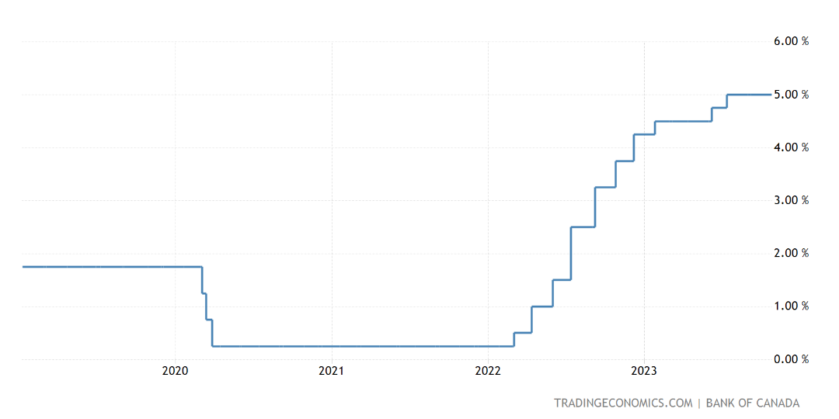
6. Do you think that you could have earned more from putting your money in a savings account or GIC and earning interest? Explain.
  No, because 5.3% average annual return is more than what I could have earned from a savings account. This is because interest rates have not been higher than 5% in the past five years.
Notes:
18

Slide 19
Debrief
Form groups of four or five.
Share your investment choices and determine who had the highest return and who had the lowest return in each group.
One representative from each group will share the findings with the class.
What trends are there for the highest and lowest performers?
Notes:
19

Slide 20
Assignment
Conduct research to investigate what caused your investment fund to fluctuate the most during the five-year period. Write a 500-word report covering the leading causes of the fund’s growth and decline over this period. Consider political, environmental and economic factors such as COVID-19, wars and interest rates.
Ex) Amazon stock went up during COVID because of increases in online shopping, whereas airline stocks went down because…
Notes:
20

Slide 21
Rubric
 | Level 4 | Level 3 | Level 2 | Level 1
Knowledge | Demonstrates a deep understanding of various factors influencing the investment fund’s fluctuations, displaying comprehensive knowledge of political, environmental and economic elements over the five-year period. | Shows solid knowledge of the causes of fund fluctuations, considering a good variety of factors, though some areas may lack detailed exploration. | Displays a foundational understanding of factors impacting the fund’s performance but lacks depth and focuses on only a few elements. | Exhibits minimal knowledge in investigating causes, lacking depth and providing only superficial insights.
Thinking | Analyzes highly relevant political, environmental and economic factors with a nuanced understanding of their impact on the investment fund, demonstrating advanced critical thinking skills. | Recognizes and discusses key factors impacting the fund with a good understanding, although some relevance may be missed or not thoroughly elaborated. | Identifies a few relevant factors, but the understanding of their impact is limited or lacks depth. | Fails to identify or discuss significant factors relevant to the fluctuations in the investment fund.
Application | Effectively integrates a five-year timeline into the analysis, showcasing an understanding of how factors evolved over time and their specific impacts in different periods. | Integrates a timeline into the overview, but may lack precision or detail in connecting specific events to fluctuations. | Briefly mentions a timeline without a strong connection to the causes of fluctuations. | Fails to incorporate a five-year timeline or lacks coherence in connecting events to the fund's performance.
Communication | Presents a concise and coherent overview of the leading causes of fund fluctuations, effectively communicating complex ideas with clarity and precision. Demonstrates exceptional writing quality, free of grammatical errors, and appropriately cites sources to support claims and findings. | Provides a clear overview with some minor lapses in clarity or coherence. Presents well-written content with minor grammatical errors and includes appropriate citations. | Offers a somewhat clear overview, but may lack coherence in presenting ideas. Writing quality is acceptable but may contain noticeable grammatical errors, and citations may be inconsistent or lacking. | The overview is unclear, disjointed or fails to convey a coherent understanding of the leading causes. Contains numerous grammatical errors, and lacks proper citations.

