Slide 1
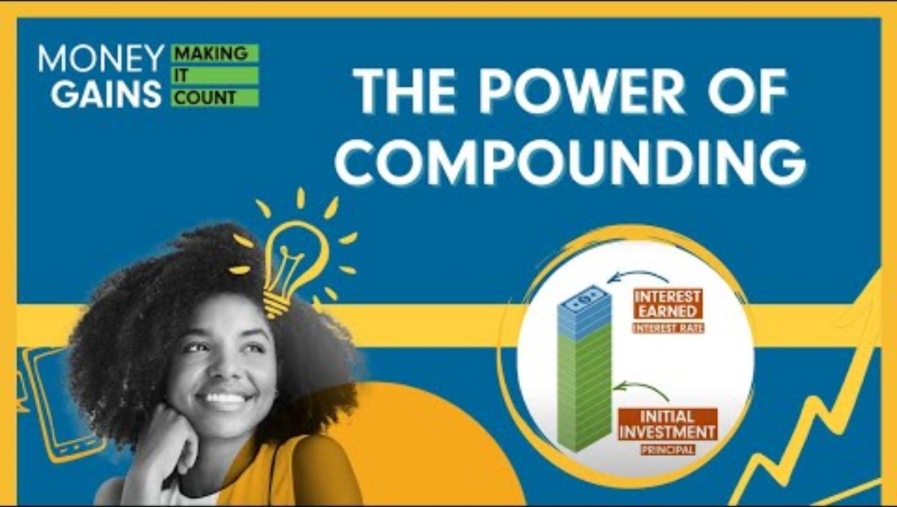
The power of compounding

Slide 2
Minds on
Would you rather start with a penny and double your money daily for 30 days or have $1 million?

Slide 3
Growth of a penny that doubles daily for 30 days
Day | Amount | Day (cont’d) | Amount (cont’d)
1 | $0.01 | 16 | $327.68
2 | $0.02 | 17 | $655.36
3 | $0.04 | 18 | $1,310.72
4 | $0.08 | 19 | $2,621.44
5 | $0.16 | 20 | $5,242.88
6 | $0.32 | 21 | $10,485.76
7 | $0.64 | 22 | $20,971.52
8 | $1.28 | 23 | $41,943.04
9 | $2.56 | 24 | $83,886.08
10 | $5.12 | 25 | $167,772.16
11 | $10.24 | 26 | $335,544.32
12 | $20.48 | 27 | $671,088.64
13 | $40.96 | 28 | $1,342,177.28
14 | $81.92 | 29 | $2,684,354.56
15 | $163.84 | 30 | $5,368,709.12

Slide 4
What is compound interest?
Compound interest is earned when the interest you earn in a savings or investment account earns interest of its own. With compound interest, you earn interest on both your initial balance – called the principal – and the interest that’s added to the balance over time.

Slide 5
Simple and compound interest formulas
Compound interest occurs when interest is added to the principal, so the interest that has been added also itself earns interest.
Compound interest formula:
Future Value (FV) = P(1 + r/n)^{nt}
r= interest rate per compounding period
n = # of compounding periods
P = Principal (original investment)
T = time (in years)
Simple interest is calculated ONLY on the principal amount.
Simple interest formula:
Future Value (FV)= P(1 + rt)
t = time (# of years)
r = interest rate
P = Principal (original investment)
Notes:
5

Slide 6
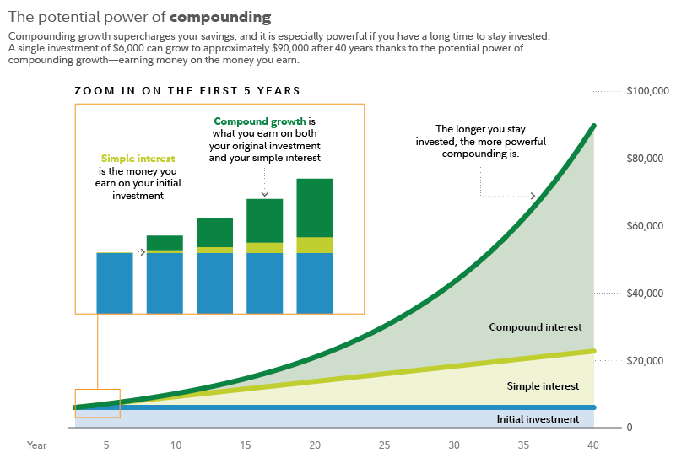
Let’s compare the returns on a $6,000 investment that earned simple interest vs. compound interest, assuming each earns a hypothetical 7%
rate of return.
The power of compounding
Compounding growth supercharges your savings, and it is especially powerful if you have a long time to
stay invested. A single investment of $6,000 can grow approximately $90,000 after 40 years thanks to
potential power of compounding growth–earning money on the money you earn.
ZOOM IN ON THE FIRST 5 YEARS
$100,000
Compound growth is
what you earn on both
your original investment
and your simple interest
The longer you stay
invested, the
more powerful
compounding is.
Simple interest
is the money you
earn on your initial
investment
$80,000
$60,000
$40,000
Compound interest
$20,000
Simple interest
Initial investment
0
YEAR
5
10
15
20
25
30
35
40
Notes:
6

Slide 7
What advice should young investors follow to take advantage
of the power of compounding?
The power of compounding
Compounding growth supercharges your savings, and it is especially powerful if you have a long time to
stay invested. A single investment of $6,000 can grow approximately $90,000 after 40 years thanks to
potential power of compounding growth–earning money on the money you earn.
ZOOM IN ON THE FIRST 5 YEARS
$100,000
Compound growth is
what you earn on both
your original investment
and your simple interest
The longer you stay
invested, the
more powerful
compounding is.
Simple interest
is the money you
earn on your initial
investment
$80,000
$60,000
$40,000
Compound interest
$20,000
Simple interest
Initial investment
0
YEAR
5
10
15
20
25
30
35
40
7
Notes:
7

Slide 8
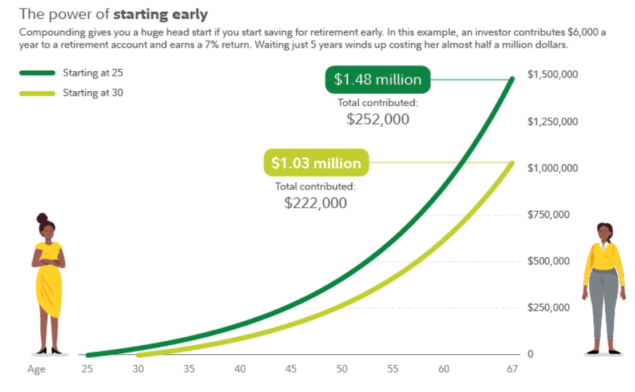
Tips: Invest early
The power of starting early
Compounding gives you a huge head start if you start saving for retirement early.
In this example, an investor contributes $6,000 a year to a retirement account and
earns 7% return. Waiting just 5 years winds up costing her almost half a million dollars.
Start investing early and consistently to take full advantage of the power of compounding and the time value of money.
You can compound any type of return on an investment by reinvesting your returns.
Example:
  Jane started investing 20 years ago and made
  10 annual contributions of $5,000 and received an 8% percent annual return. She stopped investing after 10 years and held on to the investment for a further 10 years at an 8% annual return.
  John, meanwhile, started investing 10 years ago; he made 10 annual contributions of $10,000 at an 8% annual return and he ended up with less money than Jane – even though he invested twice as much money – because he started later.
Starting at 25
$1.48 million
$1,500,000
Starting at 30
Total contributed:
$252,000
$1,250,000
$1.03 million
$1,000,000
Total contributed:
$222,000
$750,000
$500,000
$250,000
0
AGE
25
30
35
40
45
50
55
60
67
Notes:
8

Slide 9
Invest often
Regular contributions will make your money grow faster and help to decrease your risk.
The S&P 500 – a common benchmark for overall stock market performance – has averaged close to 10% annual returns over the last 100 years.
But the market doesn’t move in a straight, upward line: there are peaks and valleys, like bear markets, where stock values fall more than 20% from recent highs.
To combat this risk, many investors turn to dollar-cost averaging, a strategy that has you invest smaller amounts regularly rather than waiting to invest a large lump sum.
Because you buy the same dollar value of an investment, no matter if prices are low or high, you buy more shares when prices are down and fewer when they’re up.
This helps you avoid investing a lot right before prices drop or too little before they rise. In addition to helping minimize your risk, dollar-cost averaging may lead you to pay less per share on average over time.
But remember: Dollar cost averaging does not assure a profit or protect against loss in declining markets. For the strategy to be effective, you must continue to purchase shares in both market ups and downs.
Notes:
9

Slide 10
Diversify
The average return of the S&P 500 is based on the average returns of 500 of the largest public companies in the U.S. adjusted based on each company’s market capitalization. The S&P 500’s wide-ranging holdings help provide the kind of diversification that many investors aim for to decrease their risk.
Individual stocks may see returns that are greater than the broader stock market’s (as represented by S&P 500), and they also carry much more concentrated risk. The overall stock market has never zeroed out, but individual companies have.
By investing in a wide range of companies, you may decrease the risk, because if individual stocks you buy go down, others may rise to help balance it out.
Putting in the time, effort and research it takes to pick individual stocks can be challenging. That’s where mutual funds, index funds, exchanged-traded funds (ETFs) and target-date funds come in.
  With funds, professionals do the research for you, either by conducting due diligence themselves or by simply aiming to duplicate the performance of a major market index, like the S&P 500. In either case, they provide a diversified portfolio of many investments that offer the chance of benefiting from compounding returns.
Notes:
10

Slide 11
Returns on a $6,000 investment that earned simple interest vs. compound interest, assuming each earns a hypothetical 7% rate of return
The power of compounding
Compounding growth supercharges your savings, and it is especially powerful if you have a long time to
stay invested. A single investment of $6,000 can grow approximately $90,000 after 40 years thanks to
potential power of compounding growth–earning money on the money you earn.
ZOOM IN ON THE FIRST 5 YEARS
$100,000
Compound growth is
what you earn on both
your original investment
and your simple interest
The longer you stay
invested, the
more powerful
compounding is.
Simple interest
is the money you
earn on your initial
investment
$80,000
$60,000
$40,000
Compound interest
$20,000
Simple interest
Initial investment
0
YEAR
5
10
15
20
25
30
35
40
11
Notes:
11

Slide 12
How can compound interest
can hurt debtors?

Slide 13
Credit card and compound Interest
Interest is charged to your credit card if you haven’t fully paid off your balance from your last billing period.
Credit card interest rates are expressed through a metric called an annual percentage rate, or APR.
Canadian cards typically run between 19.99% and 25.99%.
Most credit cards charge a slightly higher APR on cash advances (withdrawing cash from your credit card on an ATM).
Credit card companies compound interest daily, but will often charge it on a monthly basis. On an APR of 20%, the daily percentage rate comes out to around 0.055%.
On a credit card with a balance of $1,000 and an APR of 20%, you would be charged an additional
$0.55 in interest for each day the balance remained unpaid. When calculated monthly, that adds up to about $16.50.
Notes:
13

Slide 14
Compound interest and credit
  The debt continues to grow with each passing month, and the interest is calculated not just on the initial balance but also on the accumulated interest from previous months.
  If the cardholder is only making minimum payments, which often cover just the interest and a small portion of the principal, the debt will grow faster due to compounding interest, making it harder to pay off the balance.
  In the long run, compound interest can make it challenging for debtors to escape the cycle of debt, and they may end up paying much more than the initial amount borrowed.
Notes:
14

Slide 15
Investigation
Interest accrued = P(1 + r/n)^{nt} - P
r = interest rate per compounding period
n = # of compounding periods
P = Principal (original investment)
T = time (in years)
What would the formula be for monthly accrued interest on a $1,000 credit card balance, with 20% APR compounded daily?
Answer:
Monthly interest accrued = [1000(1 + .2/365)^{(365)(1/12)} - P
Notes:
15

Slide 16
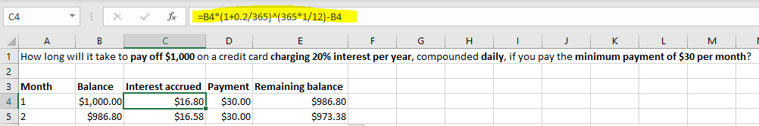
Your task:
Use Excel to calculate how long will it take to pay off 1,000 on a credit card charging 20% interest per year, compounded daily, if you pay off $30 per month?
Notes:
16

Slide 17
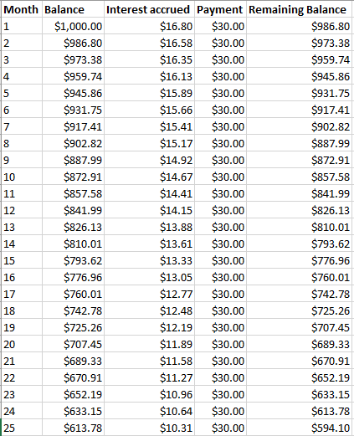
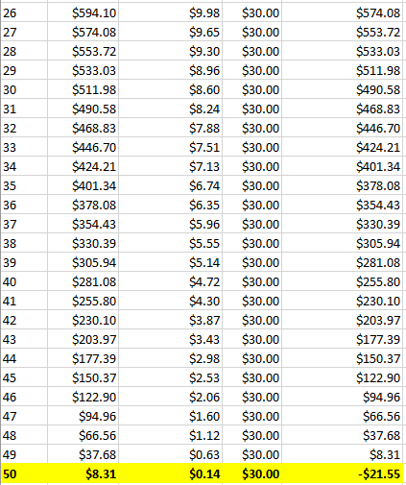
Answer: 50 months
How much will you end up paying in total over the 30 months?
30x50=$1,500 – $500 more than your initial balance!
Notes:
17

Slide 18
Homework: Reflection
Complete a reflection that answers the following questions:
What is the difference between simple and compound interest?
What are three ways that you can use compound interest in your favour to maximize your investment returns?
As a borrower, how can compound interest hurt you? How can you avoid paying interest on credit card balances?
Notes:
18

