Slide 1

Setting goals and time horizons

Slide 2
Review
What’s the difference between saving and investing?
What are asset classes?
What traditional and alternative asset classes can you remember?

Slide 3
Minds on!
On your post it, write down
Your name.
One personal goal you have, that will require money to achieve it. Ex. Travelling to a specific country, attending a specific college or university, buying a specific car, buying a home in a specific area, retiring your parents early, donating to a charity.
Please note: your goal will be read out to the class.

Slide 4
Investment timelines are the timespan that you will be contributing to the account and investing until the money is needed.
Short-term financial goals (up to three years or less)
Focused on addressing immediate financial needs or managing short-lived financial challenges.
Examples: saving for a vacation, paying off a credit card debt, saving for a car.
Medium-term financial goals (three to five years)
Usually involve more significant financial commitments and typically serve as transitions between short-term and long-term financial goals.
Examples: saving for post-secondary education, saving to start a business.
Long-term financial goals (over five years)
Typically demand substantial financial planning, investment and commitment.
Examples: buying a home, retirement planning.
What type of investment risk would be advisable for each timeline?
Notes:
4

Slide 5
Your financial goals
Goal | Investment timeline | Type of goal? (short term, medium term, long term)

Slide 6
Notes:
6

Slide 7
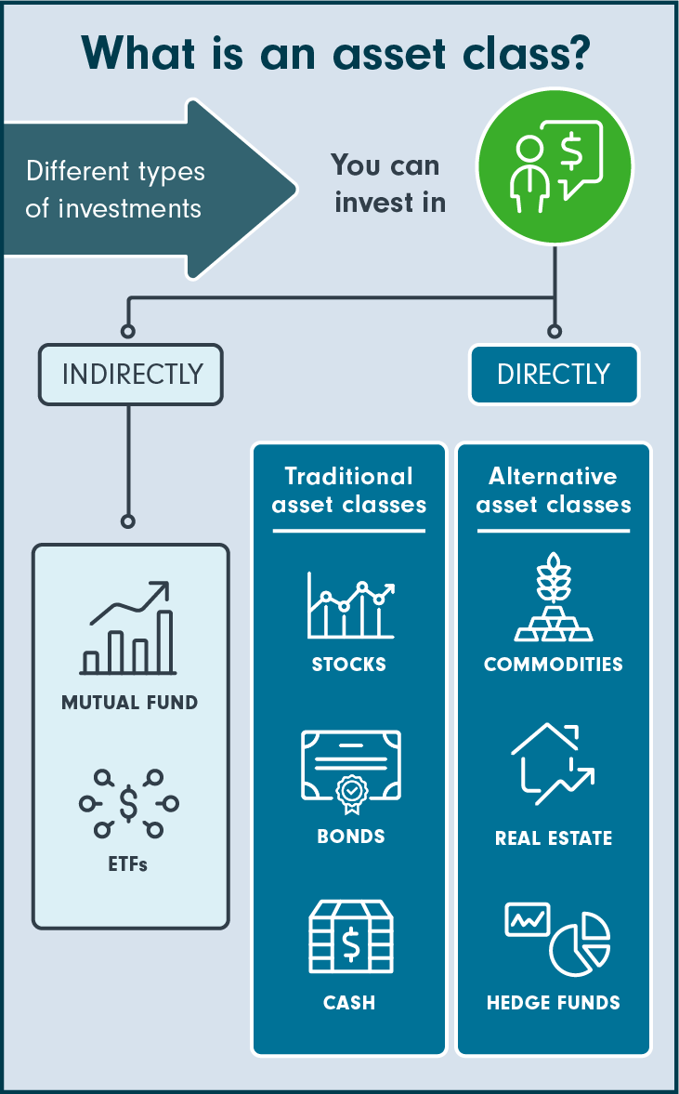
Review: Asset classes
Traditional assets
Stocks
Having stocks in company represents owning a part of it.
Bonds (fixed income, fixed interest, debt)
A bond is a loan made to a company or government when it needs to raise money.
Cash and cash equivalents
Cash equivalents are high-quality investments that can be converted into cash immediately.
Alternative: Alternative asset classes generally include groups of securities beyond stocks, bonds and cash.
Real estate and commodities such as gold are considered alternative asset classes.
Commodities: Commodities include raw materials or resources such as gold, oil and natural gas.
Real estate
REITS: Real estate, in the context of investing, may be physical property or an investment in a company that owns and operates income-producing real estate, called a real estate investment trust (REIT).
Many REITs are publicly traded, allowing investors to buy and sell them like stocks.
Digital assets
Digital assets include anything that is created and stored digitally, and make up an emerging asset class. Cryptocurrencies, such as bitcoin, non-fungible tokens (NFTs), digital art and even virtual property are considered digital assets.

Slide 8
Short-term goals require more liquid and less risky investments, while long-term goals can tolerate higher-risk investments.
Medium-term goals fall somewhere in between in terms of risk and liquidity.
Different investment vehicles are better suited for different timelines.
 | Most aggressive portfolio: 100% stocks | Short-term portfolio: 0% stocks
Best Year | 162.89% | 15.20%
Worst Year | -67.56% | -0.04%
Average return | 10.31% | 3.26%

Slide 10
Your task: Use the Fidelity Investment Finder to help you complete this chart.
Description of Goal | Money required (research the cost) | Investment option #1 and rationale | Investment option #2 and rationale
Short term (<1 year)
Medium term (1-5 years)
Long term (>5 years)

Slide 11
Debrief
Share your goals with a partner or in small groups.
After each group member shares each goal, the others should give advice as to which investment option is best given the timeline of each goal.

