Slide 1

Setting goals and time horizons

Slide 2
Review
What’s the difference between saving and investing?
What are asset classes?
What traditional and alternative asset classes can you remember?

Slide 3
Think, pair, share
Think about two financial goals that you have:
  one with a time horizon of less than one year
  one with a time horizon of more than one year
Share with a partner and discuss how you plan to achieve
each goal.
Each group will share one of their partner’s goals with the class.

Slide 4
Investment timelines are the timespan that you will be contributing to the account and investing until the money is needed.
Short-term financial goals (up to three years or less)
Focused on addressing immediate financial needs or managing short-lived financial challenges.
Examples: saving for a vacation, paying off a credit card debt, saving for a car.
Medium-term financial goals (three to five years)
Usually involve more significant financial commitments and typically serve as transitions between short-term and long-term financial goals.
Examples: saving for post-secondary education, saving to start a business.
Long-term financial goals (over five years)
Typically demand substantial financial planning, investment and commitment.
Examples: buying a home, retirement planning.
What type of investment risk would be advisable for each timeline?
Notes:
4

Slide 5
Your financial goals
Goal | Investment timeline | Type of goal? (short term, medium term, long term)

Slide 6
Notes:
6

Slide 7
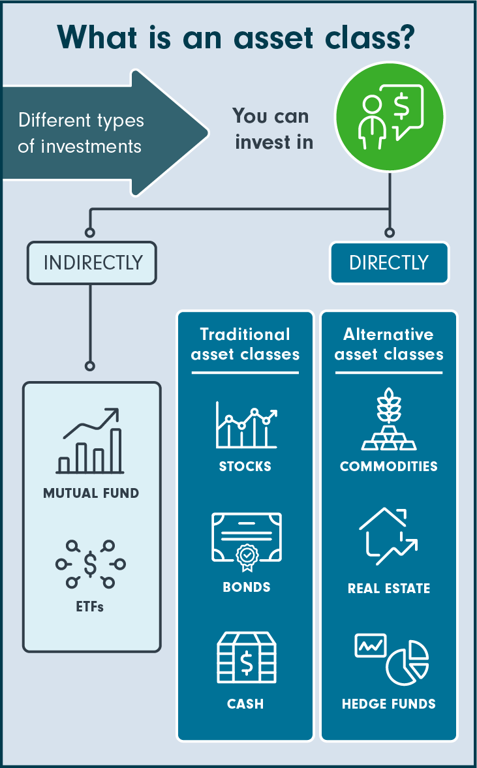
Review: Asset classes
Traditional assets
Stocks
Having stocks in company represents owning a part of it.
Bonds (fixed income, fixed interest, debt)
A bond is a loan made to a company or government when it needs to raise money.
Cash and cash equivalents
Cash equivalents are high-quality investments that can be converted into cash immediately.
Alternative: Alternative asset classes generally include groups of securities beyond stocks, bonds and cash.
Real estate and commodities such as gold are considered alternative asset classes.
Commodities: Commodities include raw materials or resources such as gold, oil and natural gas.
Real estate
REITS: Real estate, in the context of investing, may be physical property or an investment in a company that owns and operates income-producing real estate, called a real estate investment trust (REIT).
Many REITs are publicly traded, allowing investors to buy and sell them like stocks.
Digital assets
Digital assets include anything that is created and stored digitally, and make up an emerging asset class. Cryptocurrencies, such as bitcoin, non-fungible tokens (NFTs), digital art and even virtual property are considered digital assets.

Slide 8
Short-term goals require more liquid and less risky investments, while long-term goals can tolerate higher-risk investments.
Medium-term goals fall somewhere in between in terms of risk and liquidity.
Different investment vehicles are better suited for different timelines.
 | Most aggressive portfolio: 100% stocks | Short-term portfolio: 0% stocks
Best Year | 162.89% | 15.20%
Worst Year | -67.56% | -0.04%
Average return | 10.31% | 3.26%

Slide 10
Your assignment:
You and your team are financial planners.
You must
  Categorize each investment as suitable for achieving short-term, medium-term or long-term goals.
  Suggest investment options to each of your
  clients based on their investment timeline.
  Provide rationale (reasoning).
  Present to your “clients”.
Investment options:
High interest savings account.
One year certificate of deposit (GIC).
Bonds and bond ETFs.
Diversified stock portfolio.
Keeping money locked in a safe at home.
Commodities.
Real estate investment.
Collectibles.
Cryptocurrency.

Slide 11
Scenario 1: Yousef’s first car
Yousef is a Grade 10 student who is determined to buy a car to use for commuting to school and part-time work. He currently has $800 saved from his part-time job and hopes to purchase a used car within the next three years. Yousef wants to explore short-term investment options to help him reach his goal faster.
Timeline of goal (short term, medium term or long term?)
Suggested savings/ investment option
Rationale (why did you choose this option?)

Slide 12
Scenario 2: Jing’s Dream School Trip
Jing is a Grade 10 student who dreams of going on a school trip to Italy during her senior year. The trip is expected to cost around $3,000. She currently has $500 saved and plans to save the remaining funds over the next two to three years.
Timeline of goal (short term, medium term or long term?)
Suggested savings/ investment option
Rationale (why did you choose this option?)

Slide 13
Scenario 3: David’s University Fund
David’s parents have started a college savings fund for him, targeting the cost of his future education. He is currently in Grade 10 and plans to attend college in four to six years. The estimated cost of tuition and expenses is $30,000. They have saved $7,000 and want to explore investment options to grow the college fund.
Timeline of goal (short term, medium term or long term?)
Suggested savings/ investment option
Rationale (why did you choose this option?)

Slide 14
Scenario 4: Maya’s Future Career Investment
Maya is a Grade 10 student with ambitions to become a doctor and open her own private practice. She envisions going to university and then medical school. She estimates that her education and career preparation may take a total of ten years after graduating high school.
She currently has $2,000 saved.
Timeline of goal (short term, medium term or long term?)
Suggested savings/ investment option
Rationale (why did you choose this option?)

Slide 15
Scenario 5: Tola’s Early Retirement Goal
Tola is a forward-thinking Grade 10 student who has big dreams of retiring by age 40 and travelling the world. He recognizes that early retirement requires careful planning. He recently inherited $80,000.
Timeline of goal (short term, medium term or long term?)
Suggested savings/ investment option
Rationale (why did you choose this option?)

Slide 16
Homework: Reflection
Choose one of your personal financial goals and
  describe the goal
  categorize it as short term, medium term or long term
  explain how you would invest your money now, in order to achieve your goal

