Slide 1
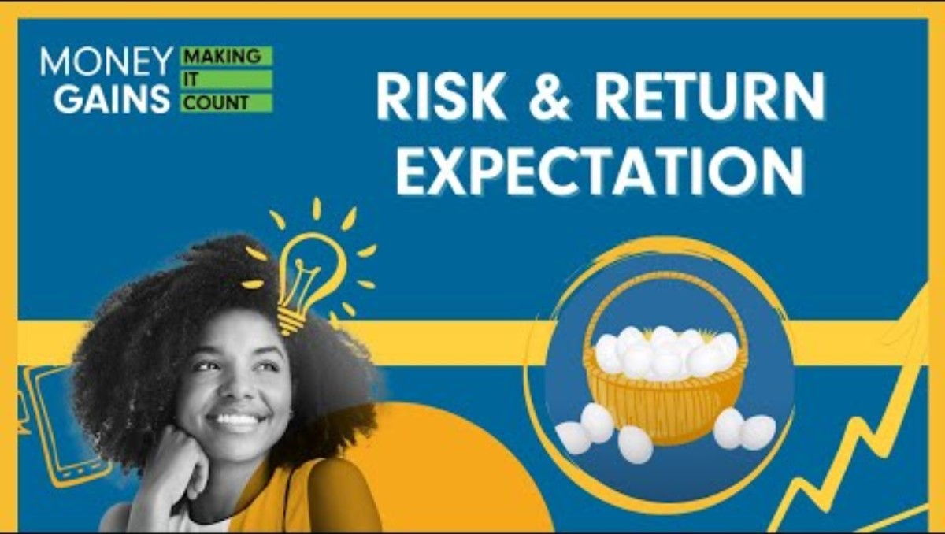
Risk and Return Expectation

Slide 2
Horse Racing
If you make a winning $2 bet on a horse that has odds of 2-1, you will profit $4 ($2x2=$4).
If you make a winning $2 bet on a horse with 5-1 odds, you will profit $10 ($2x5=$10).
What’s the relationship between the horse’s odds and the payout?
How does this relate to investment risk and return?
Notes:
2

Slide 3
Review: What is investment risk and investment return?
Investment risk is uncertainty or the possibility of losing money when investing.
Return is the profit or loss earned from an investment.

Slide 4
Activity 1: Form groups of four. Each student is responsible for answering two of the questions below. You will then gather as a group and share your responses.
What is the relationship between risk and return?
Why is it important to match your risk with your investment time horizon?
Rank asset classes in order from least to most risky: cash, government bonds, stocks, real estate.
What is diversification, and why is it important?
Give an example of how not diversifying can cause you to lose more of your investment.
Fill in the blank: Don’t put _____ your _____ in one __________.
What does it mean to have a portfolio that is 60% fixed income and 40% equities?
If you have a low risk tolerance, what might be a suitable portfolio allocation for you (in terms of fixed income
and equity)?

Slide 5
Activity 2
Choose four products or services that you use or consume every day (one per group member).
Research to find out if the companies producing them are publicly traded on a stock exchange (TSX, CAC Paris, Dow Jones, Singapore).
Speculate about the level of risk that each stock carries, based on criteria such as demand for product, industry, strength of business, performance history, profits, etc.
Share with group members whether you would or would not invest in each stock, based on your individual risk tolerance and investment timeline.

