Slide 1
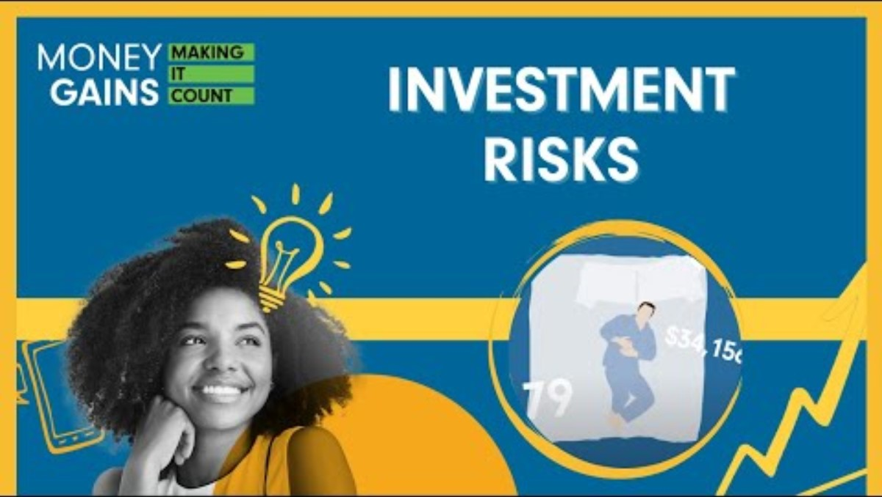
Investment Risk

Slide 2

Think, pair, share
Would you
Go skydiving?
Go bungee jumping?
Travel to a dangerous country for a vacation?
Discuss why or why not with your partner.

Slide 3
Investment risk
Investment risk is the risk taken for potential investment returns.
Risk tolerance: your willingness to take risk, which may potentially affect the size of the reward.
  Example: An investment $10,000 in equities drops by $1,000.
    No big deal, focused on the long term (higher risk tolerance).
    The loss keeps you up at night (lower risk tolerance).
Risk capacity: the amount of risk you can afford to take. Your age, income level and time horizon normally influence your risk capacity.
Each investor is unique, with distinct goals influencing their willingness and ability to take risks, and investors need to understand their comfort level with risk.
Notes:
3

Slide 4
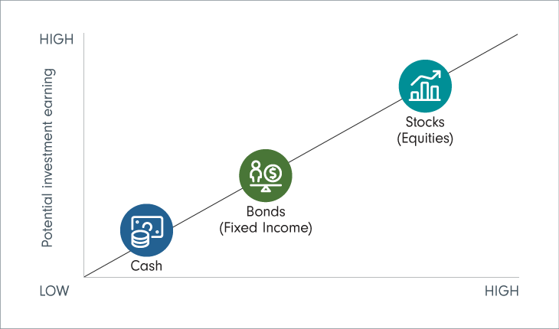
The risk and return relationship
Generally, higher risk offers higher potential for reward.
Correspondingly, higher risk involves accepting a higher potential for loss.
Asset classes and risk:
  fixed income: low to medium risk and return potential
  equities: higher return potential but higher risk
Notes:
4

Slide 5
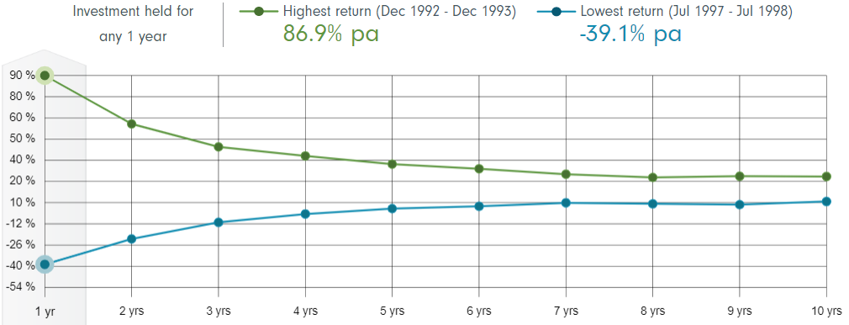
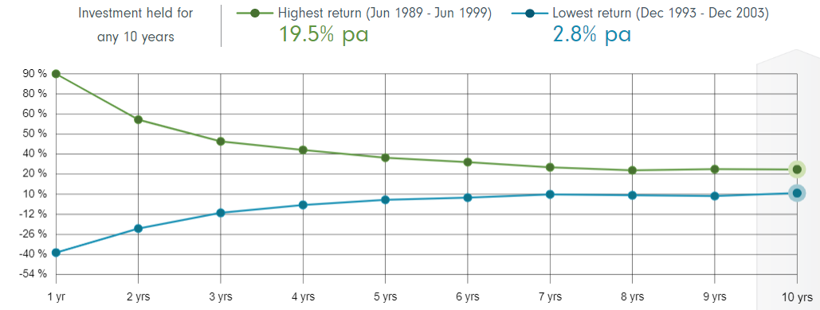
  This chart shows the minimum and maximum returns for an investment in Canadian shares over the past
  66 years, for 10 different holding periods - from 1 year to 10 years. The green line on the chart shows the highest average annual return achieved for that holding period, and the blue line shows the lowest average annual return for that
  holding period.
  What do you notice about how volatility changes as the investment is held for a longer period?
Notes:
5

Slide 6
What do you notice about how volatility changes as the investment is held for a longer period?
Answer:
Generally, the longer you remain invested, the more predictable your returns become.
Notes:
6

Slide 7
Risk ratings for investment funds
Funds in Canada often have assigned risk ratings (low to high), which allows investors to choose funds aligning with their risk profile.
An aggressive investor is willing to use high-risk growth strategies in the quest for higher returns. However, an aggressive investor must also be able to withstand substantial fluctuations in account value.
A moderate investor might be more inclined to balance their portfolio risk by using a diversified portfolio containing a mix of lower-risk choices along with a few higher-risk options.
A conservative investor is willing to accept lower returns for the safety of their capital. These investments often include bonds, cash and money market accounts.

Slide 8
How is investment risk measured?
Investors analyze factors such as market trends, economic indicators and company performance.
Probabilities are assigned to different potential outcomes based on historical data and
market analysis.
Past performance is used as a guide to assess the likelihood of future investment success or failure.
External factors, such as political events, economic policies or global market conditions, can significantly affect investment risks.
Lots of math is involved!
Investors need to continually monitor their investments and adjust their strategies based on changing market conditions.
Despite careful analysis, there is always a level of uncertainty in financial markets. Unexpected events, market reactions or changes in economic conditions can affect investment outcomes.

Slide 9
Think, group, share: How is investment risk assessment like weather forecasting?
In groups of three or four, make a list of similarities between forecasting the weather and assessing investment risk. Consider tools used and factors considered.
  Ex) Both use computer models to predict future conditions
After five minutes, we will go around the class, and each will group will share a different similarity.

Slide 10
How is investment risk assessment like weather forecasting?
Investment risk assessment
Analysis is of various factors such as market trends, economic indicators, and company performance.
Assigns probabilities to different potential outcomes.
Investors analyze financial statements, market trends and economic indicators to make informed decisions.
Uses past performance as a guide.
External factors, such as political events, economic policies or global market conditions, affect investment risks.
Need to continually monitor investments and adjust strategies based on changing market conditions.
Despite careful analysis, there is always a level of uncertainty in financial markets. Unexpected events, market reactions or changes in economic conditions can affect investment outcomes.
Weather forecasting
Meteorologists use data from weather satellites, historical patterns and computer models to predict.
Assigns probabilities to different weather events.
Meteorologists analyze atmospheric pressure, temperature, humidity and wind patterns to predict weather conditions.
External factors, like ocean currents, atmospheric pressure systems and climate patterns, influence weather conditions.
Weather conditions can change rapidly, and meteorologists continually update their forecasts based on new data.
Weather predictions also come with a degree of uncertainty. Sudden atmospheric changes, unforeseen weather patterns or unpredictable events can alter the forecasted conditions.

Slide 11
Risk tolerance quiz
Complete the risk tolerance quiz.
Write a short reflection (three or four sentences) explaining whether you agree with the results or not, based on your general risk tolerance in life.
Use the Fidelity Investment Finder to find one fund
that interests you and that is in line with your risk tolerance level.
Explain:
  What does this fund contain?
  Why does this fund have the risk classification that it does?

Slide 12
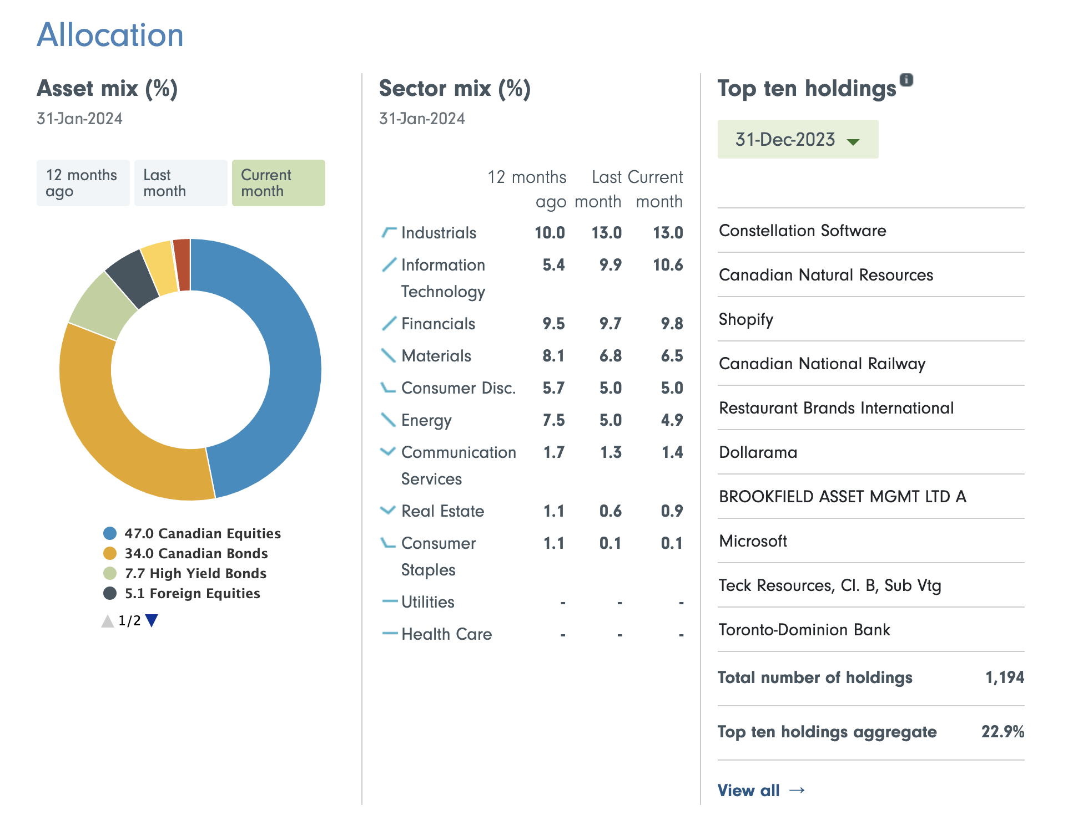
Example: Fidelity Canadian Balanced Fund
42% Canadian equities,
36.5% Canadian bonds, 8.1% high-yield bonds, 5.3% foreign equities, 4.3% foreign bonds.
Low to medium risk, which is suitable based on my risk tolerance and time horizon (medium).
Mix of higher-risk equities (stocks)
and low-risk fixed income securities (bonds).

