Slide 1

Understanding your investment returns

Slide 2
What is an IPO (initial public offering)?
An IPO is the first time shares in an company are sold to the public.
Trading then continues on the stock market; traders buy from and sell to each other.

Slide 3
What is a stock split?
A stock split divides each share into several shares (usually to reduce the price
per share).
For example, in a 2-1 split (i.e., 2 for 1), each stockholder would receive 2 shares for every 1 share owned.
This results in an increase in the total number of shares outstanding for the company, but no change in a shareholder’s proportional ownership.
This is a common strategy used by companies to make their stocks more affordable.
Notes:
3

Slide 4
MINDS ON: Stock performance of your favourite brand
As partners, choose a brand you like that is publicly traded (search here).
What was the IPO price (price the shares were first sold for at their initial public offering)?
What is the current price?
If you invested $1,000 in the IPO, what would your return on investment be in dollars if you sold today?
What would your ROI be as a percentage?
What would you do with the money?
Notes:
4

Slide 5
Ex) Nike stock
The stock was first sold to the public at $22 per share.
There have been seven stock splits ̶ all 2-for-1. This means shareholders received two shares for every one share they owned.
If you had bought just one share at the IPO price, you would own 128 shares, worth $15,558 based on the current trading price of $121.55 per share.
If you had invested $1,000, you would own 5,818 shares (1000/22*128). That investment would have a value today of $707,178.
This is a $706,178 ROI (or 70,618% (707,178-1000/1000*100).
Notes:
5

Slide 6
What are investment returns?
  How much a security or portfolio goes up or down over a period, often shown as a percentage change.
What are the two components of investment returns?
Change in price:
  Unrealized capital loss: decrease in value.
  Unrealized capital gain: increase in value.
  Realized loss/gain: occurs when selling the security.
Earned income:
  Reward for holding a security.
  Dividends: distributions from company profits (usually paid quarterly, which is four times per year).
  Interest: earned on bonds or savings accounts.
Notes:
6

Slide 7
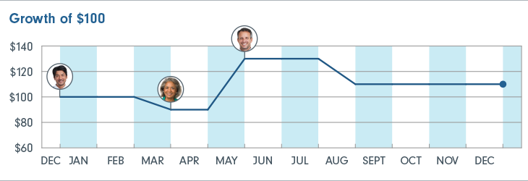
Time-weighted return vs. dollar-weighted return
Tom, Jill and Adam all purchased shares of a mutual fund (Fund A).
Fund A started the year at a price of $10 per unit. It then moved down and up before closing the year at $11 per unit. The Fund’s investment return for the year is 10%.
Time‑weighted return is identical for all three investors if they hold without selling (10%).
The dollar‑weighted rate of return varies for each investor according to the size and timing of their contributions and withdrawals.
Notes:
7

Slide 8
What are the two ways to calculate a rate of return?
Return type | What it measures | Best of evaluating | Answer the questions
Time-weighted (investment return) | Investment return for a specific period | The performance of the specific investment or portfolio manager. Comparing two different instruments. | How did the investment perform during a specific period? How did the portfolio manager perform?
Dollar-weighted (personal rate of return) | Account return, including changes in the account value, and the impact of the amount and timing of contributions and withdrawals. | Personal return factoring in the impact of contributions and withdrawals. | What was my personal return, factoring in the contributions/withdrawals that I made during a specific period?

Slide 9
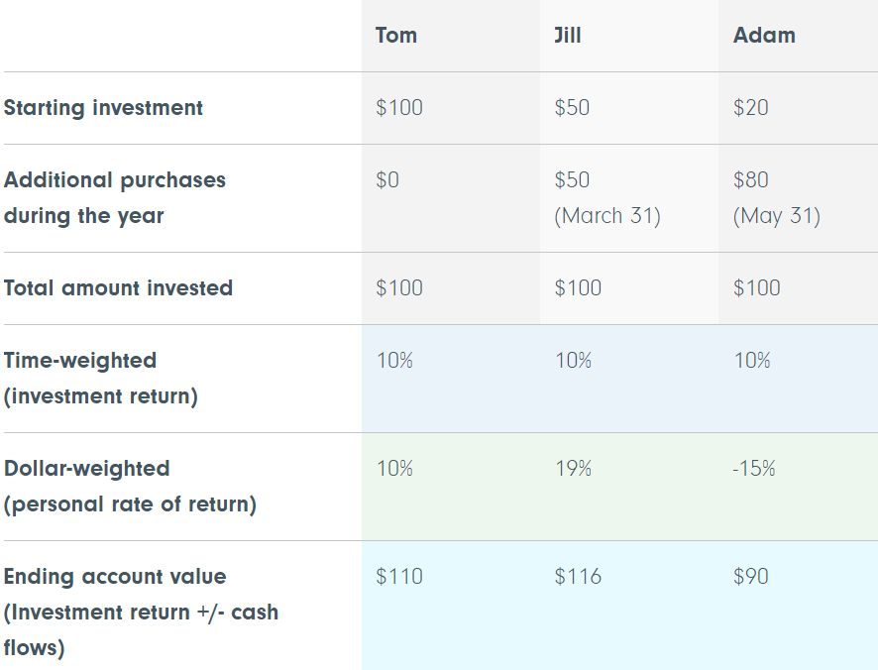
What are the two ways to calculate a rate of return?
Time-weighted returns:
  Measures performance over a specific time independent of further investments.
  Useful for comparing different investment options.
Dollar-weighted returns:
  Evaluates personal rate of return, considering additional contributions or withdrawals.
  Influenced by size, timing and ongoing transactions.

Slide 10
Comparison of returns
Cumulative return
Cumulative return shows you the total change in the value of an investment over a specific period. Over longer time periods, the cumulative return of an investment can be a very large number.
Annualized return
Annualized return measures how much an investment has grown on an annualized basis (over a one-year period). Reviewing annualized returns is common in the investment industry, as it simplifies comparing the returns of different investments.

Slide 11
Conclusion
Investment returns are crucial to understand when investing.
Time-weighted return is useful for comparing different investments.
Dollar-weighted return is more personalized, considering size, timing and transactions.
Notes:
11

Slide 12
Investigation: Choose two of your favourite companies that are publicly traded on the stock market and complete the following chart using Google Finance.
Company name and ticker symbol | Description of company | Current stock price | Annual % gain/loss | Five-year % gain/loss | In which period over the past five years did the price fluctuate the most? Why?
Example: Nike NKE | Athletic footwear and apparel | $121.55 | +18.5% | +49.185% | Feb-March 2020: Drop because of COVID. June 2021: Nike projects full-year sales of more than $50 billion, riding on pent-up demand. The company’s fourth-quarter revenue nearly doubled, topping $12 billion for the first time.

Slide 13
Debrief
Form groups of four or five.
Share your investment choices and determine who had the highest return and who had the lowest return in each group.
One representative from each group will share the findings with the class.
What trends are there for the highest and lowest performers?
Notes:
13

