Slide 1
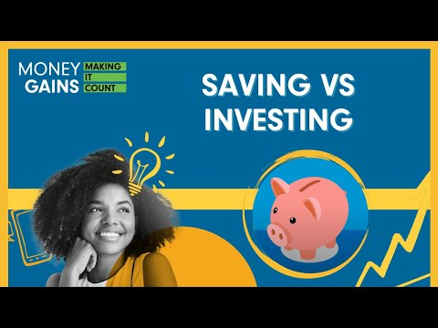
The difference between saving and investing

Slide 2
Why save money?
Reach your financial goals.
Invest in your future.
Emergency fund.

Slide 3
Emergency funds
If the pandemic has taught us anything, it is to be wise with our money, because you never know when life will change.
  Global pandemic – job loss.
  Car breaks down.
  Pet gets sick.

Slide 4
Saving vs. investing
Saving
Definition: Putting money aside for when you need it in the future. Depositing money in
your bank account or piggy bank and leaving it untouched for a period of time
is considered saving.
Purpose: Typically used for short-term goals, emergencies or planned expenses.
Benefits: Low risk, liquidity and security.
Examples: Savings account, piggy bank or cash at home.
Investing
Definition: Putting your money to work so that it can grow, with the goal that it can became more in the future than what you put away. Investing is generally associated with buying assets such as stocks or bonds.
Purpose: Typically used for long-term financial goals, such as retirement or wealth-building.
Benefits: Potential for higher returns, wealth accumulation and financial growth.
Examples: Stocks, bonds, real estate and mutual funds.
Notes:
4

Slide 5
Risk, return and liquidity
Investment risk
The uncertainty related to investing. When investing, actual outcomes may differ from expected outcomes, and you may even lose some, or all, of your investment.
Investment return
How much a security, or collection of securities (generally referred to as a portfolio) increases or decreases in value over time These returns are often expressed as a percentage change.
Liquidity
The ability of an investment to be converted into cash quickly without loss of value. E.g. stock vs. a house

Slide 6
Risk, return and liquidity
Savings
Low risk
Low return
High liquidity
Investments
High risk
High return
Low liquidity
Notes:
6

Slide 7
Inflation, savings and investments
Today, a large soft drink at your favourite fast-food place costs $1.00. You buy the soft drink but also decide to save some money for the future as well. So you put a dollar in your savings account, where it earns 5%.

Slide 8
Inflation, savings and investments
One year later, the dollar in your saving account is worth $1.05. You take the money out and visit your favourite fast-food place, hoping
to buy another delicious beverage. Unfortunately, drinks now cost $1.10.

Slide 9
Inflation, savings and investments
The point? Inflation can work against your money. You need to learn to invest wisely, follow the rate of inflation, and make sure your investment rates are higher than those of inflation.
Example - the cost of living is consistency increasing.

Slide 10
Future value
Refers to the amount of money to which an investment will grow over a finite period of time at a given interest rate.
Put another way, future value is the cash value of an investment at a particular time in the future.

Slide 11

“Time is more valuable than money. You can always make more money, but you cannot get more time.”
John Rohn
An entrepreneur, author and motivational speaker

Slide 12
Risk and return
What is the relationship between risk and return?
Stocks
Bonds
Higher risk
Higher potential return
Lower risk
Lower return
Saving Account
Cash
Notes:
12

Slide 13
Savings
Different events in our lives require different strategies for saving:
saving for a senior trip
saving for a down payment on a house
saving for retirement

Slide 14
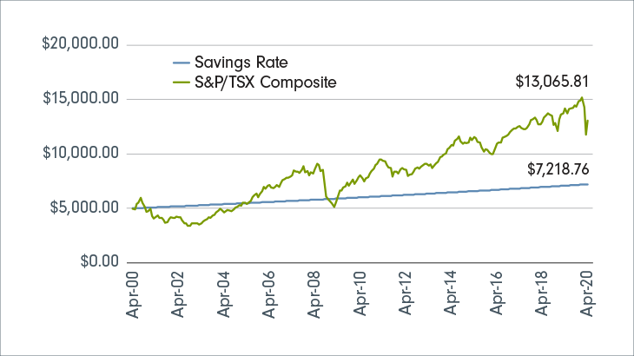
Savings vs. investing
Investing allows your wealth to grow at a much higher rate than it could in a savings account.
For example, a savings account could generate an annual return between 0.05% and 3.00%. When you compare that to a typical market-tracking index account – like one that follows the S&P/TSX Composite, with its average annual return of 4.6% – it’s clear that you could be missing out.
If you invest for the long term, your money will grow a lot more than if you hadn’t invested.
The chart shows what would have happened if you had invested $5,000 in Canadian equities between April 30, 2000, and April 30, 2020.

Slide 15
How to save money
“Pay yourself first” means setting aside money for savings before you even see the money from your pay cheque.
If you take your savings contribution and put it aside before you even see your pay, you will not miss what you do not see.
Most banks will help you with paying yourself first by allowing you to set up automatic transfers of money from your chequing account to your savings account.
Experts suggest that you should take 10% of your income off, before taxes, and put it away in savings/investments.

Slide 16

Savings calculator
https://www.fidelity.ca/en/
savingscalculator/

Slide 17
Summary
Saving is typically for short-term goals and provides security and liquidity.
Investing is for long-term goals and has the potential for higher returns but carries more risk.
The choice between saving and investing depends on one’s financial goals and risk tolerance.

Slide 18
Submission guidelines:
Your research presentation should be submitted as a digital file (e.g., PowerPoint or Google Slides) with speaker notes for each slide.
Your scenario analysis and recommendations should be neatly organized in a document
(e.g., Word or PDF).
The reflective essay should be typed and submitted separately.
Include proper citations for any sources
you used in your research.
Assessment Criteria:
Your assignment will be assessed based on the
following criteria:
understanding of saving and investing concepts
clarity and accuracy of your explanations and recommendations
depth of analysis in the scenario assessments

Slide 19
Assignment: Case study
Scenario selection: Choose three different financial scenarios. These scenarios could represent various life stages, goals or financial situations. For each scenario, consider factors such as age, income, goals and risk tolerance.
Analysis: For each of the three scenarios, analyze whether saving or investing would be the more suitable financial strategy. Consider the following questions:
  What are the financial goals in this scenario (short-term, long-term)?
  How much risk can the individual in the scenario tolerate?
  What are the potential benefits and drawbacks of saving in this situation?
  What are the potential benefits and drawbacks of investing in this situation?
Recommendation: Based on your analysis, make a clear recommendation for each scenario: whether the individual should save, invest or a combination of both. Justify your recommendations with evidence from your research and analysis.

Slide 20
Scenarios
1. College savings:
Sarah is a high school senior planning for college. She has a part-time job and some savings. She wants to explore options for funding her education.
2. Emergency fund:
Mark is a recent college graduate with a
stable job. He wants to build an emergency fund to cover unexpected expenses.
3. Home purchase:
Emily and James are a newlywed couple looking to buy their first home. They have some savings but need to decide how much to put down as a down payment.
4. Retirement planning:
David is a 35-year-old professional with
a comfortable income. He is concerned
about his retirement savings and wants
to start planning for the future.
5. Investment portfolio:
Lisa, a single parent, received an inheritance and wants to invest the money wisely to secure her children’s future.
6. Entrepreneurial venture:
Alex has a business idea and wants to decide whether to use personal savings or seek investors to start his own company.
7. Debt management:
Jennifer has significant credit card debt and wants to determine the best strategy to pay
it off while saving for the future.
8. Early retirement goals:
Robert is in his late 40s and wants to retire early. He’s willing to take on more risk to achieve his financial independence sooner.
9. Wealth preservation:
Sophia, a retiree, wants to ensure her wealth is preserved for her heirs while generating enough income to cover her expenses.
10. Short-term financial goal:
Mike has a goal of taking a luxury vacation
in two years. He needs to decide how to save and invest to make this dream a reality without taking on too much risk.

Slide 21
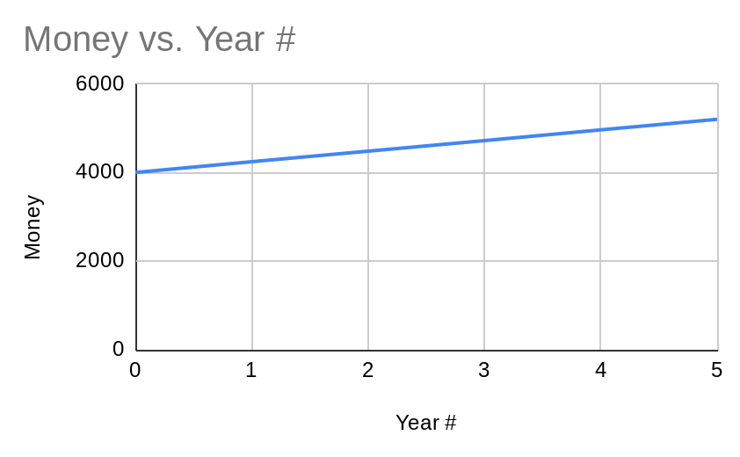
Example: Your goal is to purchase a car that costs $5,000. You have $4,000 saved up. You invest in the stock market and earn an average of 6% annually.
Note: We will set aside compound interest and concentrate solely on examining simple interest.
Represent with an equation:
Let “t” be the number of years it will take to reach your goal, and “FV” (Future Value) the total amount of money you have saved after “t” years. You start with $4,000, and your investment in the stock market earns 6% interest annually.
So, the equation would be:
FV=4000+0.06∗4000∗t
FV=4000+240t
Represent the situation with a table:
The point where the line intersects the y-axis (t=0) represents your initial savings of $4,000. The line has a slope of 240, which means you are saving an additional $240 each year.
To find out how many years it will take to reach your goal of $5,000, you can set FV equal to $5,000 and solve for t:
4000+240t=5000
240t=1000
t=1000/240
t≈4.17
So it will take approximately 4.17 years to reach your goal.
Year # | Money
0 | 4000
1 | 4240
2 | 4480
3 | 4720
4 | 4960
5 | 5200

