Slide 1
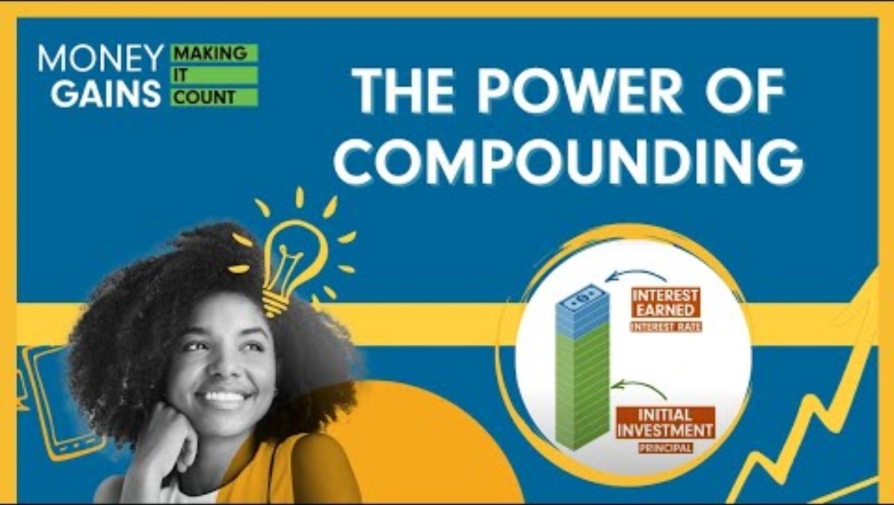
The power of compounding

Slide 2
What is compound interest?
Compound interest is earned when the interest you earn in a savings or investment account earns interest of its own. With compound interest, you earn interest on both your initial balance – called the principal – and the interest that’s added to the balance over time.

Slide 3
Simple and compound interest formulas
Compound interest occurs when interest is added to the principal, so the interest that has been added also itself earns interest.
Compound interest formula:
Future Value (FV) = P(1 + r/n)^{nt}
r= interest rate per compounding period
n = # of compounding periods
P = Principal (original investment)
T = time (in years)
Simple interest is calculated ONLY on the principal amount.
Simple interest formula:
Future Value (FV)= P(1 + rt)
t = time (# of years)
r = interest rate
P = Principal (original investment)
Notes:
3

Slide 4
Which is better, simple or compound interest?
You will each start with 10 smarties, which represent your initial investment. Your all invest your money and earn 10% annually, but half of you are earning compound interest, and half are earning simple interest.
 | #of smarties – simple interest FV= P(1 + rt) | #of smarties – compound interest , compounded annually FV= P(1 + r/n)^{nt}
Initial value | 10 | 10
 | # of Smarties at the end of:
 | year 1 | year 2 | year 3 | year 4 | year 5
Simple interest 10%
Compound interest 10%
 | year 6 | year 7 | year 8 | year 9 | year 10
Simple interest 10%
Compound interest 10%

Slide 5
Investigation
You have $1,000. You can choose between:
  an account that pays 7% simple interest
  an account that pays 6% interest, compounded annually
  Hypothesis: After how many years will the investment earning compound interest of 7%, compounded monthly, become greater than the investment earning simple interest of 6%? __________________________________________
  Use a spreadsheet to calculate the future value of your investment after 10 years, with each of the two accounts. Graph the data.
  Conclusions: Were your hypotheses correct? Why or why not?
  ______________________________________________________________________________________________________________________________________________________________________________________________________________________________________
Notes:
5

Slide 6
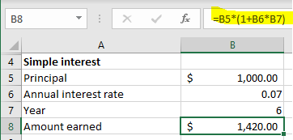
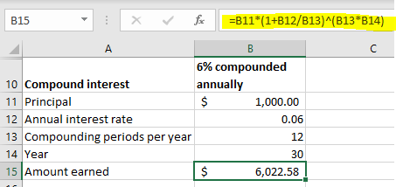
Investigation
Notes:
6

Slide 7
7% simple interest VS 6% interest, compounded annually
 | Balance of $1,000 investment at the end of:
 | year 1 | year 2 | year 3 | year 4 | year 5
Simple interest 7%
Compound interest 6%
 | year 6 | year 7 | year 10 | year 20 | year 30
Simple interest 7%
Compound interest 6%

Slide 8
Was your hypothesis correct?
How close were you?
What surprised you about this investigation?

Slide 9
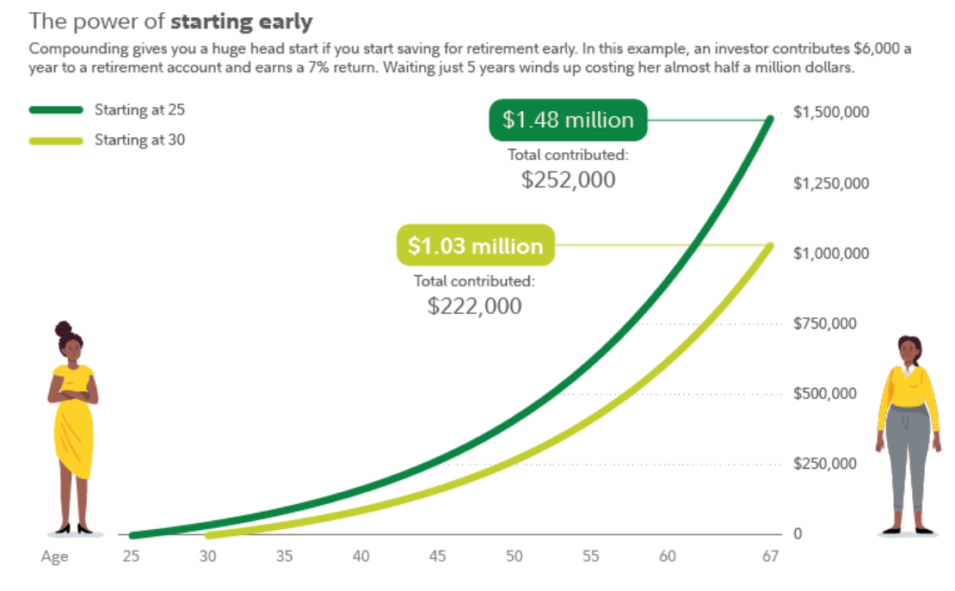
Tips: Invest early
The power of starting early
Compounding gives you a huge head start if you start saving for retirement early.
In this example, an investor contributes $6,000 a year to a retirement account and
earns 7% return. Waiting just 5 years winds up costing her almost half a million dollars.
Start investing early and consistently to take full advantage of the power of compounding and the time value of money.
You can compound any type of return on an investment by reinvesting your returns.
Example:
  Jane started investing 20 years ago and made
  10 annual contributions of $5,000 and received an 8% percent annual return. She stopped investing after 10 years and held on to the investment for a further 10 years at an 8% annual return.
  John, meanwhile, started investing 10 years ago; he made 10 annual contributions of $10,000 at an 8% annual return and he ended up with less money than Jane – even though he invested twice as much money – because he started later.
Starting at 25
$1.48 million
$1,500,000
Starting at 30
Total contributed:
$252,000
$1,250,000
$1.03 million
$1,000,000
Total contributed:
$222,000
$750,000
$500,000
$250,000
0
AGE
25
30
35
40
45
50
55
60
67
Notes:
9

Slide 10
Invest often
Regular contributions will make your money grow faster and help to decrease your risk.
The S&P 500 – a common benchmark for overall stock market performance – has averaged close to 10% annual returns over the last 100 years.
But the market doesn’t move in a straight, upward line: there are peaks and valleys, like bear markets, where stock values fall more than 20% from recent highs.
To combat this risk, many investors turn to dollar-cost averaging, a strategy that has you invest smaller amounts regularly rather than waiting to invest a large lump sum.
Because you buy the same dollar value of an investment, no matter if prices are low or high, you buy more shares when prices are down and fewer when they’re up.
This helps you avoid investing a lot right before prices drop or too little before they rise. In addition to helping minimize your risk, dollar-cost averaging may lead you to pay less per share on average over time.
But remember: Dollar cost averaging does not assure a profit or protect against loss in declining markets. For the strategy to be effective, you must continue to purchase shares in both market ups and downs.

Slide 11
Diversify
The average return of the S&P 500 is based on the average returns of 500 of the largest public companies in the U.S. adjusted based on each company’s market capitalization. The S&P 500’s wide-ranging holdings help provide the kind of diversification that many investors aim for to decrease their risk.
Individual stocks may see returns that are greater than the broader stock market’s (as represented by S&P 500), and they also carry much more concentrated risk. The overall stock market has never zeroed out, but individual companies have.
By investing in a wide range of companies, you may decrease the risk, because if individual stocks you buy go down, others may rise to help balance it out.
Putting in the time, effort and research it takes to pick individual stocks can be challenging. That’s where mutual funds, index funds, exchanged-traded funds (ETFs) and target-date funds come in.
  With funds, professionals do the research for you, either by conducting due diligence themselves or by simply aiming to duplicate the performance of a major market index, like the S&P 500. In either case, they provide a diversified portfolio of many investments that offer the chance of benefiting from compounding returns.

Slide 12
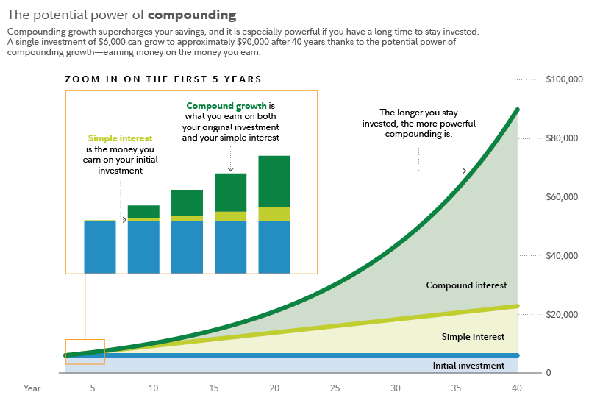
Returns on a $6,000 investment that earned simple interest vs. compound interest, assuming each earns a hypothetical 7% rate of return
The power of compounding
Compounding growth supercharges your savings, and it is especially powerful if you have a long time to
stay invested. A single investment of $6,000 can grow approximately $90,000 after 40 years thanks to
potential power of compounding growth–earning money on the money you earn.
ZOOM IN ON THE FIRST 5 YEARS
$100,000
Compound growth is
what you earn on both
your original investment
and your simple interest
The longer you stay
invested, the
more powerful
compounding is.
Simple interest
is the money you
earn on your initial
investment
$80,000
$60,000
$40,000
Compound interest
$20,000
Simple interest
Initial investment
0
YEAR
5
10
15
20
25
30
35
40
© 2024 FIDELITY INVESTMENTS CANADA ULC 1809161-v2024412
12
12
Notes:
12

