Slide 1
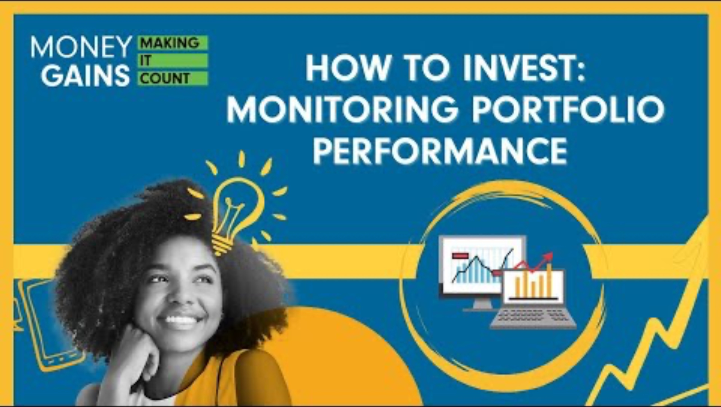
Monitoring your investment portfolio

Slide 2
Would you rather?
Pick your choice: A or B!

Slide 3

Would you rather…
Imagine you have $100 to invest.
A) Invest in something that grows slowly but steadily by 5% every year
B) Invest in something that could grow 20% some years but might also drop 10% in others
Question: Which one feels safer? Which is more exciting?

Slide 4

Would you rather…
Imagine you have $100 to invest.
A) Know exactly how much your investment is worth every day
B) Just wait and find out at the end of the year
Question: Would it stress you out not knowing? Or do you like surprises?

Slide 5

Would you rather…
Imagine you have $100 to invest.
A) Get steady returns but earn a little less
B) Take a chance to earn more, even if it means more risk
Question: What influences your choice — goals, personality or timing?

Slide 6
So… why does this matter?
Every investor makes choices about risk and reward.
But once you've invested, you need to monitor how your money is doing.
Let’s play a video to learn how investors track performance – and make smart decisions based on it!

Slide 7
Video and questions (play or read transcript and answer at the same time)

Slide 8

Why monitor performance?
Investing without monitoring is like driving without a speedometer.
Monitoring ensures alignment with goals and risk tolerance.

Slide 9
What is a benchmark in investing?
A) The original value of your investment
B) A standard to compare your investment’s performance against
C) A document explaining market trends
D) A report card from your advisor

Slide 10
What is a benchmark in investing?
A) The original value of your investment
B) A standard to compare your investment’s performance against
C) A document explaining market trends
D) A report card from your advisor

Slide 11

What is a benchmark?
A reference point to compare your portfolio’s performance
Measures effectiveness of investment strategy
Ensure alignment with portfolio composition

Slide 12
If your portfolio is mostly technology stocks, which benchmark makes the most sense?
A) TSX Composite
B) Global Aggregate Bond Index
C) Dow Jones Industrial Average
D) NASDAQ Composite

Slide 13
If your portfolio is mostly technology stocks, which benchmark makes the most sense?
A) TSX Composite
B) Global Aggregate Bond Index
C) Dow Jones Industrial Average
D) NASDAQ Composite

Slide 14
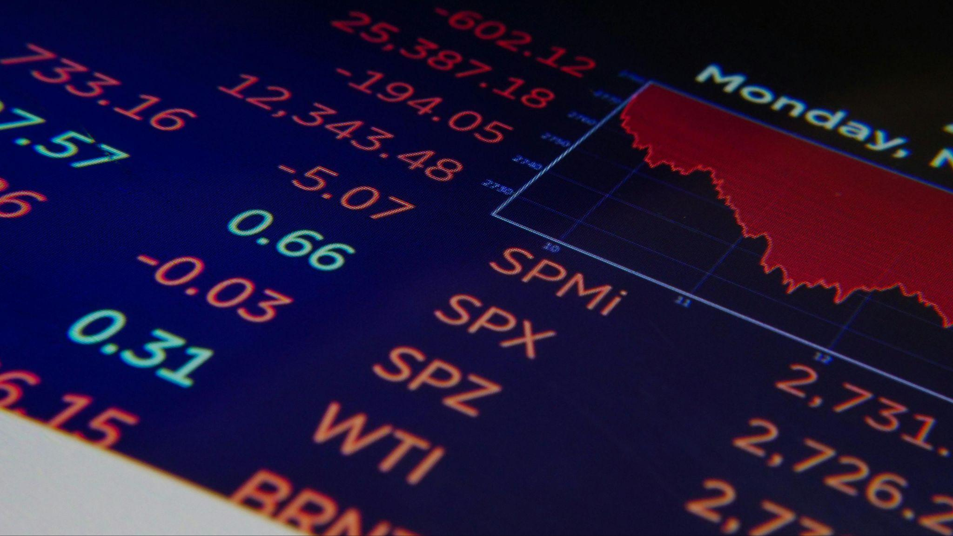
Types of benchmarks
Examples: TSX, S&P 500, NASDAQ, Dow Jones
Tech-heavy: NASDAQ Composite
Balanced: 50% Global Aggregate Bond + 50% S&P 500

Slide 15
In the apple-tree example, what does the increase in the tree's value represent?
A) Standard deviation
B) Dividends
C) Price appreciation
D) Rebalancing

Slide 16
In the apple-tree example, what does the increase in the tree's value represent?
A) Standard deviation
B) Dividends
C) Price appreciation
D) Rebalancing

Slide 17

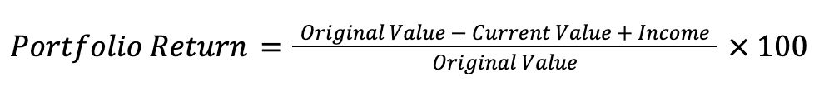
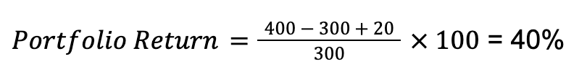
How to calculate returns
Note: Online brokerages and financial advisors provide return information t
hese days!
Imagine you have three apple trees. If each apple tree is originally worth $100 and increases in value to $133.33, what is the return value?
Take the value of your three trees ($400)
Subtract the original value ($300), then add whatever apples have grown ($20 worth)
Divide by the initial value ($300)
Multiply by 100
The return value is 40%

Slide 18
Which term describes how much the value of an investment goes up and down over time?
A) Benchmark
B) Return
C) Volatility
D) Diversification

Slide 19
Which term describes how much the value of an investment goes up and down over time?
A) Benchmark
B) Return
C) Volatility
D) Diversification

Slide 20
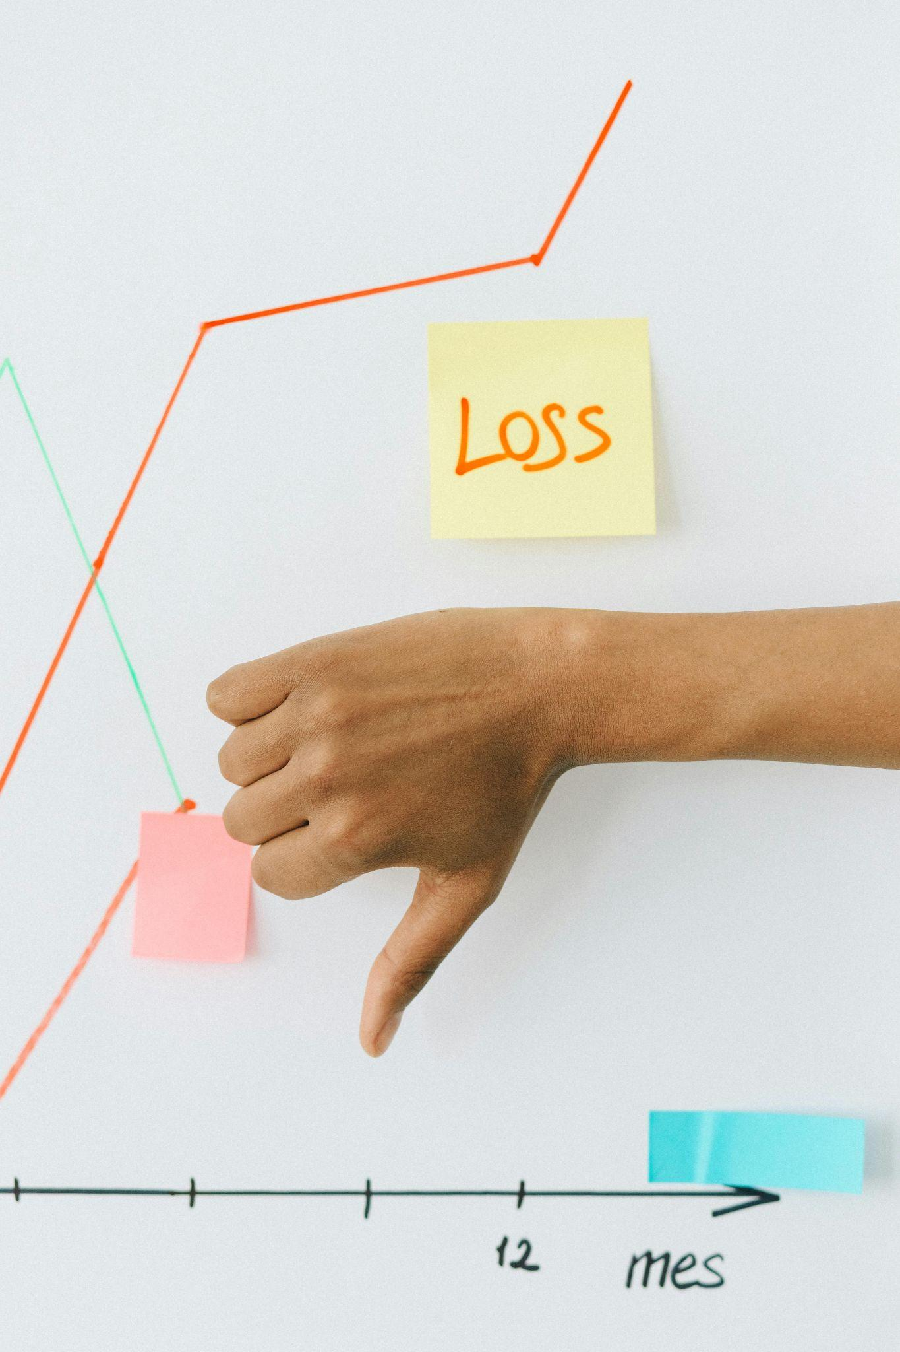
Beyond return: consistency and risk
Consider performance consistency and risk level
Volatility: the degree fluctuation in the price of an asset over time

Slide 21
What does standard deviation measure in an investment?
A) The number of investments in the portfolio
B) The risk of bankruptcy
C) The average price
D) The fluctuation in returns over time

Slide 22
What does standard deviation measure in an investment?
A) The number of investments in the portfolio
B) The risk of bankruptcy
C) The average price
D) The fluctuation in returns over time

Slide 23
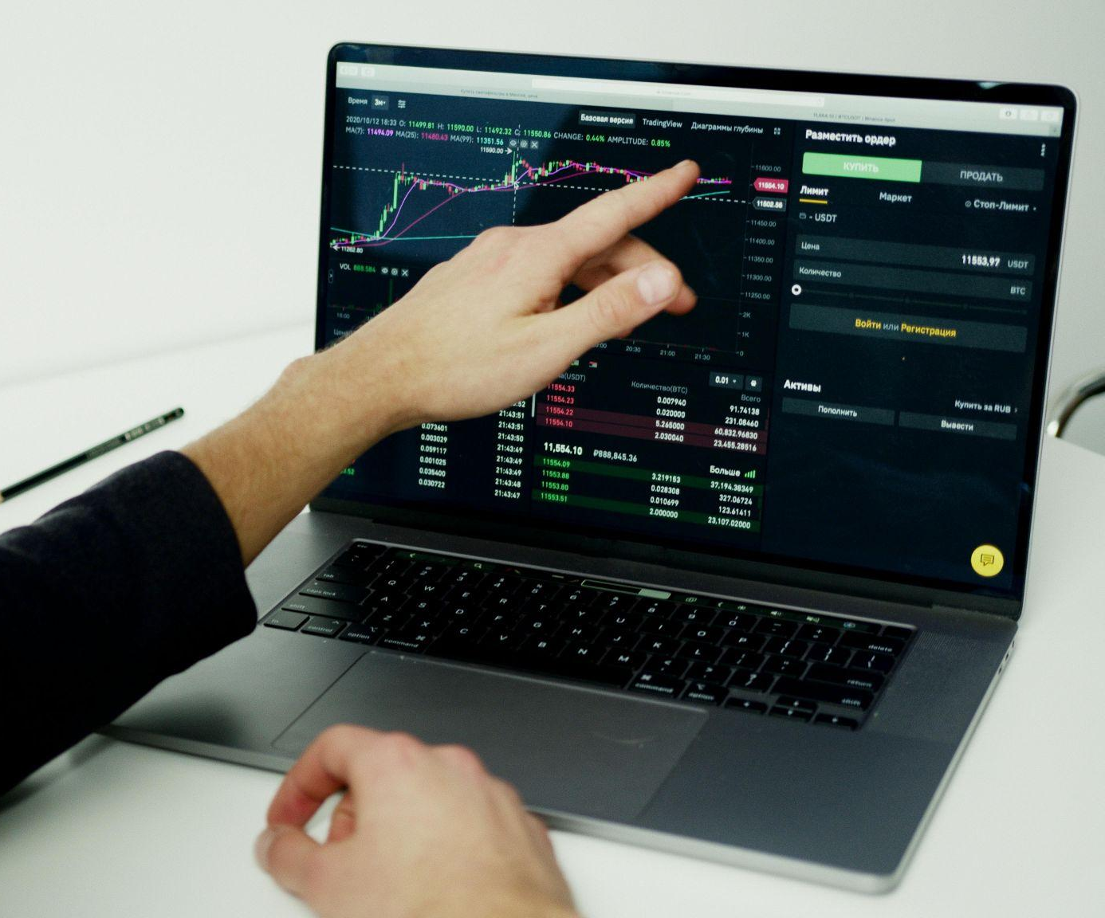
Volatility vs. benchmark: beta
Volatility calculated by standard deviation: variation of returns from the average
Higher SD = more volatility
Lower SD = more stability
Beta > 1: More volatile than benchmark
Beta < 1: Less volatile than benchmark

Slide 24
If a portfolio has a beta greater than one, what does that mean?
A) It’s more volatile than the market
B) It pays more dividends
C) It has lower risk than the market
D) It’s guaranteed to outperform

Slide 25
If a portfolio has a beta greater than one, what does that mean?
A) It’s more volatile than the market
B) It pays more dividends
C) It has lower risk than the market
D) It’s guaranteed to outperform

Slide 26
Volatility vs. benchmark: beta
Beta > 1: More volatile than benchmark
Beta < 1: Less volatile than benchmark

Slide 27
The Sharpe ratio tells you:
A) If your investment is socially responsible
B) The total return of the market
C) How much extra return you’re getting for each unit of risk
D) How many stocks are in your portfolio

Slide 28
The Sharpe ratio tells you:
A) If your investment is socially responsible
B) The total return of the market
C) How much extra return you’re getting for each unit of risk
D) How many stocks are in your portfolio

Slide 29
If two investments return the same amount, but one has less risk, which has the better Sharpe ratio?
A) They’re the same
B) The one with less risk
C) The riskier one
D) The one with dividends

Slide 30
If two investments return the same amount, but one has less risk, which has the better Sharpe ratio?
A) They’re the same
B) The one with less risk
C) The riskier one
D) The one with dividends

Slide 31
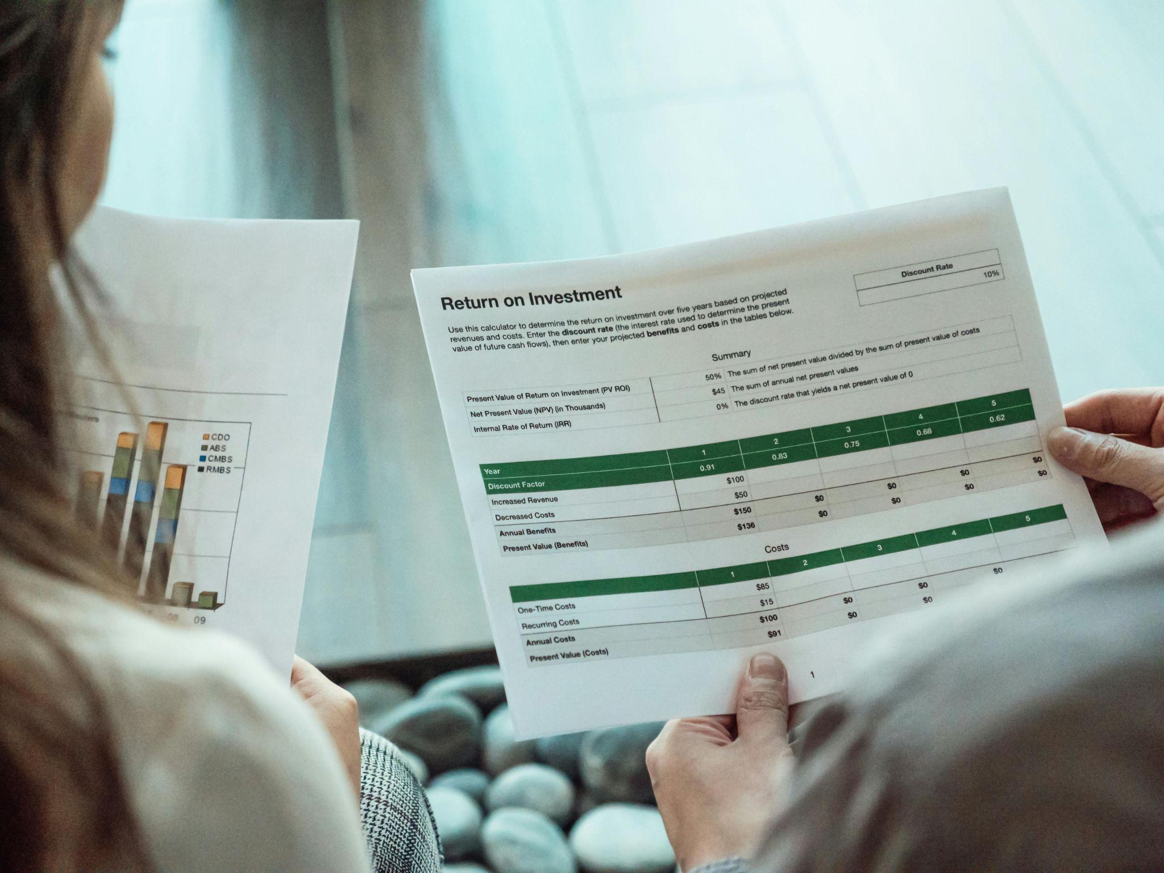
Risk-adjusted return: sharpe ratio
Sharpe Ratio = return / risk
Higher ratio = better return for risk taken
Higher Sharpe = more efficient investment

Slide 32
What is the main reason investors rebalance their portfolios?
A) To sell everything
B) To adjust to changing career paths
C) To avoid paying taxes
D) To maintain their target risk level

Slide 33
What is the main reason investors rebalance their portfolios?
A) To sell everything
B) To adjust to changing career paths
C) To avoid paying taxes
D) To maintain their target risk level

Slide 34

Rebalancing a portfolio
Adjusts assets to maintain target allocation
Keeps risk level aligned
with goals

Slide 35
Which of the following is not one of the three steps of rebalancing?
A) Only invest in bonds
B) Monitor regularly
C) Set a target allocation
D) Buy or sell to realign

Slide 36
Which of the following is not one of the three steps of rebalancing?
A) Only invest in bonds
B) Monitor regularly
C) Set a target allocation
D) Buy or sell to realign

Slide 37
Rebalancing a portfolio
Steps to rebalancing:
1. Set target allocation.
2. Monitor regularly.
3. Buy/sell to return to target.

Slide 38

Wrap-up
Monitor and rebalance to stay on track.
Helps grow and protect your investments long-term.

Slide 39
Matching activity
Get into groups of three or four
Match each investor with two or three monitoring concepts or strategies that best fit their profile
Use your knowledge of benchmarks, volatility, Sharpe ratio and rebalancing

Slide 40
Tips for matching
Consider the investor’s risk tolerance and time horizon
Match benchmarks to the type of portfolio (e.g., NASDAQ for
tech-heavy)
Think about volatility and how comfortable the investor is with risk
Use rebalancing strategies that align with their goals
Evaluate risk-adjusted returns (Sharpe ratio) for performance insights

Slide 41
Present and discuss
After matching, each group shares one investor and their matches
The class votes on best fits; focus on reasoning over “winning”
There is no single right answer – explain your choices clearly!
Use the concepts from the video to support your matches

Slide 42
Sophia, 28
e NASDAQ Composite as benchmark
Accept higher volatility for potential higher returns
Rebalance portfolio quarterly

Slide 43
Dwayne, 65
Use Global Aggregate Bond Index as benchmark
Focus on preserving capital
Rebalance only when allocation deviates by 5% or more

Slide 44
Lena, 17
Focus on preserving capital
Avoid comparing your portfolio to unrelated benchmarks
Use benchmarks aligned to portfolio assets

Slide 45
Mason, 35
Accept higher volatility for potential higher returns
Aim for high Sharpe ratio
Monitor portfolio return regularly

Slide 46
Jesse, 45
Use blended benchmark: 50% Global Aggregate Bond plus 50% S&P 500
Rebalance portfolio quarterly
Compare portfolio beta to benchmark

Slide 47
Mindy, 50
Aim for high Sharpe ratio
Check portfolio volatility (standard deviation)
Use risk-adjusted metrics to evaluate performance

Slide 48
Reflection
What was the hardest match to make during the game? Why?
What did you learn about rebalancing or Sharpe ratio that surprised you?

Slide 49
True or false?
Benchmarks help investors know if their portfolio is doing better than the market.

Slide 50
True or false?
Benchmarks help investors know if their portfolio is doing better than the market.
Benchmarks provide a point of comparison to see if your portfolio is outperforming or underperforming the market.

Slide 51
True or false?
Higher volatility always means better returns.

Slide 52
True or false?
Higher volatility always means better returns.
Higher volatility means more fluctuation in returns, not necessarily better returns.

Slide 53
True or false?
Rebalancing can help keep your risk level stable.

Slide 54
True or false?
Rebalancing can help keep your risk level stable.
Rebalancing adjusts asset allocations to maintain your intended risk tolerance.

Slide 55
True or false?
Sharpe ratio tells you how much return you get for the risk you take.

Slide 56
True or false?
Sharpe ratio tells you how much return you get for the risk you take.
Sharpe ratio is a risk-adjusted return metric — higher means better reward for risk taken.

Slide 57
Imagine you’re like Mason (high risk, tech stocks). NASDAQ drops 20%, but your portfolio only drops 10%. What does this tell you about your portfolio’s beta? What might you do next?

Slide 58
Imagine you’re like Mason (high risk, tech stocks). NASDAQ drops 20%, but your portfolio only drops 10%. What does this tell you about your portfolio’s beta? What might you do next?
Beta insight:
Your portfolio has a beta less than one compared to NASDAQ, meaning it is less volatile than the benchmark. Despite being tech-heavy and high-risk, your portfolio dropped less than the NASDAQ index.
What to do next:
  You might review the portfolio to understand which assets reduced risk
  (e.g., diversification, bonds).
  Decide if this lower volatility fits your risk tolerance and goals.
  Consider rebalancing if you want to increase exposure to higher-risk, higher-reward assets.
  Continue monitoring to see if this pattern persists or changes with market conditions.

