Slide 1
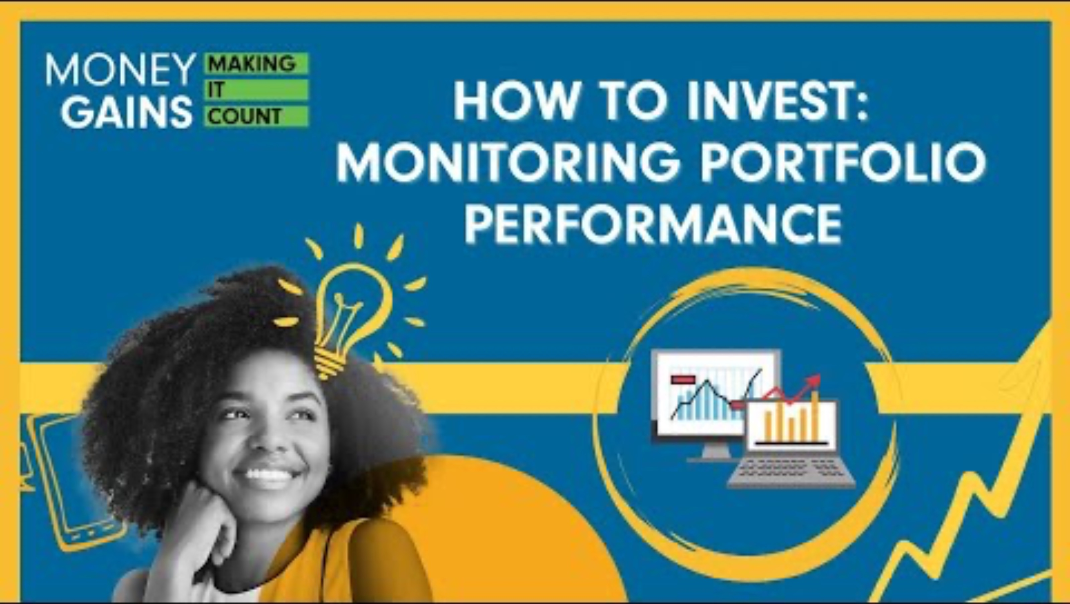
Monitoring your investment portfolio

Slide 2
Before we get into today’s lesson on monitoring your investments, let’s take a look at a short story about someone who did all the right things at first… but still didn’t reach their financial goals.
Your job is to figure out:
What went wrong?

Slide 3
Work together in groups and solve the case study!
10 Minutes

Slide 4
Year one - solid start
What went right:
Malik had a clear goal: to grow money for college over four years
He chose a balanced portfolio: 50% global bonds and 50% equities
He likely stayed within his risk tolerance and earned a steady 8% return

Slide 5
Year two - market shifts
What likely went wrong:
Malik changed his investment mix based on market trends
(tech and crypto)
He reduced bond holdings and increased high-growth, high-risk assets
Risk level increased without adjusting goals or timeline
New allocation (70% equities, 30% bonds) no longer aligned with moderate risk tolerance

Slide 6
Year three - volatility hits
What likely went wrong:
Tech-focused investments dropped significantly
Malik wasn’t actively monitoring his portfolio
Ignored brokerage notices and reminders
Unintentionally shifted to 80% equities, 20% bonds—too aggressive
Didn’t rebalance to reduce volatility

Slide 7
Year four - unexpected results
What likely went wrong:
Surprised portfolio hadn’t recovered despite market improvement
Overexposure to slow-recovering sectors like tech
Ignored risk-adjusted metrics and timing issues.
Final return missed expectations due to:
Lack of monitoring
Failure to rebalance
Chasing trends without reevaluating goals

Slide 8
Concept | What Malik should have done
Monitoring | Regularly reviewed portfolio performance and asset allocation
Benchmarking | Compared his performance to relevant market indexes to evaluate changes
Rebalancing | Adjusted portfolio back to original 50/50 allocation annually or semi-annually
Risk tolerance | Stuck to a moderate risk level appropriate for a four-year investment horizon
Volatility awareness | Understood that shifting heavily into tech increased the chance of large swings
Sharpe ratio awareness | Considered whether the higher returns were worth the increased risk

Slide 9
Video and questions (play or read transcript and answer at the same time)

Slide 10

Why monitor performance?
Investing without monitoring is like driving without a speedometer.
Monitoring ensures alignment with goals and risk tolerance.

Slide 11
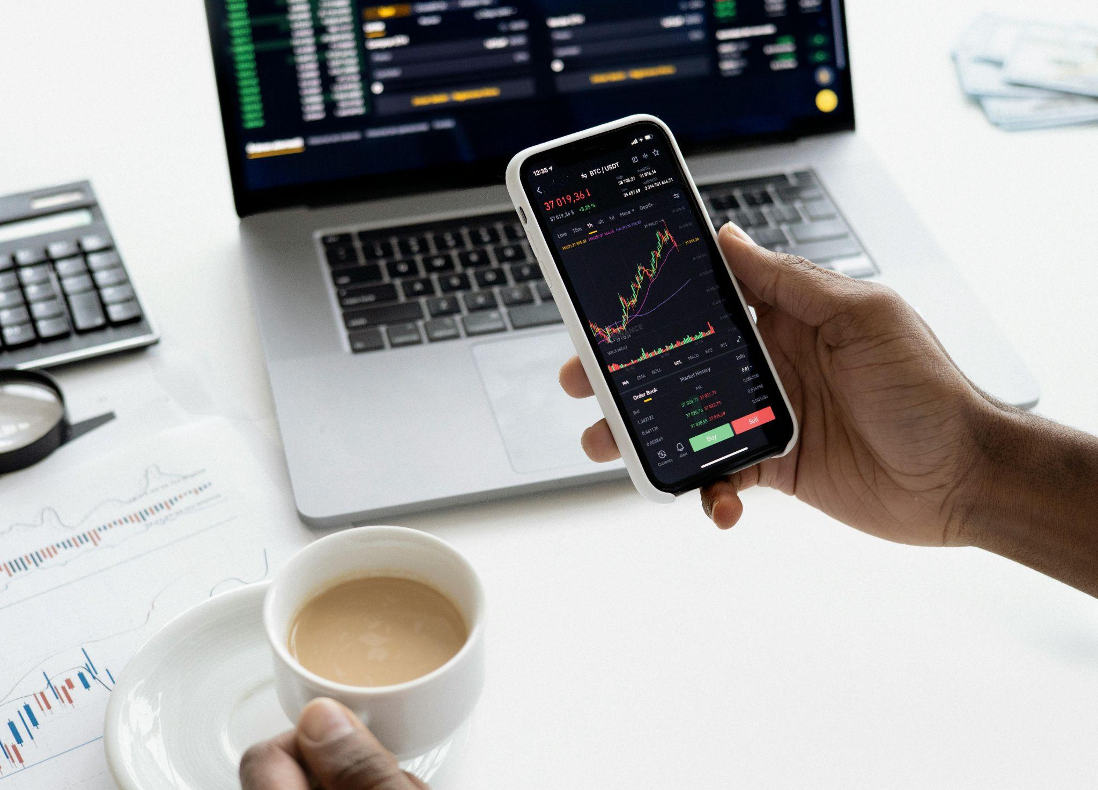
What is a benchmark?
A reference point to compare your portfolio’s performance
Measures effectiveness of investment strategy
Ensure alignment with portfolio composition

Slide 12
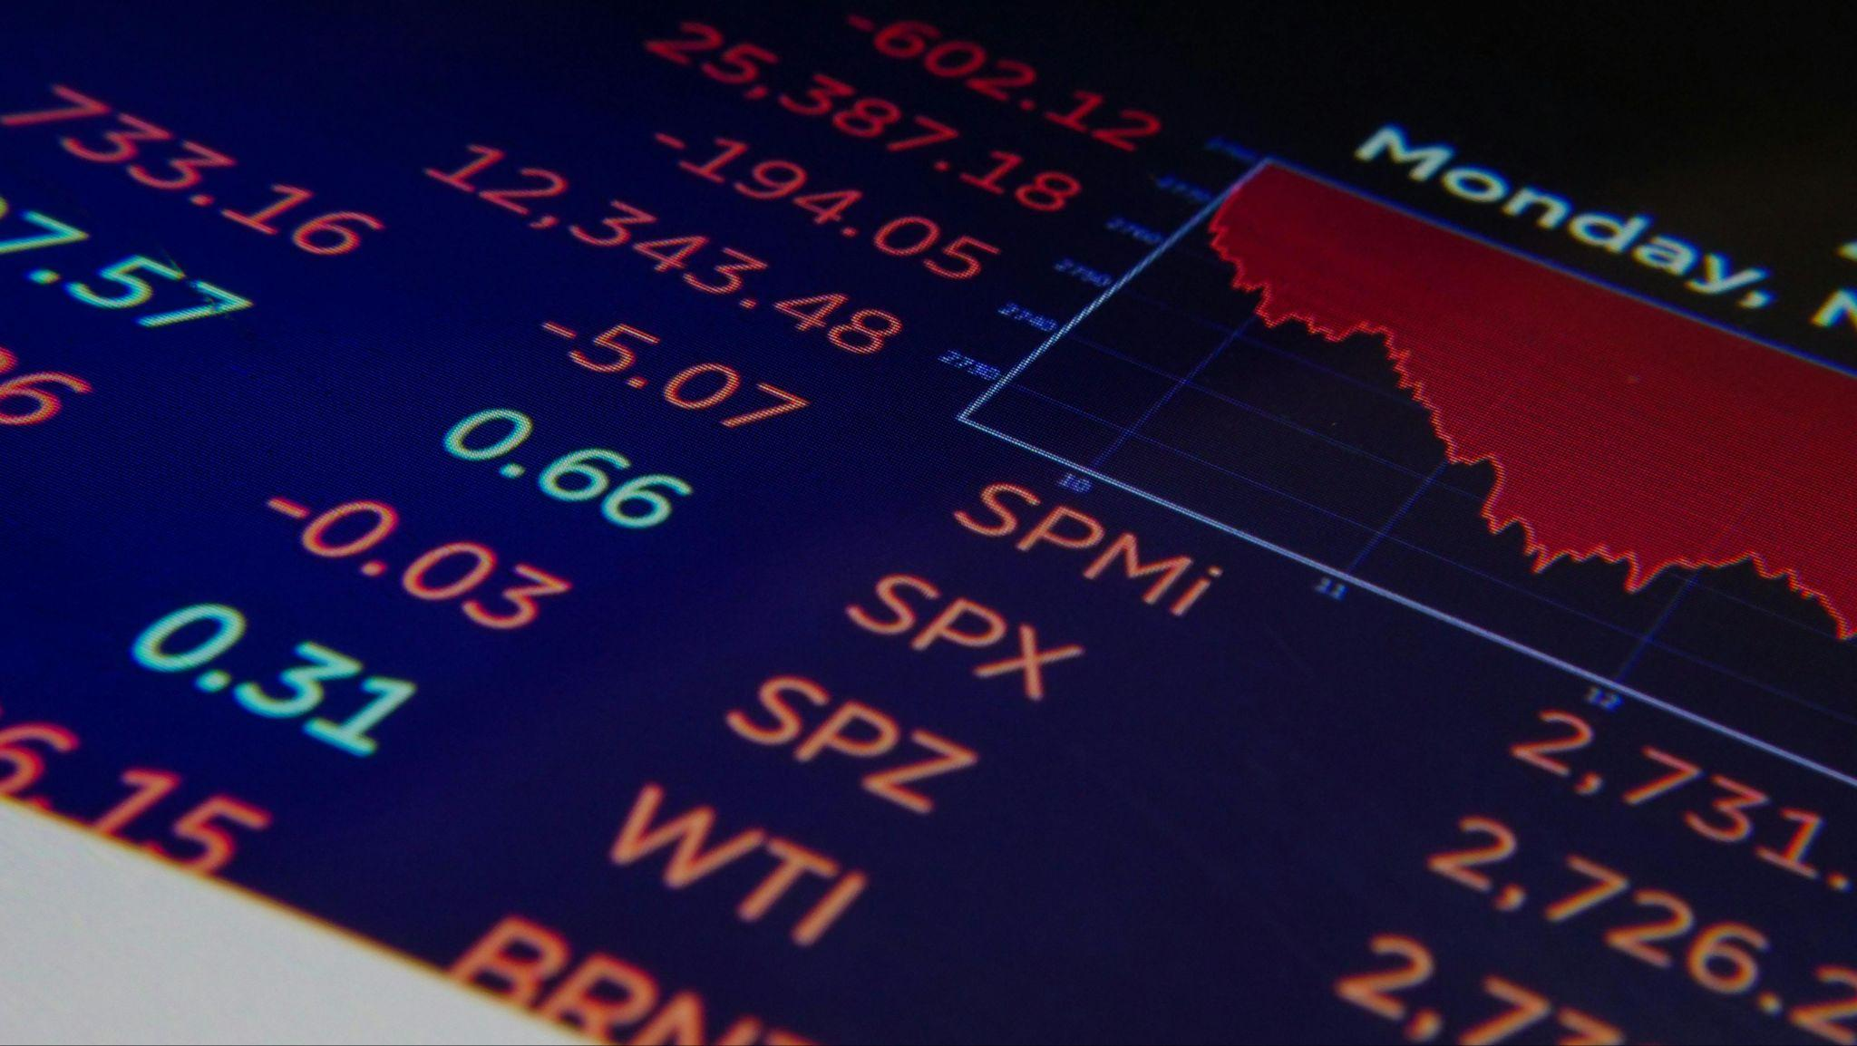
Types of benchmarks
Examples: TSX, S&P 500, NASDAQ, Dow Jones
Tech-heavy: NASDAQ Composite
Balanced: 50% Global Aggregate Bond + 50% S&P 500

Slide 13

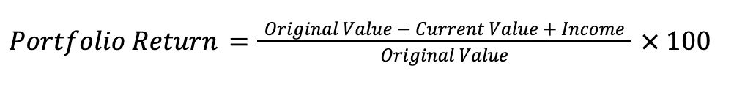
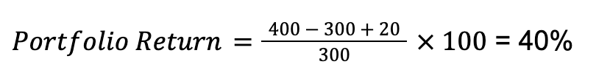
How to calculate returns
Note: Online brokerages and financial advisors provide return information t
hese days!
Imagine you have three apple trees. If each apple tree is originally worth $100 and increases in value to $133.33, what is the return value?
Take the value of your three trees ($400)
Subtract the original value ($300), then add whatever apples have grown ($20 worth)
Divide by the initial value ($300)
Multiply by 100
The return value is 40%

Slide 14
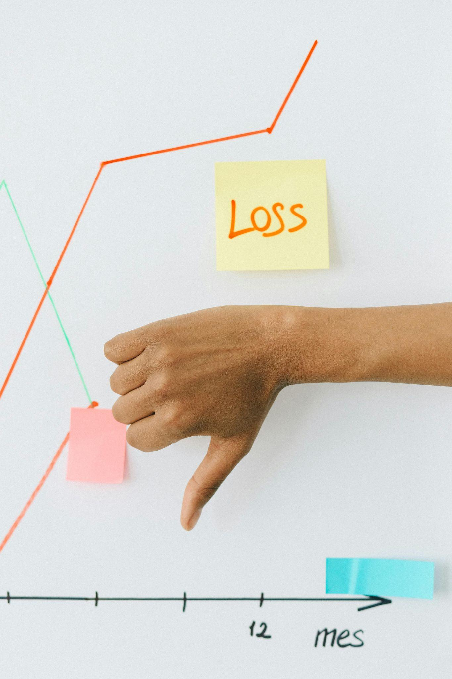
Beyond return: consistency and risk
Consider performance consistency and risk level
Volatility: the degree fluctuation in the price of an asset over time

Slide 15
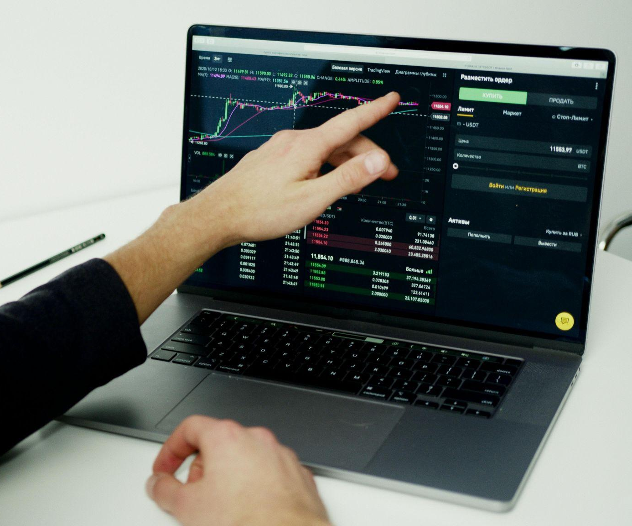
Volatility vs. benchmark: beta
Volatility calculated by standard deviation: variation of returns from the average
Higher SD = more volatility
Lower SD = more stability
Beta > 1: More volatile than benchmark
Beta < 1: Less volatile than benchmark

Slide 16
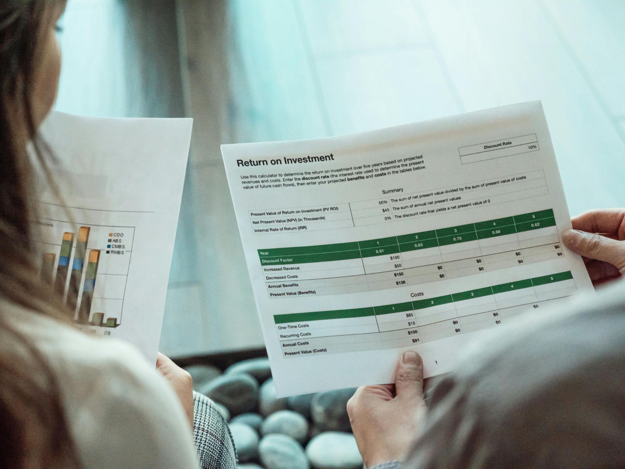
Risk-adjusted return: sharpe ratio
Sharpe Ratio = return / risk
Higher ratio = better return for risk taken
Higher Sharpe = more efficient investment

Slide 17
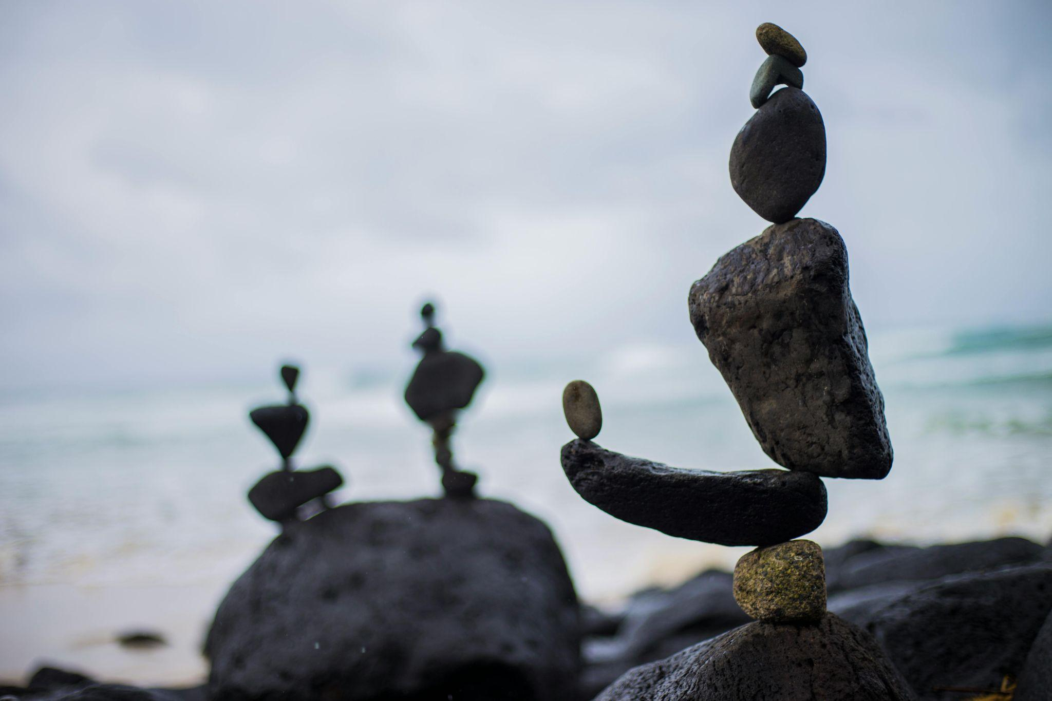
Rebalancing a portfolio
Adjusts assets to maintain target allocation
Keeps risk level aligned
with goals
1. Set target allocation.
2. Monitor regularly.
3. Buy/sell to return to target.

Slide 18
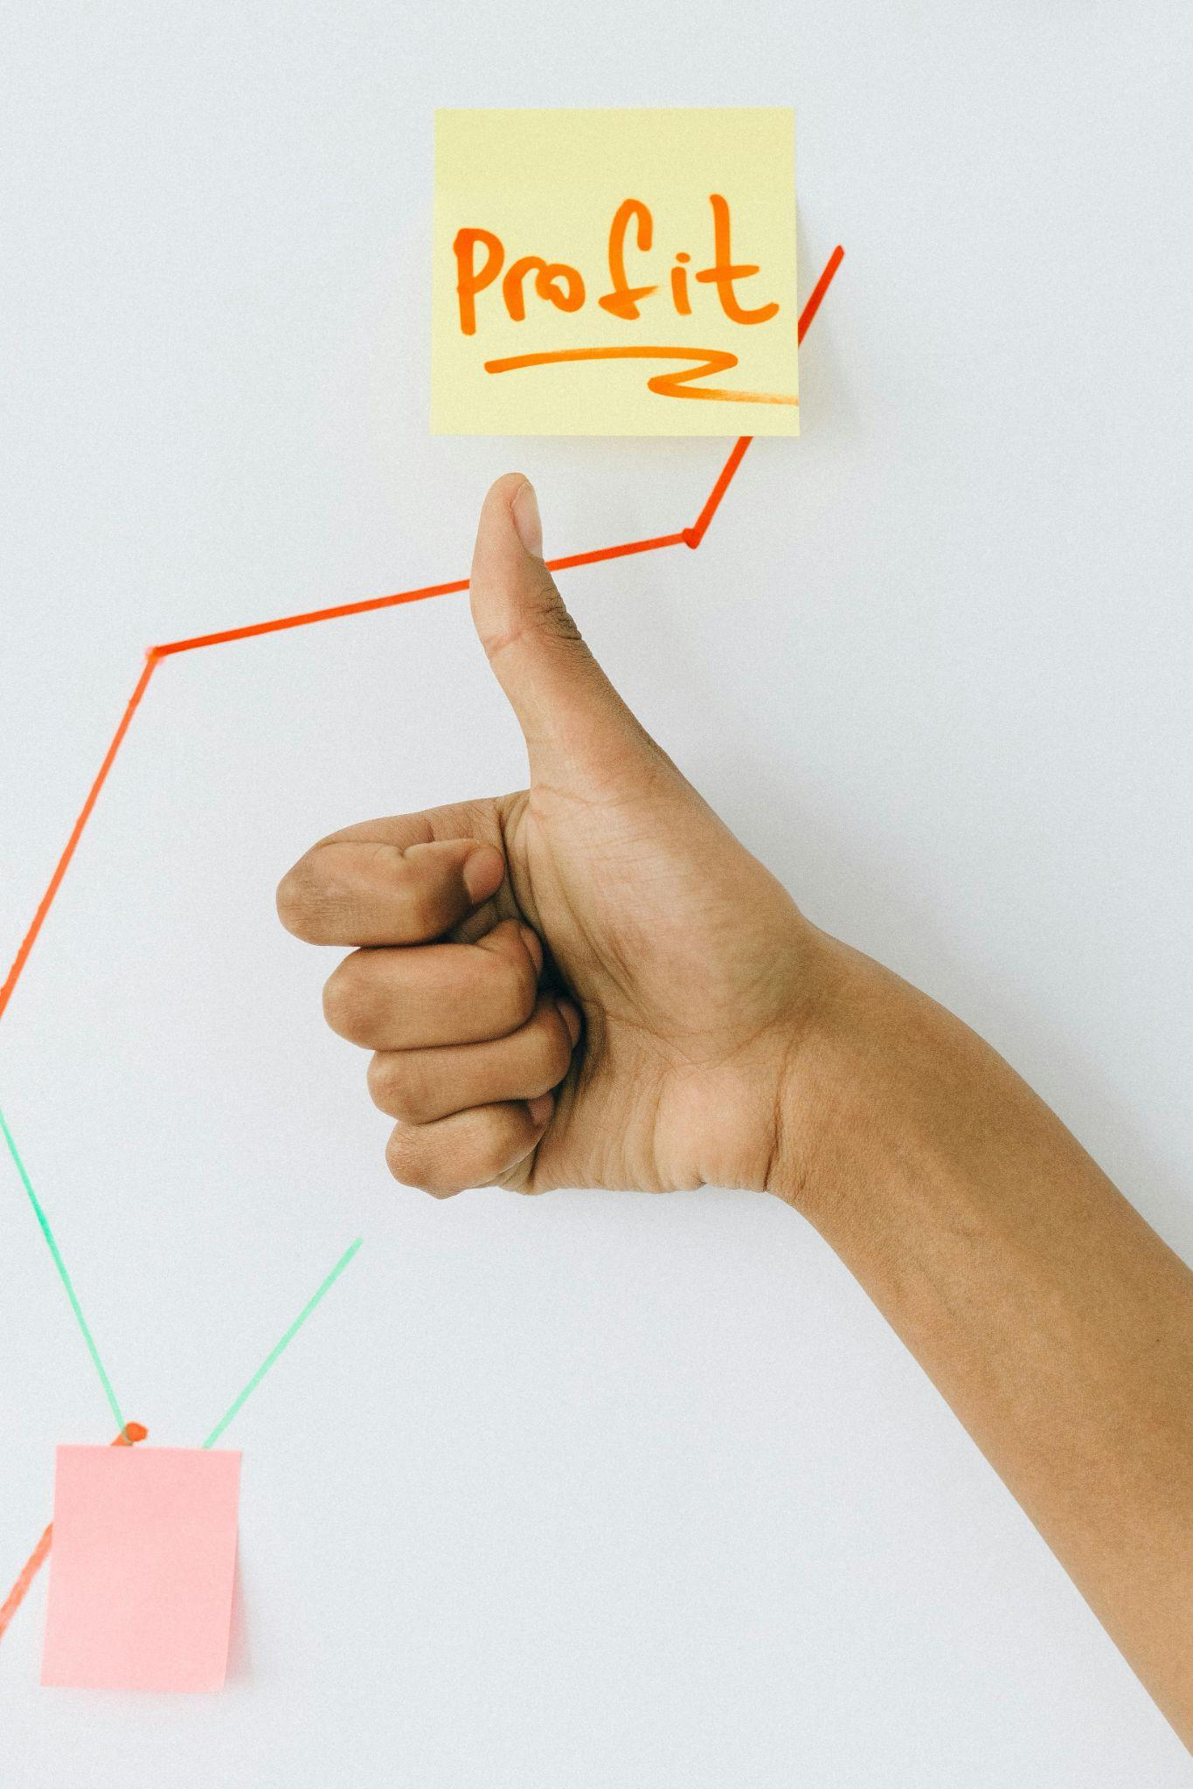
Wrap-up
Monitor and rebalance to stay on track.
Helps grow and protect your investments long-term.

Slide 19
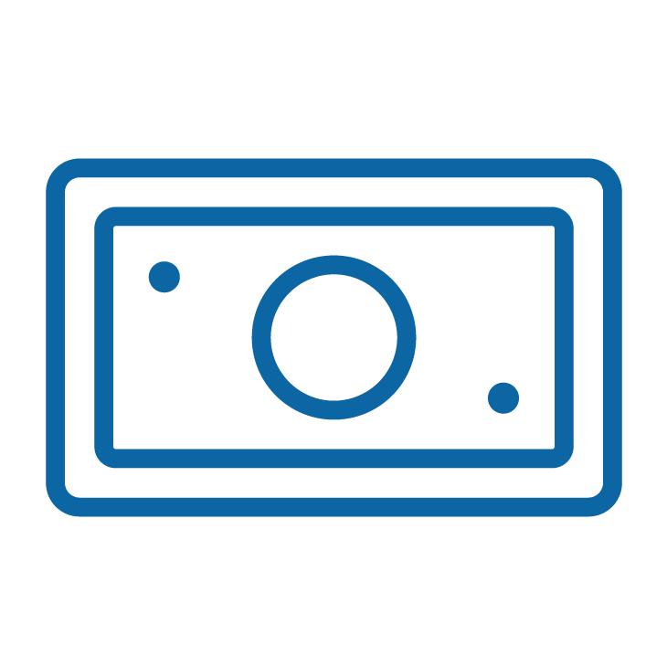


Simulation activity!
Simulation instructions: build and balance your portfolio
Start with $10,000 in investment money.
Choose four assets from your team’s Asset Cards and write them down in Step 1.
Aim for a balanced portfolio (mix of risk levels).

Slide 20



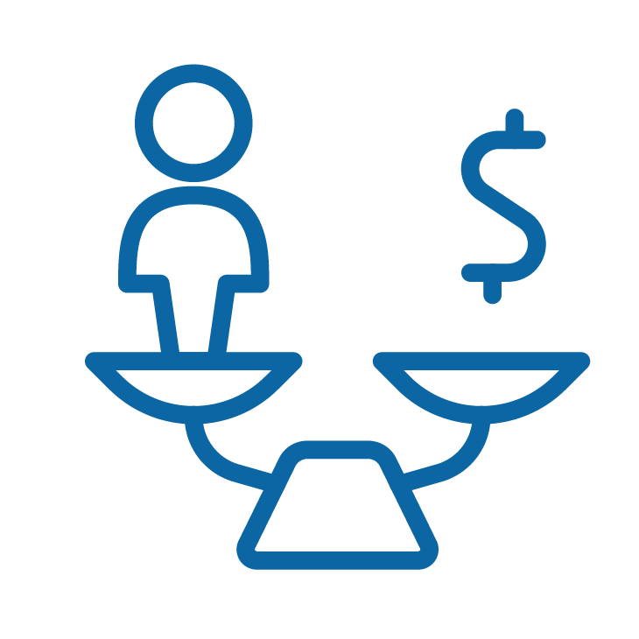
For each year (three rounds)
You will see market return at the end of each year.
Record the outcomes of your portfolio in Step 2.
Calculate your year-end value for each asset:
starting value × (1 + return rate)
Add up your total portfolio value.
Decide: Will you rebalance your portfolio?
+

Slide 21
Market year summary: Year one asset class returns
General market summary
The economy is stable with moderate growth. Inflation and interest rates are low, leading to positive returns across most asset classes.
Government Bond | +3%
S&P 500 ETF | +8%
Tech stock | +10%
International Equity Fund | +5%
Corporate bond | +4%
High-yield savings account | +1.5%
Crypto fund | +20%
Balanced mutual fund | +6%
Real estate investment trust (REIT) | +7%
Emerging market fund | +12%
Inflation is 1.8%. Interest rates remain steady at 2%. Optimism supports equity growth.

Slide 22
Market year summary: Year two asset class returns
General market summary
Global uncertainty causes market volatility. Rising interest rates impact bonds and high-risk assets decline significantly.
Government Bond | +2%
S&P 500 ETF | +6%
Tech stock | –12%
International Equity Fund | –3%
Corporate bond | +1%
High-yield savings account | +2%
Crypto fund | –25%
Balanced mutual fund | +4%
Real estate investment trust (REIT) | +1%
Emerging market fund | –10%
Interest rates increase to 3.5%. Inflation hits 3.2%.
Caution advised with high-volatility investments.

Slide 23
Market year summary: Year three asset class returns
General market summary
The market rebounds after a difficult year. Growth sectors recover, interest rates stabilize, and global confidence improves.
Government Bond | +4%
S&P 500 ETF | +12%
Tech stock | +18%
International Equity Fund | +9%
Corporate bond | +4%
High-yield savings account | +1.8%
Crypto fund | +10%
Balanced mutual fund | +7%
Real estate investment trust (REIT) | +5%
Emerging market fund | +15%
Interest rates stabilize at 2.5%. Inflation lowers to 2%. Investors regain confidence across most sectors.

Slide 24

Final summary
Calculate your total return (%) over three years:
(final value – starting value) ÷ starting value × 100
Reflect with your group in Step 3:
Performance analysis: How did your portfolio perform over the three simulated years? Which assets contributed most to your gains or losses?
Rebalancing decisions: How often did you rebalance your portfolio? What factors influenced your decision to rebalance or not?
Market impact: How did the different market conditions each year impact your portfolio? Were there any surprises?

