Slide 1

Types of stock orders

Slide 2
Minds on!
Imagine you’ve saved $200 from a part-time job. You hear that a new sneaker company called Kicks Unlimited is growing fast, and all your friends are talking about it. You’re thinking of buying four shares at $50 each.
Suddenly, you see the stock price is starting to move.
What would you do if the price rises to $55?
What if it drops to $45?
Would you buy now, wait, or sell?
What information would help you make a smart choice?

Slide 3
Think, pair, share!
Think (5 mins): Individually, jot down your personal reactions and decisions based on the scenario.

Slide 4
Think, pair, share!
Pair (5 mins): Discuss decisions in pairs, compare choices and reasoning. What did you have in common and what was different?

Slide 5
Think, pair, share!
Share (5 minutes)
Share your responses. Who said:
Buy now
Wait
Sell
It depends...

Slide 6
You’ve just explored the kind of decisions investors make every day - when to buy, sell, or wait. Now let’s look at the different tools investors use to help make those decisions smarter and safer. In this video, we’ll explore five different types of stock orders...

Slide 7
Types of stock Orders

Slide 8

Market orders
Buy/sell immediately at next available price
Fast execution, guaranteed fill
Price uncertain (depends on bid/ask)
Example: Buy Kicks Unlimited at ~$50/share

Slide 9
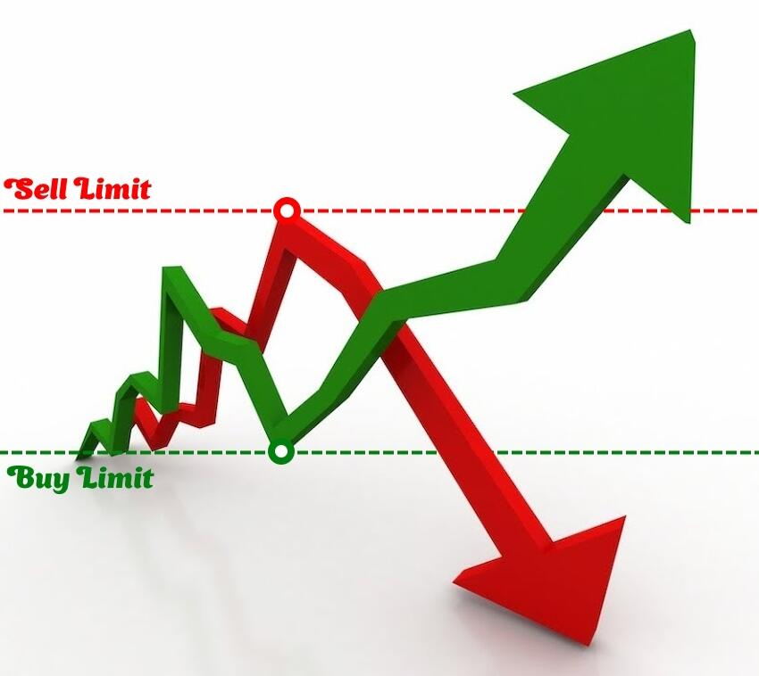
Limit orders
Set max buy price or minimum sell price
Only execute if price hits limit or better
Control over price, no guarantee of fill
Example: Buy Kicks Unlimited only if ≤ $45

Slide 10
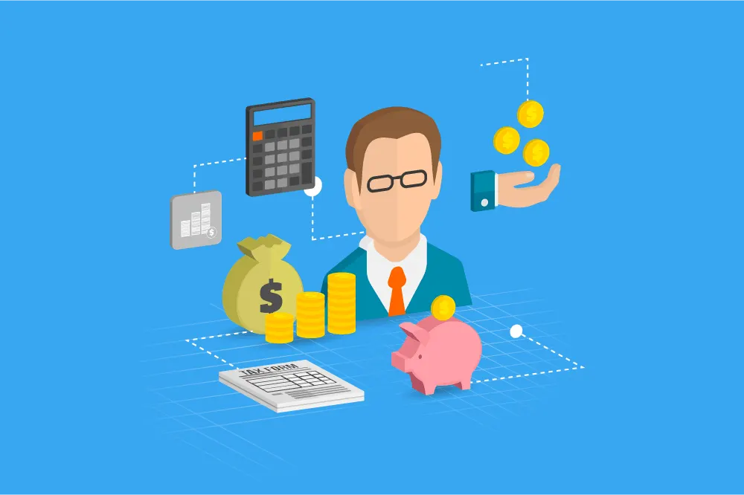
Considerations for market & limit orders
Broker fees
Bid-ask spread affects final cost
Order duration affects fees and execution

Slide 11
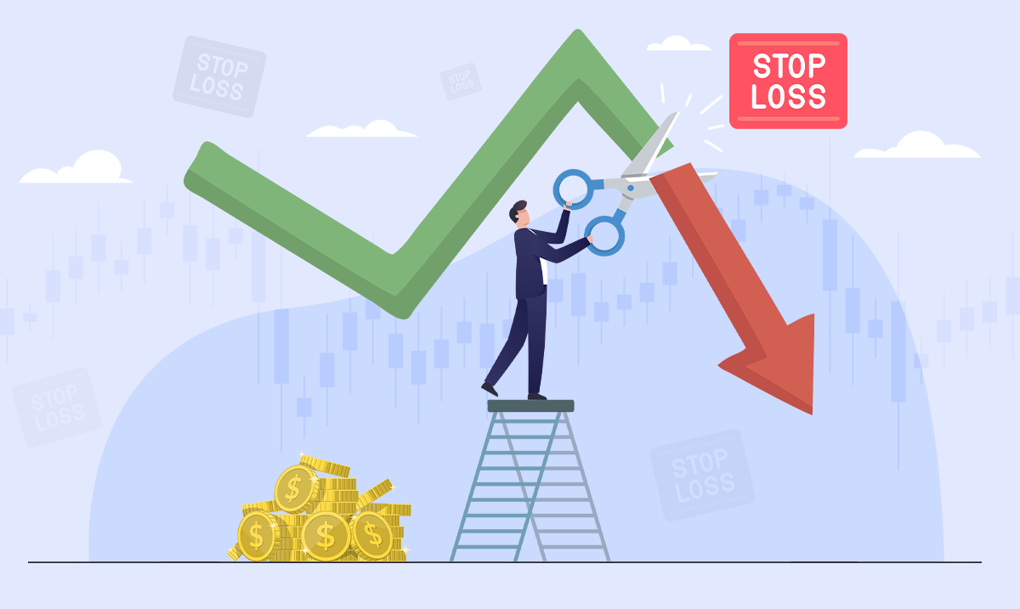
Stop orders (stop loss)
Turns into market order once stop price reached
Used to limit losses or protect profits
Example: Sell Kicks Unlimited if price falls to $45

Slide 12
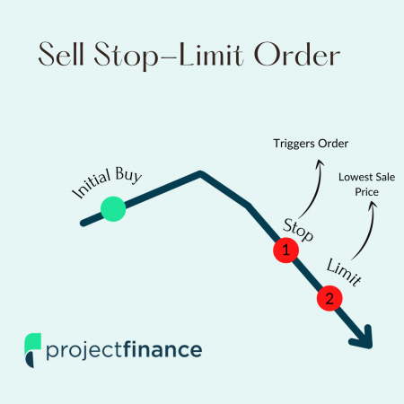
Stop limit orders
Combination: stop triggers a
limit order
Two prices: stop price and limit price
Only sells at limit price or better after stop triggered
Example: Stop at $45, limit at $44

Slide 13
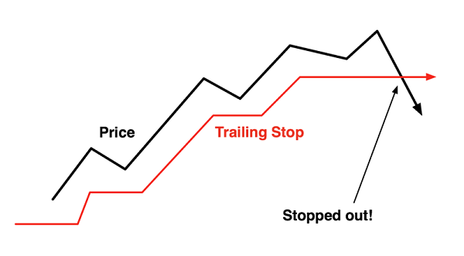
Trailing stop orders
Stop price trails market price by fixed $ or %
Adjusts as stock price moves
Locks in profit, sells if price falls by trail amount
Example: $2 trail; stock rises $50→$55, stop moves $48→$53, sells if drops to $53

Slide 14
Summary
Order type | Key feature | Example (Kicks Unlimited)
Market | Immediate execution | Buy at $50 market price
Limit | Price control | Buy only if ≤ $45
Stop | Protect loss | Sell if drops to $45
Stop Limit | Stop and limit price | Sell if hits $45, at ≥ $44
Trailing | Adjustable stop | Sell if drops $2 from high

Slide 15

Final thoughts
Knowing order types helps DIY investors
Choose orders based on goals and risk tolerance

Slide 16
Stock market game!

Slide 17
Game overview
Students act as investors in Kicks Unlimited.
They place buy/sell orders each round.
The market price changes based on a dice roll.
Students track their trades and see if their choices paid off!

Slide 18
Game set-up
Divide students into teams of four
Each team starts with $500 and 0 shares
Use a die to simulate market movement; each number represents a movement in the market
Students will track their progress each round using the provided tracking sheet
The team with the highest portfolio value at the end, wins!

Slide 19
Each round
The teacher announces the current stock price (starting at $50)
Teams choose an order: market, limit, stop, etc.
Roll the die to simulate the market
Reveal what happened: Did the order execute? Profit or loss?
Track everything on the sheet
Repeat for five rounds

Slide 20
Tracking Sheet instructions
Each team records:
Round number
Current stock price
Their order and action
Shares bought/sold
Cash remaining
Shares owned
Portfolio value (cash + shares × price)

Slide 21
Round one - roll the die!

Slide 22
Rumor alerts (announce each round)
Roll One: Drop flopped — quality is trash! (-$5)
Roll Two: Copycat scandal on TikTok! (-$3)
Roll Three: Release delay frustrates fans (-$1)
Roll Four: Restock brings some hype back (+$1)
Roll Five: NBA star wears them — trending! (+$3)
Roll Six: Travis Scott collab leaked! (+$5)

Slide 23
Round one - decide on a order and quantity.

Slide 24
Round one - roll the die!

Slide 25
Round one results!
Roll One: Drop flopped — quality is trash! (-$5)
Roll Two: Copycat scandal on TikTok! (-$3)
Roll Three: Release delay frustrates fans (-$1)
Roll Four: Restock brings some hype back (+$1)
Roll Five: NBA star wears them — trending! (+$3)
Roll Six: Travis Scott collab leaked! (+$5)
Complete your tracking sheet given the market movement and your choice!

Slide 26
Round two - track your results!

Slide 27
Round two - decide on a order and quantity.

Slide 28
Round two - roll the die!

Slide 29
Round one results!
Roll One: Drop flopped — quality is trash! (-$5)
Roll Two: Copycat scandal on TikTok! (-$3)
Roll Three: Release delay frustrates fans (-$1)
Roll Four: Restock brings some hype back (+$1)
Roll Five: NBA star wears them — trending! (+$3)
Roll Six: Travis Scott collab leaked! (+$5)
Complete your tracking sheet given the market movement and your choice!

Slide 30
Round three - track your results!

Slide 31
Round three - decide on a order and quantity.

Slide 32
Round three - roll the die!

Slide 33
Round three results!
Roll One: Drop flopped — quality is trash!' (-$5)
Roll Two: Copycat scandal on TikTok!' (-$3)
Roll Three: Release delay frustrates fans' (-$1)
Roll Four: Restock brings some hype back' (+$1)
Roll Five: NBA star wears them — trending!' (+$3)
Roll Six: Travis Scott collab leaked!' (+$5)
Complete your tracking sheet, given the market movement and your choice!

Slide 34
Round three - track your results!

Slide 35
Round four - decide on a order and quantity.

Slide 36
Round four - roll the die!

Slide 37
Round four results!
Roll One: Drop flopped — quality is trash! (-$5)
Roll Two: Copycat scandal on TikTok! (-$3)
Roll Three: Release delay frustrates fans (-$1)
Roll Four: Restock brings some hype back (+$1)
Roll Five: NBA star wears them — trending! (+$3)
Roll Six: Travis Scott collab leaked! (+$5)
Complete your tracking sheet, given the market movement and your choice!

Slide 38
Round four - track your results!

Slide 39
Round five - decide on a order and quantity.

Slide 40
Round five - roll the die!

Slide 41
Round five results!
Roll One: Drop flopped — quality is trash! (-$5)
Roll Two: Copycat scandal on TikTok! (-$3)
Roll Three: Release delay frustrates fans (-$1)
Roll Four: Restock brings some hype back (+$1)
Roll Five: NBA star wears them — trending! (+$3)
Roll Six: Travis Scott collab leaked! (+$5)
Complete your tracking sheet, given the market movement and your choice!

Slide 42
Round five - track your results!

Slide 43
Winning the game
Calculate your total portfolio value!
The team with the highest portfolio value wins!

Slide 44
Consolidation - part 1
Discuss one question from each category with your team using the consolidation question sheet!

Slide 45
Consolidation - part 2
Go back to the minds on handout and see if you would change your decisions!

