Slide 1

Types of investment vehicles

Slide 2
Minds on!
When you think of the word “Vehicle,” what comes to mind?

Slide 3
Minds on!
What are examples of vehicles?

Slide 4
Minds on!
What do vehicles do for us?

Slide 5
Minds on!
Can you describe some types of vehicles – how are they different?

Slide 6
Minds on!
What if I told you that money also needs a vehicle? What would this mean?

Slide 7
Minds on!
Just like a car takes you somewhere, an investment vehicle helps your money get from one point to another, like from saving to growing, or from now to retirement!

Slide 8
Pay attention during today’s video to learn about the different types of investment vehicles. Answer the questions as you watch!

Slide 9
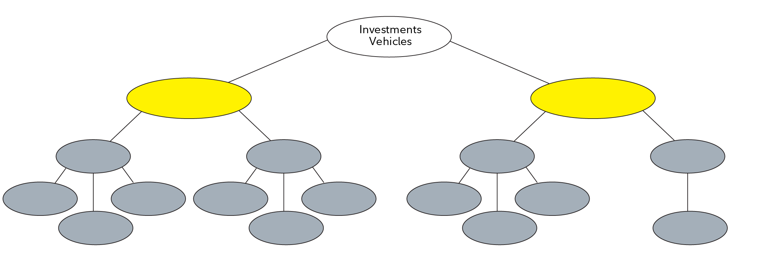
What is an investment vehicle?
What are the two types of investment vehicles?

Slide 10
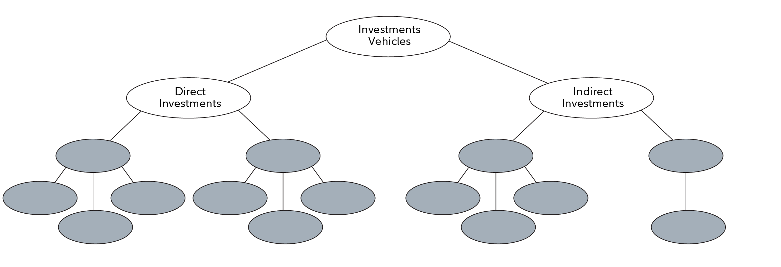
What are the two types of investment vehicles?

Slide 11
What is an investment vehicle?
A product that helps individuals grow their money
Two main categories:
  Direct investment vehicles
  Indirect investment vehicles

Slide 12
Direct investment vehicles
Involves directly owning assets
Offered by public and private companies
Private securities require high investment amounts, for wealthy/institutional investors

Slide 13
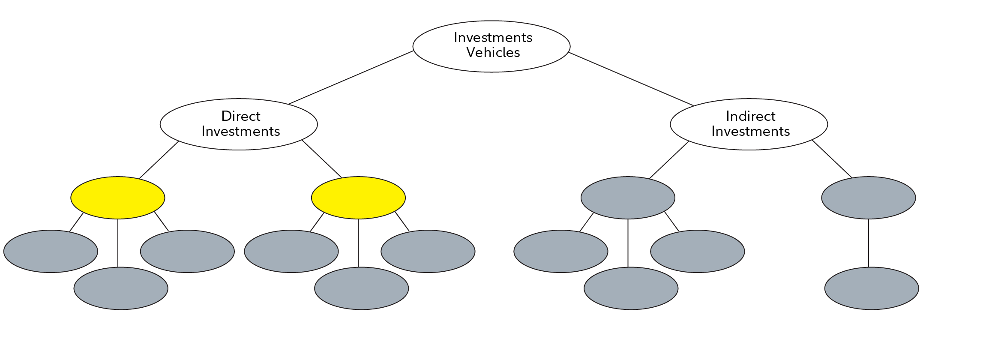
What are the two types of direct investment?

Slide 14
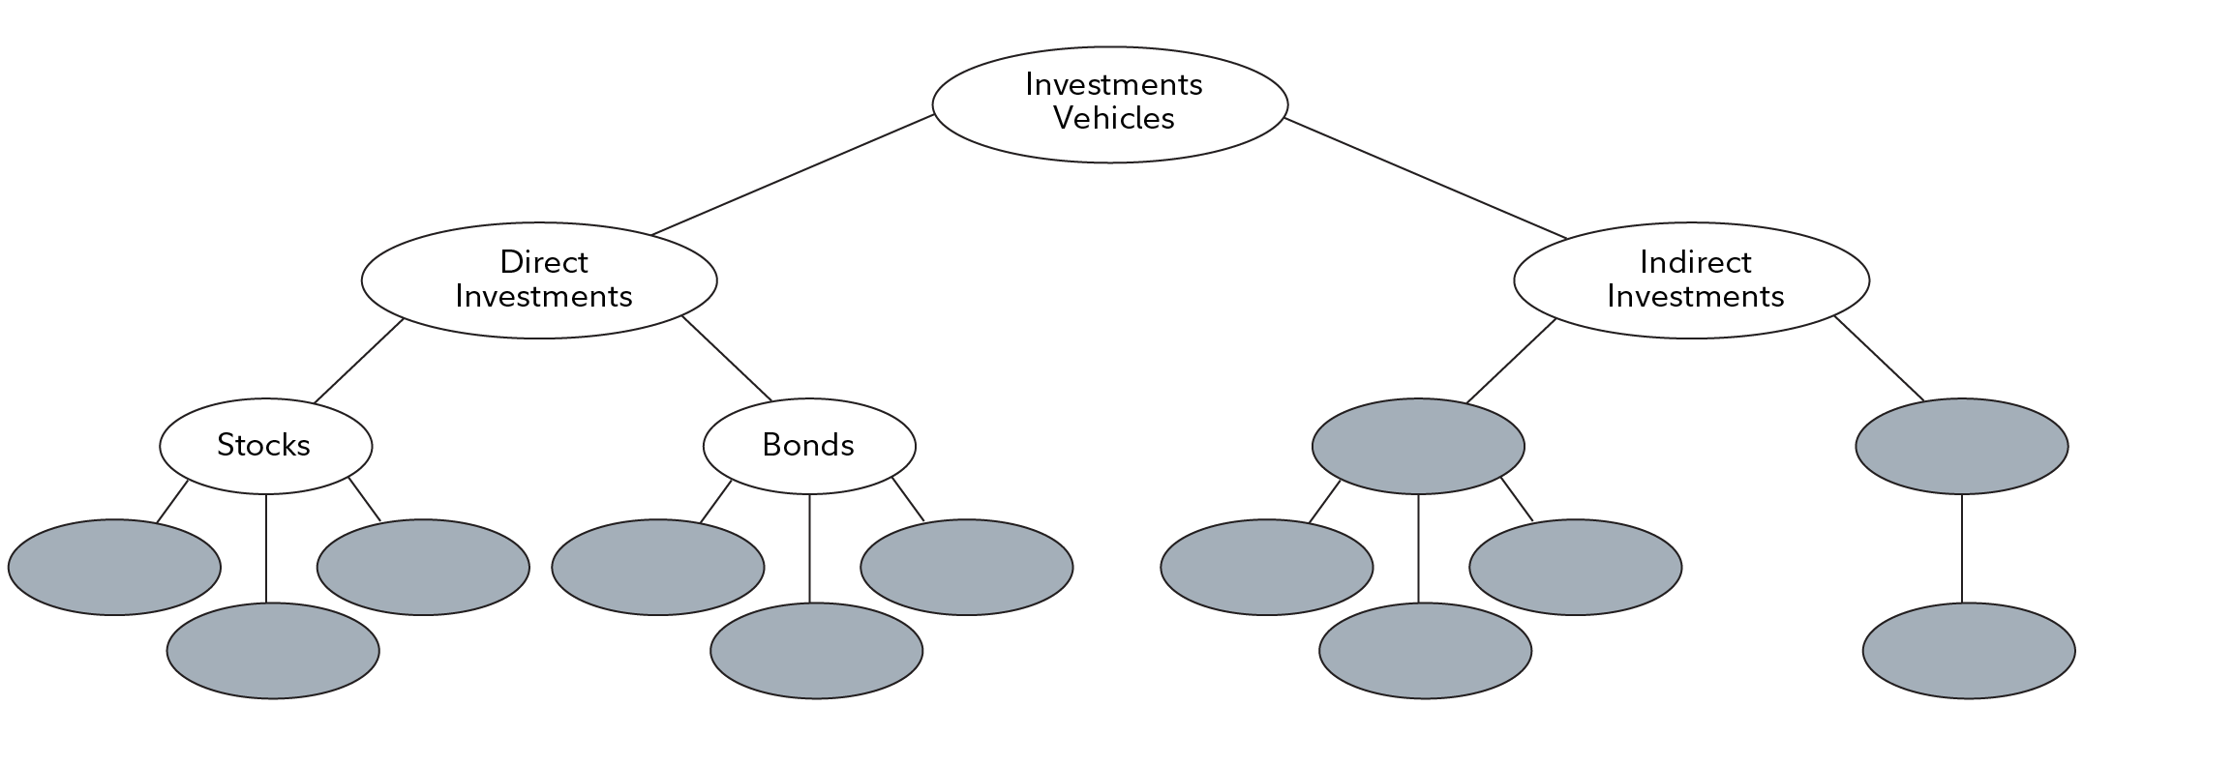
What are the two types of direct investment?

Slide 15
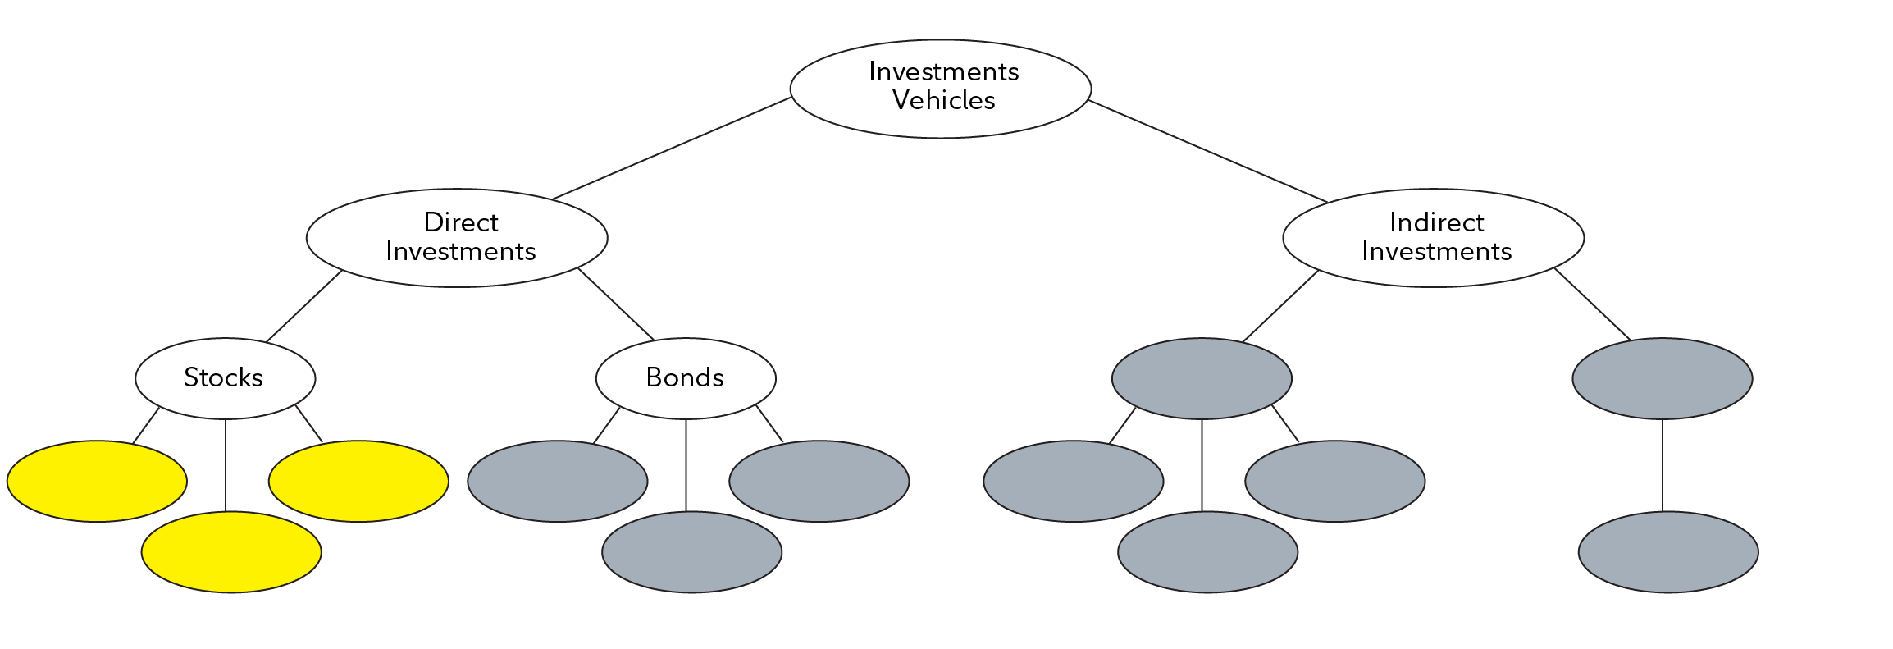
What are three features of stocks?

Slide 16
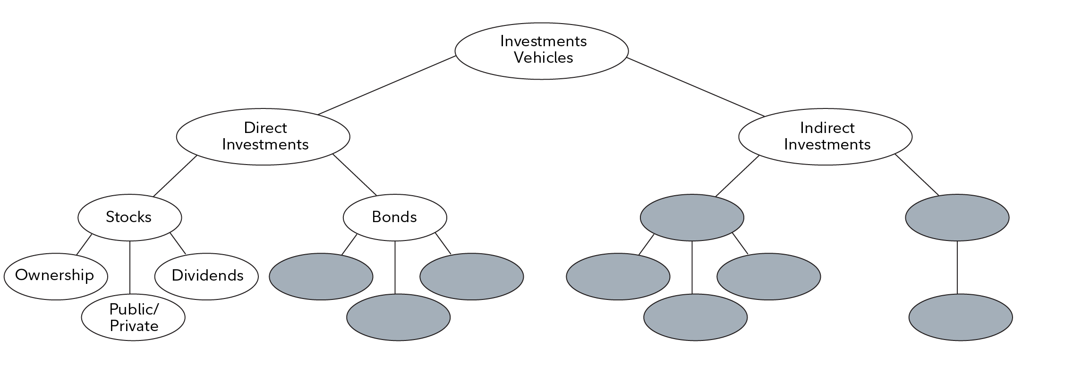
What are three features of stocks?

Slide 17
Stocks as a direct investment
Public securities: More affordable, such as stocks
Stocks = Share of ownership in a company
Potential for capital growth and dividends

Slide 18
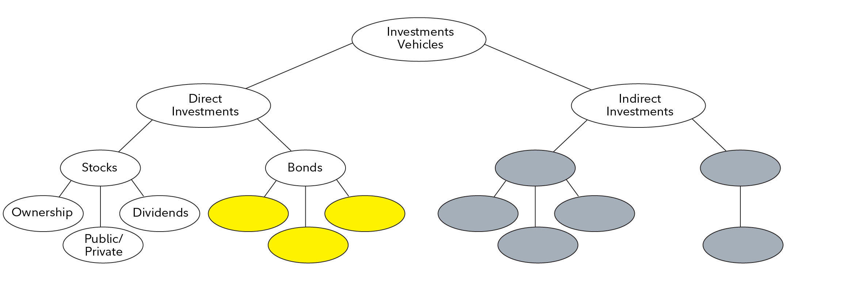
What are three features of bonds?

Slide 19
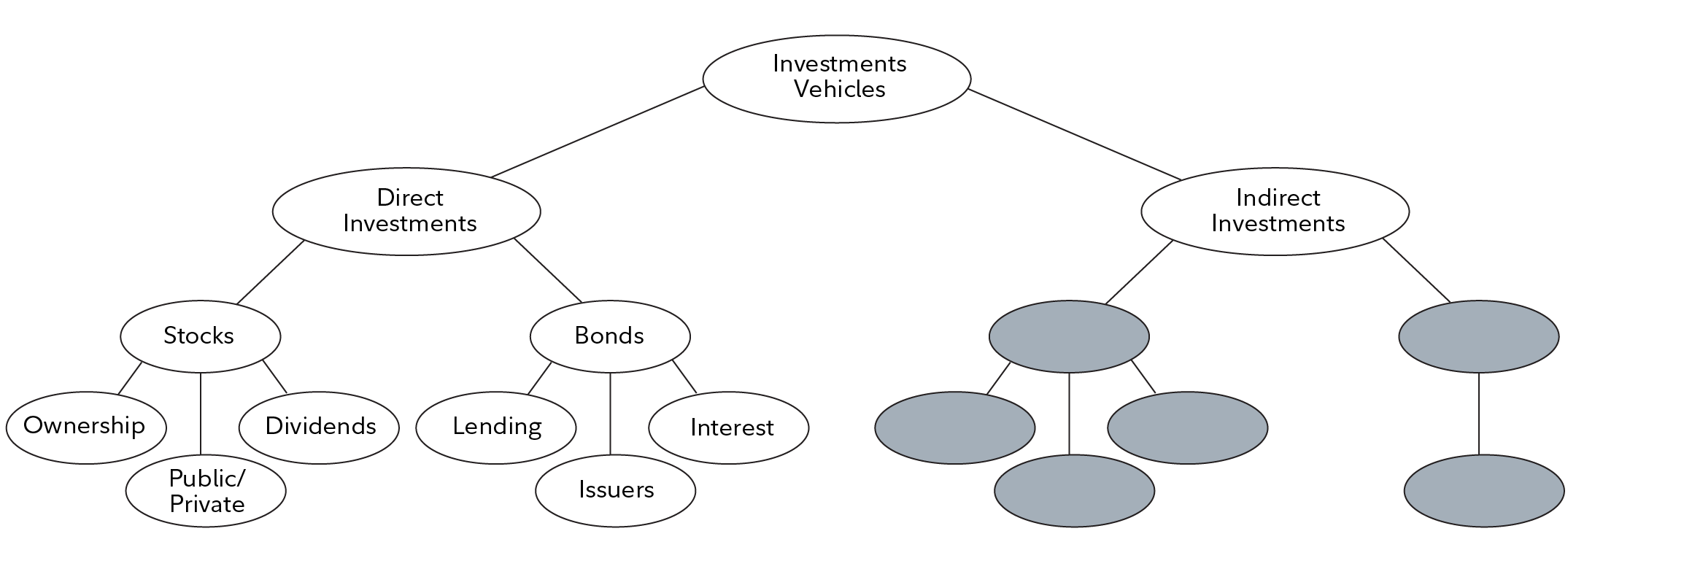
What are three features of bonds?

Slide 20
Bonds as a direct investment
Bonds: Investor lends money to company or the government
Issuer repays with interest over time

Slide 21

Challenges with direct investments
Requires time, research and market knowledge
Important considerations: Diversification, asset allocation, geography, sectors, styles

Slide 22
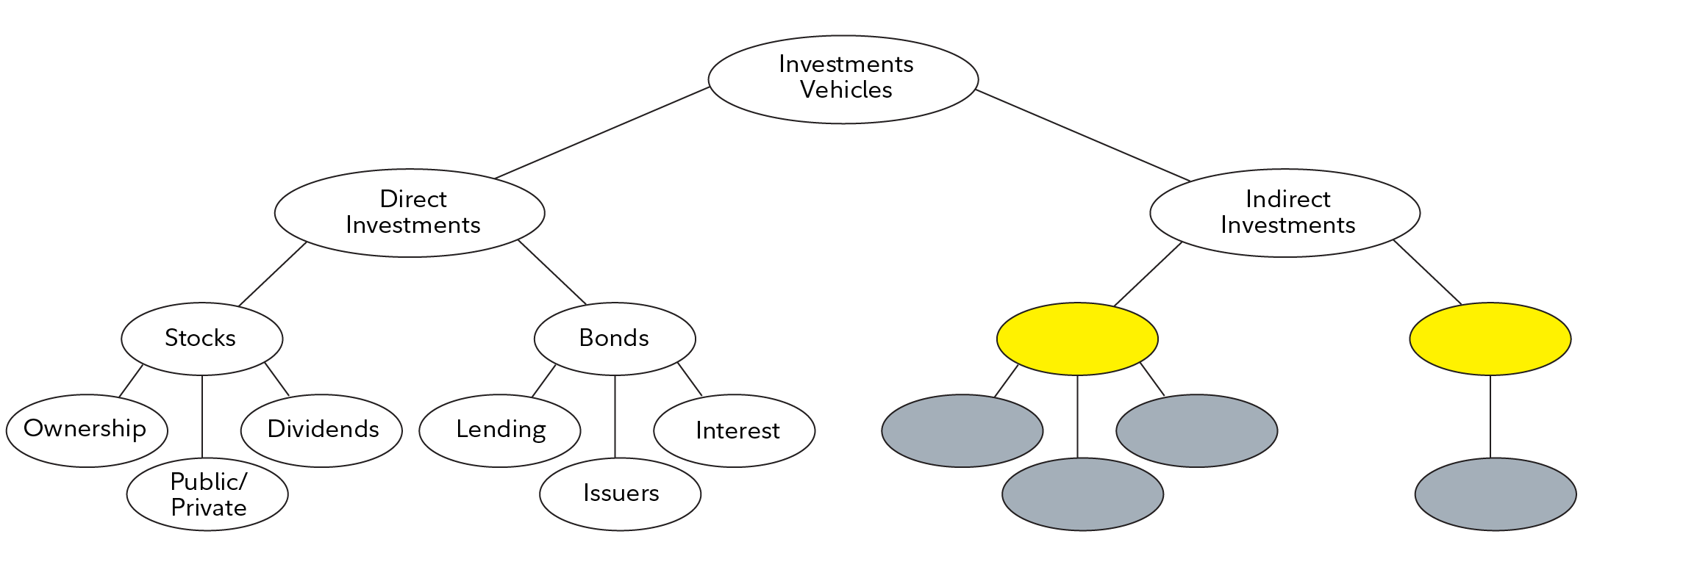
What are the two types of indirect investment?

Slide 23
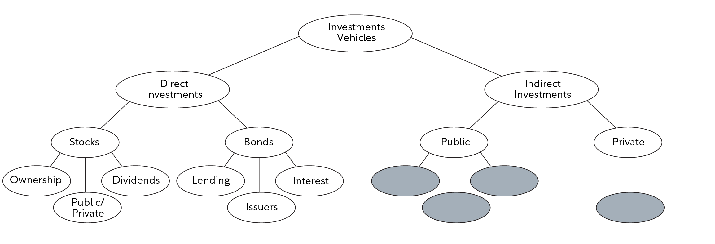
What are the two types of indirect investment?

Slide 24
Indirect investment vehicles
Portfolio management is outsourced to professionals
Investors purchase the assets directly
Split into: Public and private indirect vehicles

Slide 25
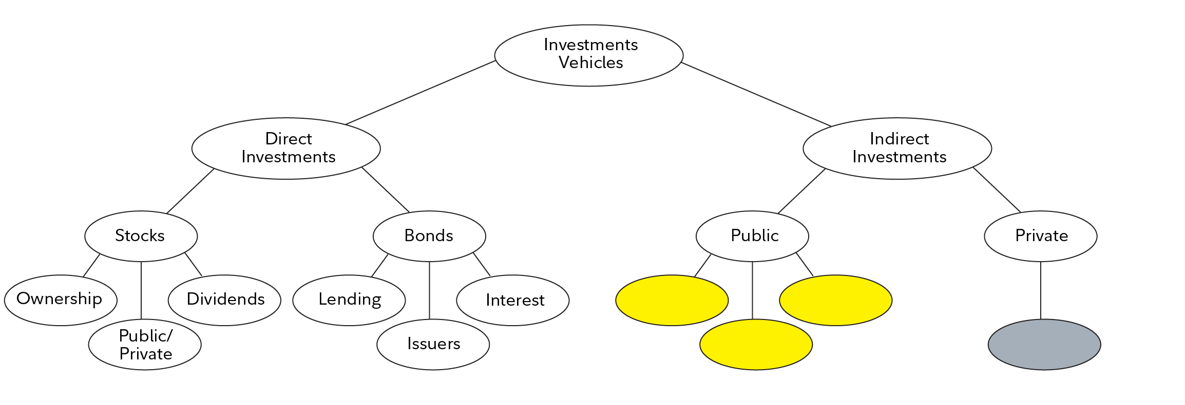
What are the three types of public indirect investment?

Slide 26
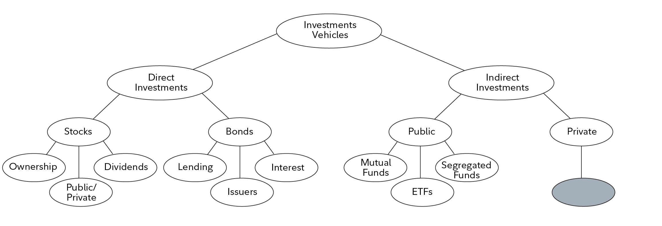
What are the three types of public indirect investment?

Slide 27

Public indirect investment vehicles
Available to general public
Includes:
  ETFs
  Mutual funds
  Segregated funds

Slide 28

Mutual funds and ETFs overview
Cost-effective way to diversify
Invest in: Equities, bonds and alternative asset classes, such as commodities, real estate

Slide 29
Pricing and purchasing differences between mutual funds and ETFs
Mutual fund: Priced daily at market close (net asset value or NAV)
NAV/Total number of units outstanding = price per unit for mutual fund
ETF: Priced in real time during trading hours
Bought and sold on the stock exchange
Determined by supply and demand on the market
Price and amount can change daily

Slide 30
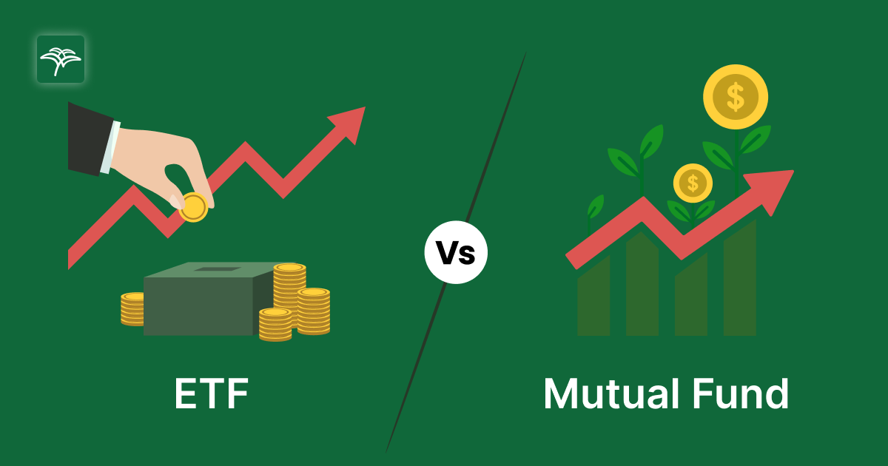
Mutual funds vs. ETFs management differences
Management style:
Mutual funds: Typically actively managed (higher cost)
ETFs: Typically passive (track performance of an index; lower cost)

Slide 31

Segregated funds
Offered by Canadian insurance companies
Mix of insurance + investment
Suited for conservative investors or those nearing retirement
Comes with a guarantee (75% to 100% of investment protected after ~10 years)

Slide 32
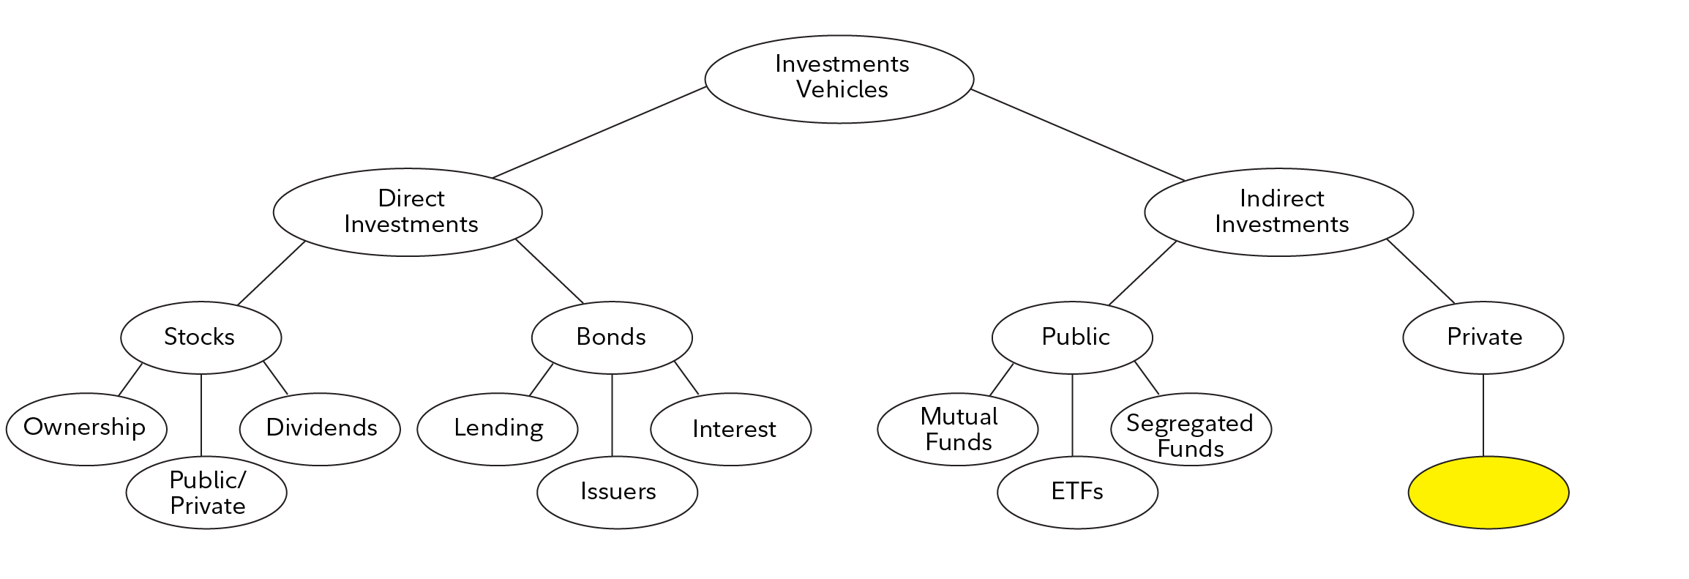
What is the one type of private indirect investment?

Slide 33
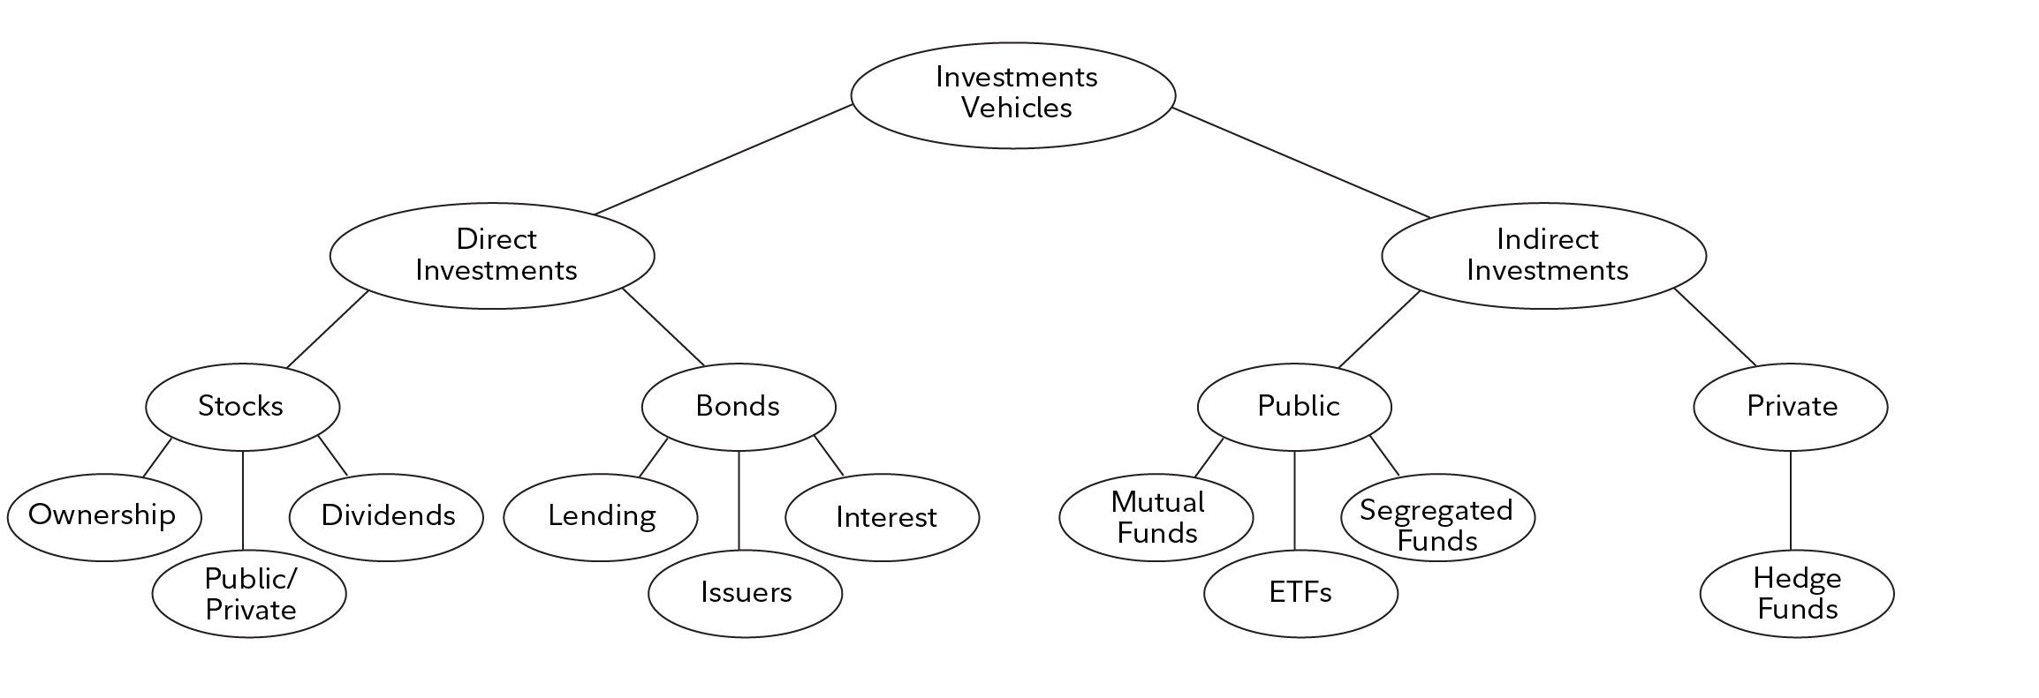
What is the one type of private indirect investment?

Slide 34

Private indirect investment vehicles: Hedge funds
Hedge funds aim for high returns through advanced strategies (e.g., short selling, leverage)
Requirements: Accredited investor status (high income/assets)
Less regulated than mutual funds

Slide 35
What are the three factors to consider before choosing an investment vehicle?

Slide 36

Choosing an investment vehicle
Factors to consider:
Goals (short-term vs. long-term)
Risk tolerance
Diversification across asset classes, geographies, sectors

Slide 37
Mini-profile activity
Get into pairs and complete the mini-profile activity!

Slide 38
Emma’s profile
Age 22 First job, wants long-term growth Open to some risk No immediate financial needs | Stock ETF Bond | Stocks offer high growth potential over the long-term. Emma is young and has time to handle market ups and downs. Offers diversified exposure to large U.S. companies. Good for passive growth at a low cost. Suitable for a long investment horizon. Adds a low-risk component to her portfolio to help balance out more volatile stock investments.

Slide 39
Carlos’ profile
Age 45 Saving for family and kids’ education Medium risk tolerance Wants steady growth | Mutual fund Bond ETF | Offers a mix of stocks and bonds. Great for someone seeking moderate risk with steady growth. Reliable and lower risk. Helps preserve capital while still earning interest. Adds global diversification to reduce country-specific risk. Useful for long-term educational savings.

Slide 40
Nora’s profile
Age 63 Nearing retirement Prioritizes safety and stability Low risk tolerance | Segregated fund Bond | Offers capital protection (75%–100% guarantee) and combines insurance with investment. Ideal for conservative investors close to retirement. A secure, low-risk choice that generates steady income. Helps preserve capital during retirement.

Slide 41
Teenager profile
Example: High school student Age: 14–17 Short-term goals; save for a car Risk tolerance: Low, not much savings | Bond Mutual fund | Backed by the government. Safe and predictable, great for preserving money over 1–3 years. Provides slight growth through a diversified bond portfolio. Low risk and good for conservative investors. Note: Stocks and real estate would not be a good idea for a high school student as they have higher risk and are more for long-term investment.

Slide 42
Exit ticket
Complete the exit ticket!

