Slide 1

Types of investment vehicles

Slide 2
Minds on!
Complete your Minds on questionnaire (answer honestly and ignore the points)!

Slide 3
Total up your points!
Determine what your investor type and vehicle may be based on the total number of points from the quiz!

Slide 4
Now that you know your investor type, pay attention during today’s video to see which investment vehicles match your profile. Watch the video and take notes in your handout!

Slide 5

What is an investment vehicle?
A product that helps individuals grow their money
Two main categories: Direct and indirect investment vehicles

Slide 6

Direct investment vehicles
Involves directly owning assets (e.g., stocks, bonds, real estate)
Offered by public and private companies
Private securities require high investment amounts, for wealthy/institutional investors

Slide 7

Stocks as a direct investment
Public securities: More affordable, such as stocks
Stocks = Share of ownership in a company
Potential for capital growth and dividends

Slide 8

Bonds as a direct investment
Bonds: Investor lends money to company or the government
Issuer repays with interest
over time

Slide 9

Challenges with direct investments
Requires time, research and market knowledge
Important considerations: Diversification, asset allocation, geography, sectors, styles

Slide 10

Indirect investment vehicles
Portfolio management is outsourced to professionals
Investors purchase the assets directly
Split into: Public and private indirect vehicles

Slide 11

Public indirect investment vehicles
Available to general public
Includes:
  ETFs
  Mutual funds
  Segregated funds

Slide 12

Mutual funds and ETFs overview
Cost-effective way to diversify
Invest in: Equities, bonds and alternative asset classes, such as commodities, real estate

Slide 13
Pricing and purchasing differences between mutual funds and ETFs
Mutual fund: Priced daily at market close (net asset value or NAV)
NAV/Total number of units outstanding = price per unit for mutual fund
ETF: Priced in real time during trading hours
Bought and sold on the stock exchange
Determined by supply and demand on the market
Price and amount can change daily

Slide 14
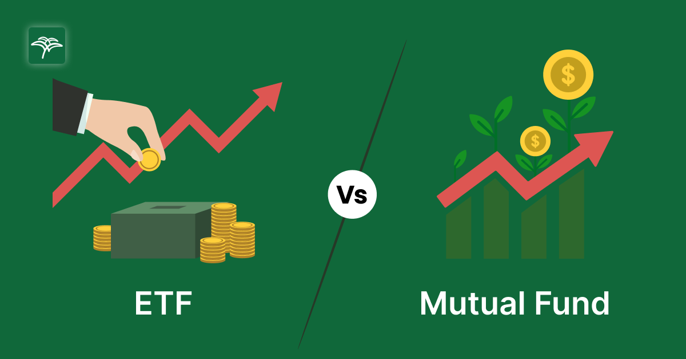
Mutual funds vs. ETFs management differences
Management style:
Mutual funds: Typically actively managed (higher cost)
ETFs: Typically passive (track performance of an index; lower cost)

Slide 15

Segregated funds
Offered by Canadian insurance companies
Mix of insurance + investment
Suited for conservative investors or those nearing retirement
Comes with a guarantee (75% to 100% of investment protected after ~10 years)

Slide 16

Private indirect investment vehicles: Hedge funds
Hedge funds aim for high returns through advanced strategies (e.g., short selling, leverage)
Requirements: Accredited investor status (high income/assets)
Less regulated than mutual funds

Slide 17

Choosing an investment vehicle
Factors to consider:
Goals (short-term vs. long-term)
Risk tolerance
Diversification across asset classes, geographies, sectors

Slide 18
Matching game
You have been each given a card: either a term, a definition, a key feature or an investor profile. Find your matching group of four! The first group to do so correctly, wins!

Slide 19
Gallery share
Each group will present their vehicle, definition, key feature and investor profile in a gallery share!

Slide 20
Reflect: Now that you understand the types of investment vehicle types, would you still agree with the investor type and investment vehicle that was given to you in the Minds On questionnaire?
Reflect on your handout!

