Slide 1
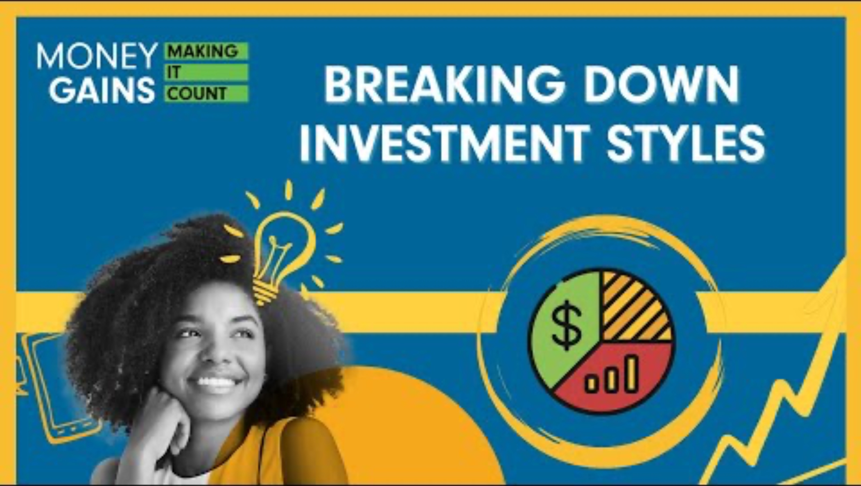
Different types of investment styles

Slide 2
Question:
Imagine you have $1,000 to invest. You can choose one of
three strategies:
(a) Pick stocks yourself and trade often.
(b) Buy a fund that matches the whole market.
(c) Use a computer program that chooses stocks based on data.
Discuss with your partner and be prepared to share!

Slide 3
Active investing
Analogy:
Management style:
Goal:
Fees:
Use of technology:
Share what you recorded in your chart!

Slide 4
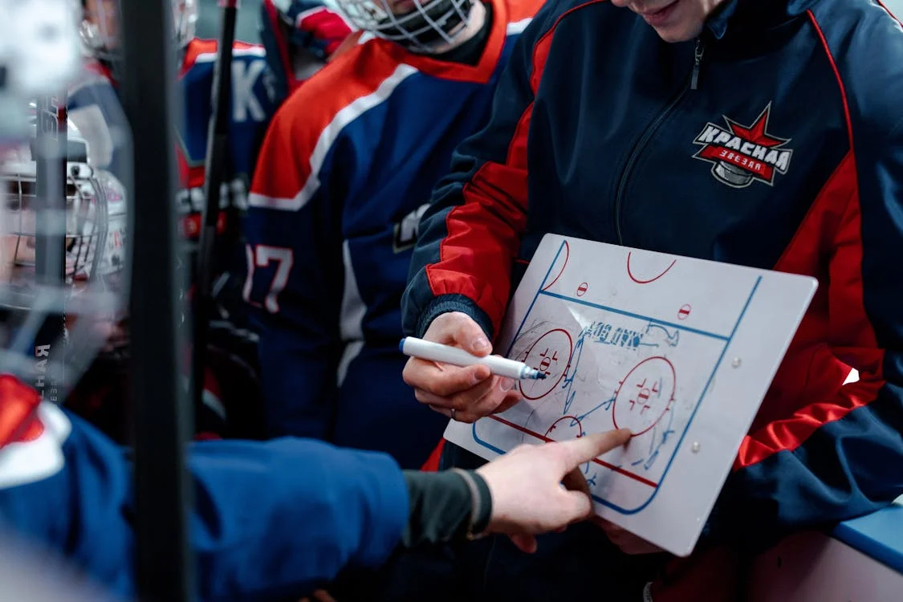
Active investing
Analogy: Like a hockey coach.
Management style:
hands-on approach
continuously buying and selling securities
managed by professionals
using research and expertise to manage
Goal: Outperform the market (beat the index).
Fees: High cost.
Use of technology: Limited.

Slide 5
What are bottom-up vs. top-down managers?

Slide 6


Bottom-up vs. top-down managers
Bottom-up managers
Focus on individual company financials.
Top-down managers
Focus on economic indicators (GDP, inflation, interest rates).

Slide 7
Passive investing
Analogy:
Management style:
Goal:
Fees:
Use of technology:
Share what you recorded in your chart!

Slide 8

Passive investing
Analogy: Like a gardener.
Management style:
long-term strategy; growth over-time
invest in index mutual funds or ETFs
Goal: Match market returns, not beat them.
Fees: Lower cost.
Use of technology: Minimal.

Slide 9
Systematic investing
Analogy:
Management style:
Goal:
Fees:
Use of technology:
Share what you recorded in your chart!

Slide 10

Systematic investing
Also known as quantitative investing.
Analogy: Like a robot.
Management style:
uses AI, machine learning and computer models to make decisions
focus on multiple factors (equity characteristics): size, value, momentum, quality
Goal: Have a diverse portfolio.
Fees: Low, like passive.
Use of technology: Heavy.

Slide 11
Summary
Active: Hands-on, higher cost, aims to outperform
Passive: Tracks index, lower cost
Systematic: Data-based, computer reliant, diversified, lower cost, can be active or passive

Slide 12
Activity - Debate!

Slide 13
Judges deliberate

Slide 14
Who won?

Slide 15
Consolidation: Independently reflect on what you learned today using the reflection sheet!

