Slide 1
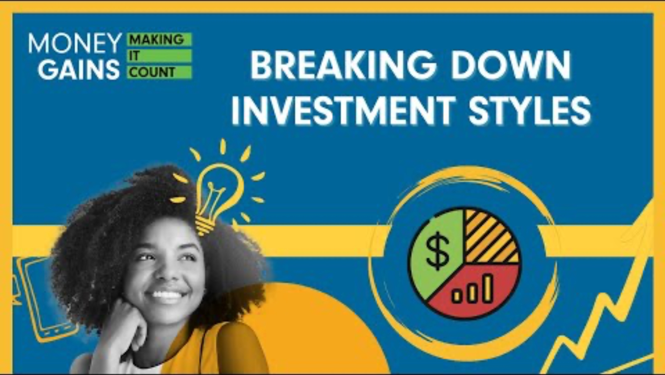
Different types of investment styles

Slide 2

Active investing
Hands-on approach.
Continually buying and selling securities.
Managed by professionals.
Using research and expertise to manage.
Constant buying/selling of securities.
Goal: Outperform the market (beat the index).
Typically involves higher management fees.

Slide 3


Bottom-up vs. top-down managers
Bottom-up managers
Focus on individual company financials.
Top-down managers
Focus on economic indicators (GDP, inflation, interest rates).

Slide 4

Passive investing
Long-term strategy; growth over-time.
Invest in index mutual funds or ETFs.
Goal: Match market returns, not beat them.
Match exposure by sector, geography or risk characteristics.
Rebalancing: buying and selling holdings to match the index.
Less decision making = Lower fees.

Slide 5

Systematic investing
Also known as quantitative investing.
Data driven: uses AI, machine learning and computer models to make decisions.
Focus on multiple factors (equity characteristics): size, value, momentum, quality.
More factors = more diverse portfolio.
Active (reliance on human oversight) and passive (reliance on computers).
Low cost due to less oversight.

Slide 6
Summary
Active: Hands-on, higher cost, aims to outperform
Passive: Tracks index, lower cost
Systematic: Data-based, computer reliant, diversified, lower cost, can be active or passive

Slide 7
Guess the investment style – Game!

Slide 8
Split into teams of three or four! Your job is to read each scenario and determine the best style of investment for the scenario and why! One point for the correct scenario and one point for a strong explanation! The team with the most points at the end wins!

Slide 9
Scenario 1
Chris wants to analyze a company’s balance sheet and financial reports in detail before investing. He’s comfortable making frequent trades based on performance and earnings.
Which investment style would be most appropriate, and why?

Slide 10
Scenario 1
Chris wants to analyze a company’s balance sheet and financial reports in detail before investing. He’s comfortable making frequent trades based on performance and earnings.
Which investment style would be most appropriate, and why?
Answer: Active
Reasoning: This fits a bottom-up, hands-on approach focused on company fundamentals.

Slide 11
Scenario 2
Jamie wants to invest in the overall stock market with minimal time commitment. They’re okay with matching market returns and prefer low fees.
Which investment style would be most appropriate, and why?

Slide 12
Scenario 2
Jamie wants to invest in the overall stock market with minimal time commitment. They’re okay with matching market returns and prefer low fees.
Which investment style would be most appropriate, and why?
Answer: Passive
Reasoning: Jamie doesn’t want to beat the market, just match it – classic passive investing.

Slide 13
Scenario 3
Taylor is tech-savvy and wants to invest using a computer-driven strategy. They are interested in using factors like momentum and quality to choose stocks.
Which investment style would be most appropriate, and why?

Slide 14
Scenario 3
Taylor is tech-savvy and wants to invest using a computer-driven strategy. They are interested in using factors like momentum and quality to choose stocks.
Which investment style would be most appropriate, and why?
Answer: Systematic
Reasoning: Taylor is using data-driven rules and factors, which is systematic investing.

Slide 15
Scenario 4
Morgan believes economic trends (like rising interest rates) signal which industries will do well. They want to shift investments based on these forecasts.
Which investment style would be most appropriate, and why?

Slide 16
Scenario 4
Morgan believes economic trends (like rising interest rates) signal which industries will do well. They want to shift investments based on these forecasts.
Which investment style would be most appropriate, and why?
Answer: Active
Reasoning: This is top-down analysis and involves hands-on decision-making.

Slide 17
Scenario 5
Dana wants to focus on investing in the technology sector and is looking for a low-cost, long-term option without making frequent changes.
Which investment style would be most appropriate, and why?

Slide 18
Scenario 5
Dana wants to focus on investing in the technology sector and is looking for a low-cost, long-term option without making frequent changes.
Which investment style would be most appropriate, and why?
Answer: Passive
Reasoning: Buying a sector-based ETF to match tech performance is a passive approach.

Slide 19
Scenario 6
Lee wants their portfolio to be managed by artificial intelligence using historical stock data, trends and computer models to
make decisions.
Which investment style would be most appropriate, and why?

Slide 20
Scenario 6
Lee wants their portfolio to be managed by artificial intelligence using historical stock data, trends and computer models to
make decisions.
Which investment style would be most appropriate, and why?
Answer: Systematic
Reasoning: Using AI and raw data for investing is part of systematic (quantitative) investing.

Slide 21
Scenario 7
Sasha reads economic reports and market news to decide which industries to invest in each quarter. They want to actively manage their portfolio based on this information.
Which investment style would be most appropriate, and why?

Slide 22
Scenario 7
Sasha reads economic reports and market news to decide which industries to invest in each quarter. They want to actively manage their portfolio based on this information.
Which investment style would be most appropriate, and why?
Answer: Active
Reasoning: Using broad economic data fits the top-down method in active investing.

Slide 23
Scenario 8
Pat is building a diversified portfolio using a model that prioritizes small companies with strong value scores. They want a balance of automation and control.
Which investment style would be most appropriate, and why?

Slide 24
Scenario 8
Pat is building a diversified portfolio using a model that prioritizes small companies with strong value scores. They want a balance of automation and control.
Which investment style would be most appropriate, and why?
Answer: Systematic
Reasoning: Using equity characteristics (size and value) and
models = systematic investing.

Slide 25
Scenario 9
Jordan wants to invest in as many stocks as possible to mimic
the entire market index and reduce risk. They plan to
rebalance occasionally.
Which investment style would be most appropriate, and why?

Slide 26
Scenario 9
Jordan wants to invest in as many stocks as possible to mimic
the entire market index and reduce risk. They plan to
rebalance occasionally.
Which investment style would be most appropriate, and why?
Answer: Passive
Reasoning: Replicating the index with periodic rebalancing is a passive strategy.

Slide 27
Scenario 10
Casey likes to study market trends, company performance and earnings calls. They believe they can beat the market by trading often and adjusting their portfolio as needed.
Which investment style would be most appropriate, and why?

Slide 28
Scenario 10
Casey likes to study market trends, company performance and earnings calls. They believe they can beat the market by trading often and adjusting their portfolio as needed.
Which investment style would be most appropriate, and why?
Answer: Active
Reasoning: Frequent trading based on expert judgment is the hallmark of active investing.

Slide 29
Who won?

Slide 30
Consolidation: Independently reflect on what you learned today using the reflection sheet!

