Slide 1
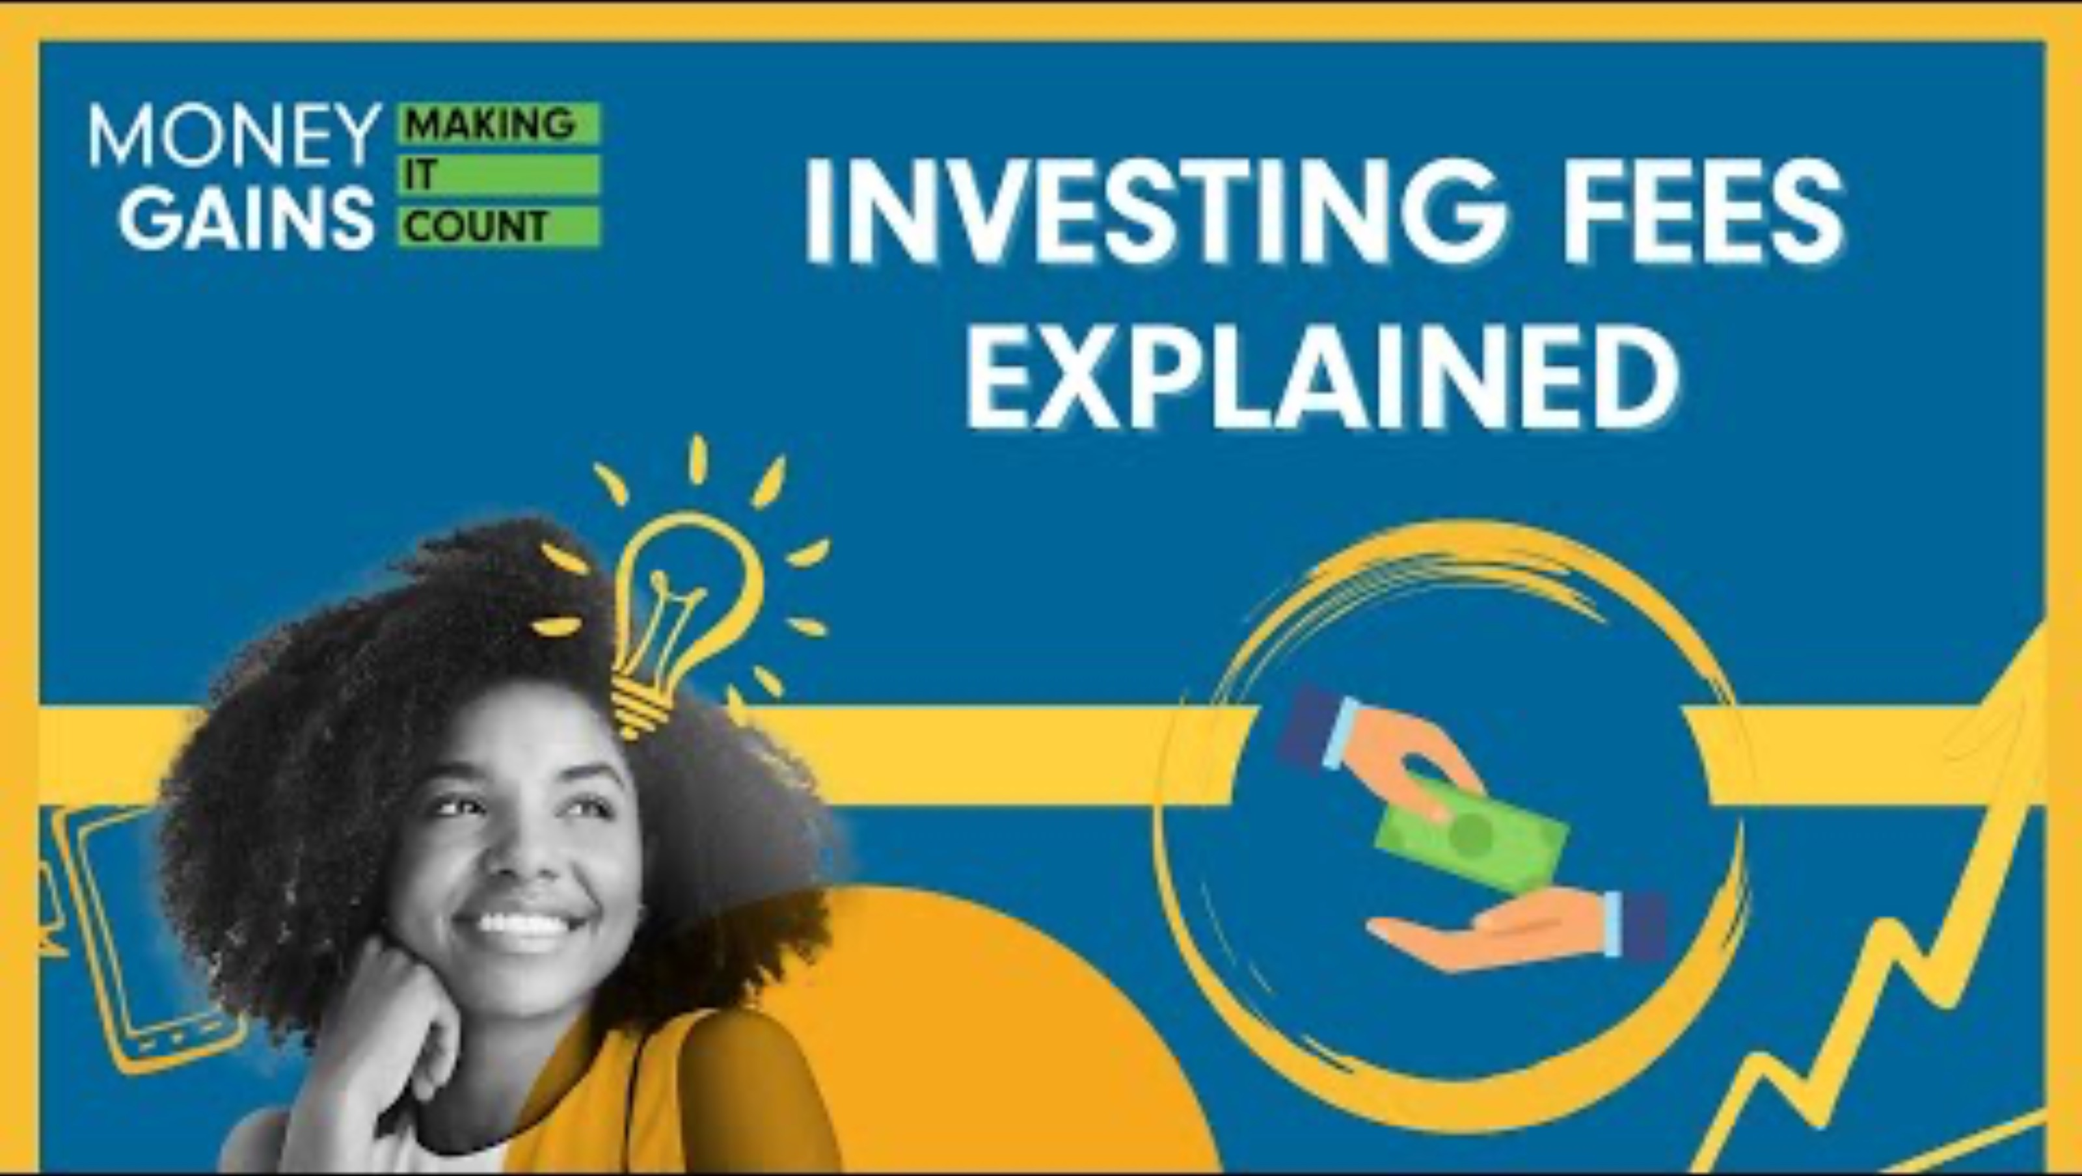
Investing fees explained

Slide 2
Learning objectives
Identify and explain the common types of fees associated with DIY (do-it-yourself) investing platforms, including
  commission fees
  maintenance fees
  withdrawal and inactivity fees
Differentiate between the types of sales commissions charged by financial advisors, including
  front-end load
  back-end load (deferred sales charge)
  level load fees
Understand the management expense ratio (MER) in mutual funds and ETFs, including its key components.
Recognize the role of brokers in both DIY and advisor-assisted investing, and compare brokerage fee structures (e.g., commission-based vs. commission-free platforms).
Analyze key considerations when managing investment costs.
Apply knowledge of fees and tax rules to make informed decisions that help maximize investment returns over time.

Slide 3
Watch the video and complete the Venn diagram as you watch! What fees belong to DIY, financial advisors or both?

Slide 4
Investing fees explained

Slide 5
Minds on: Create a Venn diagram that places all the investment fees in the correct spot.

Slide 6
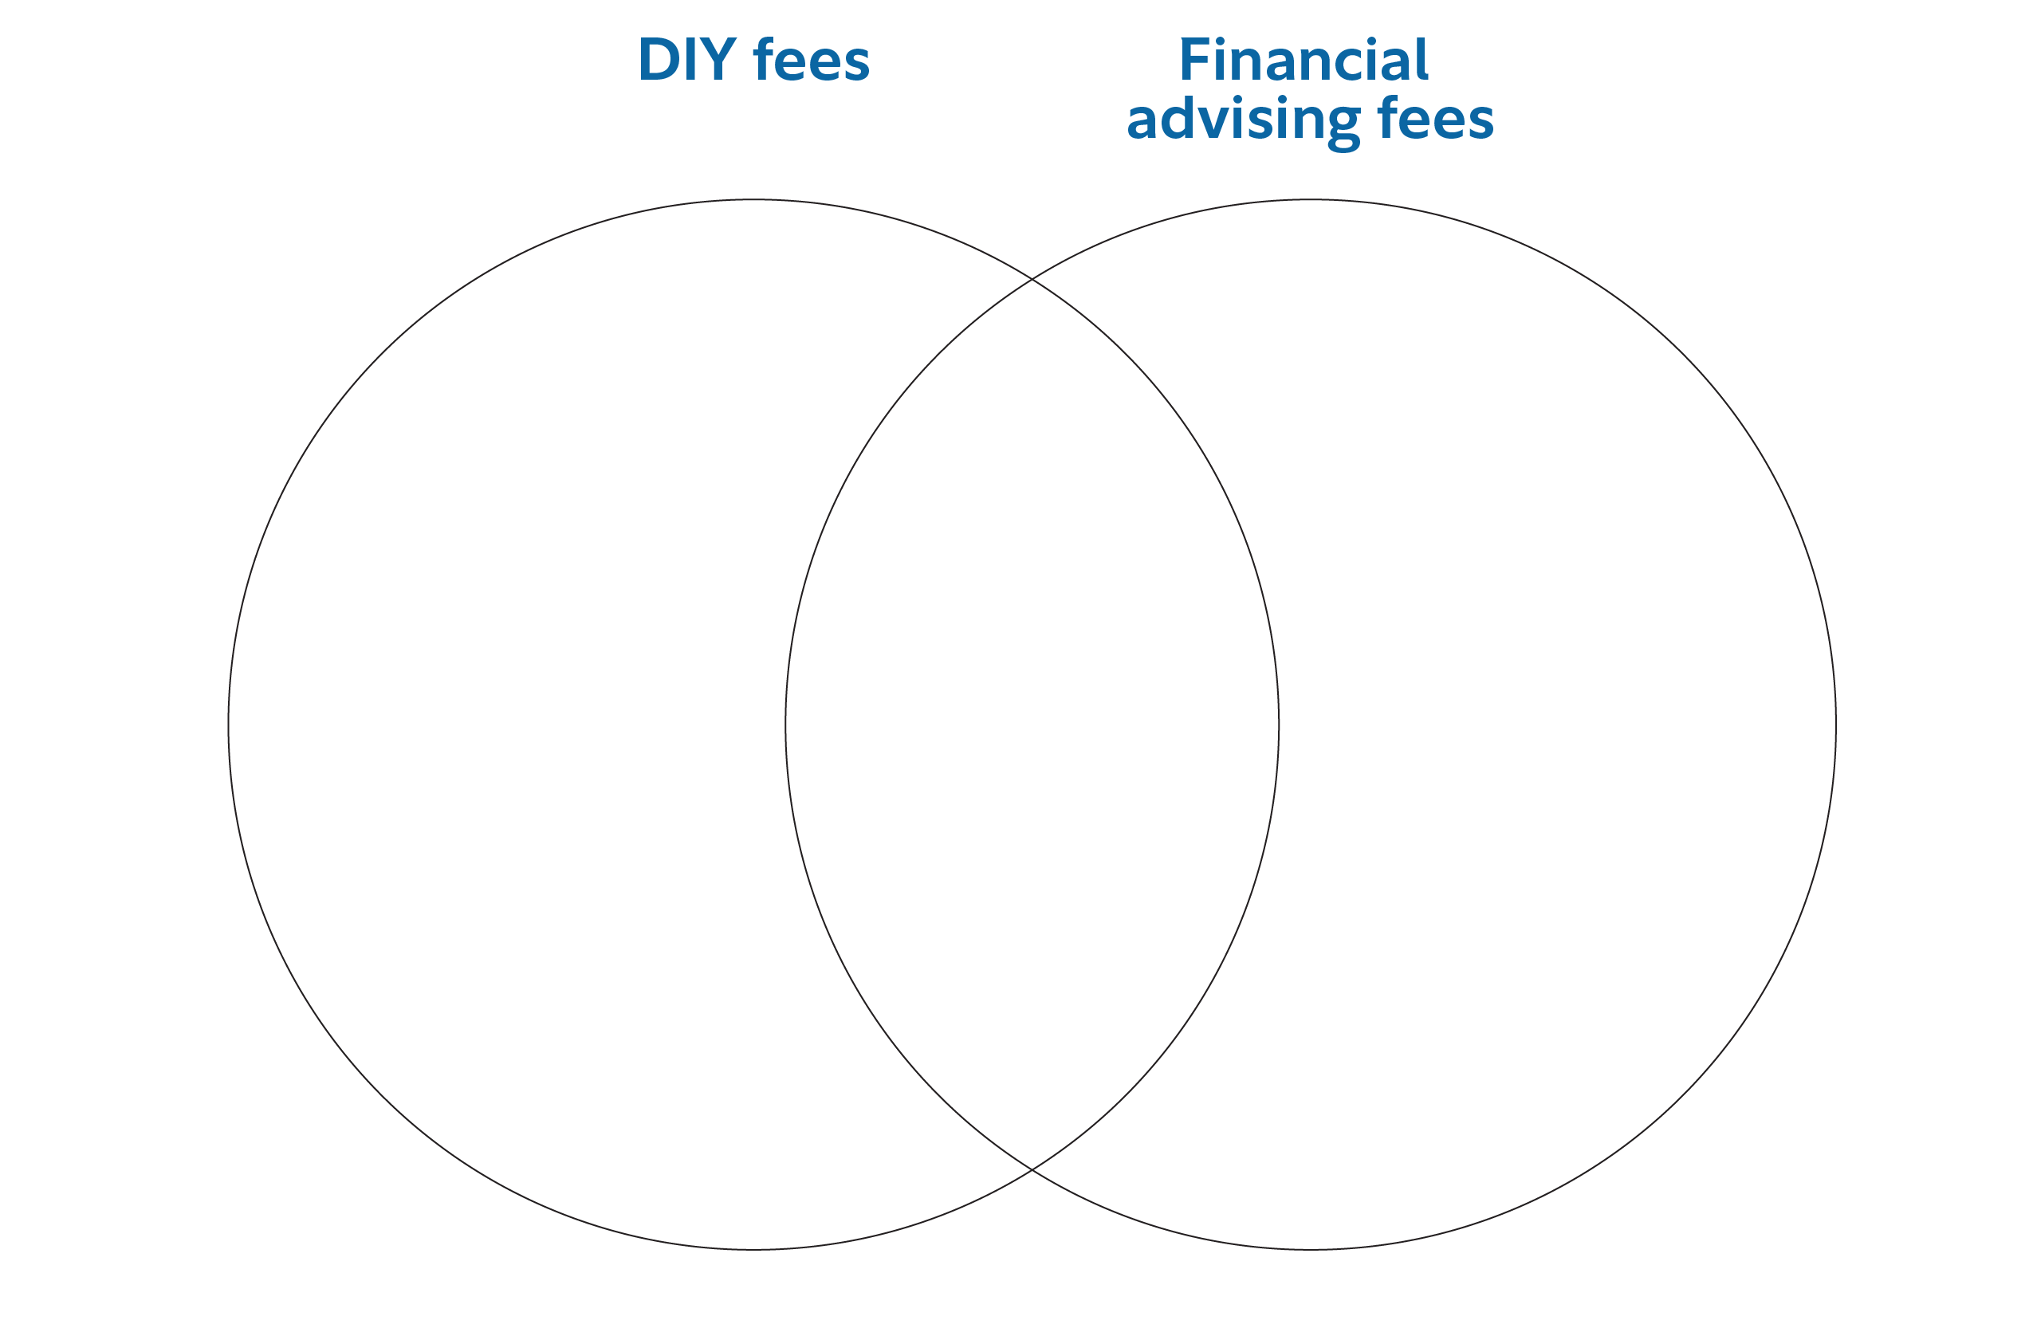
Minds on: Create a Venn diagram that places all the investment fees in the correct spot.

Slide 7
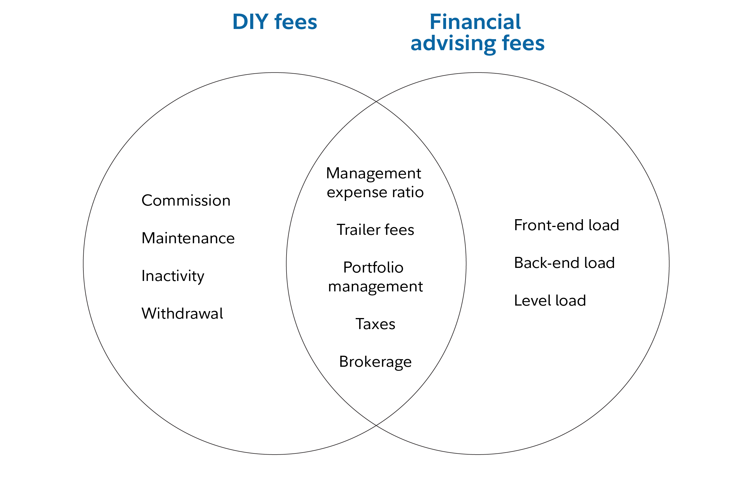
Minds on: Create a Venn diagram that places all the investment fees in the correct spot.

Slide 8
Scenario: You bought a stock and paid $5 for each transaction you made.
Question: What type of fee is this?
A) Withdrawal fee
B) Commission fee
C) Maintenance fee

Slide 9
Scenario: You bought a stock and paid $5 for each transaction you made.
Question: What type of fee is this?
A) Withdrawal fee
B) Commission fee
C) Maintenance fee

Slide 10

Commission fees
Commission fee: charged every time you buy or sell a financial asset. Some platforms offer a certain number of free trades per month.

Slide 11
You are charged a fee every quarter just to keep your investment account open, even if you don’t make any trades. What kind of fee is this?
A) Front-end load
B) Withdrawal fee
C) Maintenance fee

Slide 12
You are charged a fee every quarter just to keep your investment account open, even if you don’t make any trades. What kind of fee is this?
A) Front-end load
B) Withdrawal fee
C) Maintenance fee

Slide 13

Maintenance fees
Maintenance fee: charged for holding your account, especially if your balance falls below a certain amount. Often charged monthly or annually.

Slide 14
Scenario: You decide to pull your money out of your investment account, and you’re charged a $30 fee for doing so.
Question: What type of fee is this?
A) Withdrawal fee
B) Inactivity fee
C) Back-end load

Slide 15
Scenario: You decide to pull your money out of your investment account, and you’re charged a $30 fee for doing so.
Question: What type of fee is this?
A) Withdrawal fee
B) Inactivity fee
C) Back-end load

Slide 16

Withdrawal fee
Withdrawal fee: charged when you take money out of your account.

Slide 17
You didn’t make any trades for six months, and now your platform charges you a penalty.
Question: What is this fee called?
A) Inactivity fee
B) Withdrawal fee
C) Level load fee

Slide 18
You didn’t make any trades for six months, and now your platform charges you a penalty.
Question: What is this fee called?
A) Inactivity fee
B) Withdrawal fee
C) Level load fee

Slide 19

Inactivity fee
Inactivity fee: charged when you don’t make trades for a certain period.

Slide 20
Every time you buy or sell a stock, you pay $10.
Question: What type of fee is this?
A) Management fee
B) Back-end load
C) Transaction fee

Slide 21
Every time you buy or sell a stock, you pay $10.
Question: What type of fee is this?
A) Management fee
B) Back-end load
C) Transaction fee

Slide 22

Transaction fees
Transaction fee: charged when advisors make trades on your behalf.

Slide 23
You invest $1,000 in a mutual fund, but 3% is taken out right away as a sales charge. What kind of fee is this?
A) Back-end load
B) Trailer fee
C) Front-end load

Slide 24
You invest $1,000 in a mutual fund, but 3% is taken out right away as a sales charge. What kind of fee is this?
A) Back-end load
B) Trailer fee
C) Front-end load

Slide 25

Front-end load
Front-end load: charged when you purchase units of funds and is deducted from your initial investment.

Slide 26
You sell your mutual fund units and are charged a fee because you sold too soon.
Question: What is this fee called?
A) Back-end load
B) Management expense ratio
C) Maintenance fee

Slide 27
You sell your mutual fund units and are charged a fee because you sold too soon.
Question: What is this fee called?
A) Back-end load
B) Management expense ratio
C) Maintenance fee

Slide 28

Back-end load
Back-end load: charged when you sell units in a fund; usually decreases over time.

Slide 29
You’re charged an ongoing annual fee just for staying invested in a fund.
Question: This fee is called:
A) Inactivity fee
B) Level load
C) Transaction fee

Slide 30
You’re charged an ongoing annual fee just for staying invested in a fund.
Question: This fee is called:
A) Inactivity fee
B) Level load
C) Transaction fee

Slide 31

Level load
Level load: an ongoing sales commission charged annually, like a subscription fee.

Slide 32
Scenario: You’re investing in a mutual fund and you pay a 2% fee yearly for managing the fund.
Question: What type of fee is this?
A) Mutual earning return
B) Management expense ratio
C) Market equity return

Slide 33
Scenario: You’re investing in a mutual fund and you pay a 2% fee yearly for managing the fund.
Question: What type of fee is this?
A) Mutual earning return
B) Management expense ratio
C) Market equity return

Slide 34

Management expense ratio
MER stands for management expense ratio.
Covers the cost of running the fund, including administration, marketing and other expenses.
Example: If a fund’s MER is 2.5% and you invest $10,000, the annual fee would be $250.
The three main components of the MER are
  trailer fee (paid to the investment dealer)
  taxes (such as GST and HST)
  portfolio management fee (covers research, trading and risk management)

Slide 35
Your broker helps execute trades and charges you either a flat fee or a percentage of the transaction. What is this called?
A) Brokerage fee
B) Tax fee
C) Trailer fee

Slide 36
Your broker helps execute trades and charges you either a flat fee or a percentage of the transaction. What is this called?
A) Brokerage fee
B) Tax fee
C) Trailer fee

Slide 37

Brokerage fees
Brokers help organize and perform trades in the stock market.
Brokerage fees can be based on a percentage of the transaction, a flat fee or a hybrid of both.
Some online platforms offer commission-free trading, but may charge other fees, like account maintenance.

Slide 38
True or false: The more you move your money around, the more you save on fees.

Slide 39
True or false: The more you move your money around, the more you spend on fees.

Slide 40
In Canada, how much is taxed on capital gains?
A) 50%
B) 25%
C) 75%
D) 10%

Slide 41
In Canada, how much is taxed on capital gains?
A) 50%
B) 25%
C) 75%
D) 10%

Slide 42

Considerations when managing investment costs
Moving your money frequently can increase your transaction costs.
In Canada, 50% of any capital gains are taxable.
If you buy a stock for $500 and sell it for $800, your taxable gain is $150.
Using tax-deferred or tax-exempt accounts can help reduce tax costs.
Understanding the various fees involved in investing helps you make informed decisions and keep more of your returns.
Managing fees and taxes effectively is key to maximizing your investment returns over time.

Slide 43
Activity time:
Fee or free scavenger hunt

Slide 44
Instructions
Get into teams of two to four! Each team will get a team scavenger hunt worksheet.
Cards with different fees are spread out around the room. Your team’s job is to locate each card and fill in the questions on the worksheet. You must show your work!
You must come back to me after each card is completed before finding your next card! Hide your finished card where you found it for the next group!
The first group to complete the entire worksheet wins!

Slide 45
Scenario presentation
Present the answers to your first scenario from the scavenger hunt!

Slide 46
Reflection
Which fees were the most costly?
How would an investor’s strategy change if they were more aware of the fees associated with their investments?
What strategies can we use to avoid or reduce fees?

