Slide 1
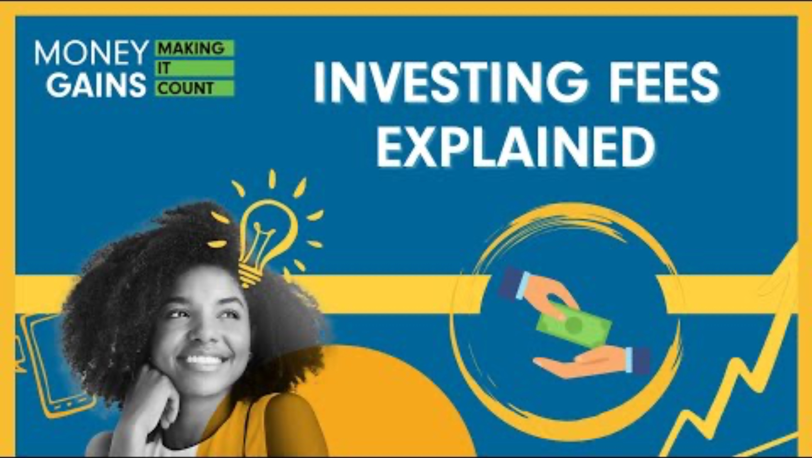
Investing fees explained

Slide 2
Learning objectives
Identify and explain the common types of fees associated with DIY (do-it-yourself) investing platforms, including
  commission fees
  maintenance fees
  withdrawal and inactivity fees
Differentiate between the types of sales commissions charged by financial advisors, including
  front-end load
  back-end load (deferred sales charge)
  level load fees
Understand the management expense ratio (MER) in mutual funds and ETFs, including its key components.
Recognize the role of brokers in both DIY and advisor-assisted investing, and compare brokerage fee structures (e.g., commission-based vs. commission-free platforms).
Analyze key considerations when managing investment costs.
Apply knowledge of fees and tax rules to make informed decisions that help maximize investment returns over time.

Slide 3
Minds on: Create a Venn diagram that places all the investment fees in the correct spot.

Slide 4
Investing fees explained

Slide 5

Commission fees
Commission fee: charged every time you buy or sell a financial asset. Some platforms offer a certain number of free trades per month.

Slide 6

Maintenance fees
Maintenance fee: charged for holding your account, especially if your balance falls below a certain amount. Often charged monthly or annually.

Slide 7

Withdrawal fee
Withdrawal fee: charged when you take money out of your account.

Slide 8

Inactivity fee
Inactivity fee: charged when you don’t make trades for a certain period.

Slide 9

Transaction fees
Transaction fee: charged when advisors make trades on your behalf.

Slide 10

Front-end load
Front-end load: charged when you purchase units of funds and is deducted from your initial investment.

Slide 11

Back-end load
Back-end load: charged when you sell units in a fund; usually decreases over time.

Slide 12

Level load
Level load: an ongoing sales commission charged annually, like a subscription fee.

Slide 13

Management expense ratio
MER stands for management expense ratio.
Covers the cost of running the fund, including administration, marketing and other expenses.
Example: If a fund’s MER is 2.5% and you invest $10,000, the annual fee would be $250.
The three main components of the MER are
  trailer fee (paid to the investment dealer)
  taxes (such as GST and HST)
  portfolio management fee (covers research, trading and risk management)

Slide 14

Brokerage fees
Brokers help organize and perform trades in the stock market.
Brokerage fees can be based on a percentage of the transaction, a flat fee or a hybrid of both.
Some online platforms offer commission-free trading, but may charge other fees, like account maintenance.

Slide 15

Considerations when managing investment costs
Moving your money frequently can increase your transaction costs.
In Canada, 50% of any capital gains are taxable.
If you buy a stock for $500 and sell it for $800, your taxable gain is $150.
Using tax-deferred or tax-exempt accounts can help reduce tax costs.
Understanding the various fees involved in investing helps you make informed decisions and keep more of your returns.
Managing fees and taxes effectively is key to maximizing your investment returns over time.

Slide 16
Fee detective activity
Each group will act as “fee detectives” for their assigned investor and will
Step 1: Identify and calculate all applicable fees (commissions, MER, account fees, trailer loads, withdrawal fees, taxes).
Step 2: Calculate total fees paid this year for their investor profile.
Step 3: Analyze and recommend cost-saving strategies to reduce
those fees.
Step 4: Answer the reflection question for their profile to investigate potential savings.

Slide 17
Presentation
Prepare a chart paper, whiteboard or slideshow to present your findings!
Ensure that each member of your team speaks equally.

Slide 18
Which profile faced the highest costs?

Slide 19
Highest fees: Profile 6: Retirement Rita
Total fees: $3,700
Why so high?
Large mutual fund investment with high MER (2%).
Front-end load (2%) on the entire $80,000.
Ongoing trailer fees and withdrawal/account fees.
RRSP withdrawals are taxable as income.

Slide 20
Which strategies were most effective in reducing fees?

Slide 21
Which strategies were most effective in reducing fees?
1. Switching to lower-cost ETFs (DIY Dana and Active Trader Asha)
Asha saved $250 in the reflection boost simply by reducing trades and using commission-free ETFs instead of paid stock trades.
Dana could also save by watching for platform fees, avoiding too-frequent trading and using ETFs instead of stocks to reduce both commissions and possible future MERs.

Slide 22
Which strategies were most effective in reducing fees?
2. Avoiding front-end and back-end loads (Mutual Fund Max and Balanced Bob)
If Max chose no-load funds or low-MER ETFs, he could avoid the initial $750 front-end load and save hundreds annually on MERs.
Bob would avoid the 5% back-end load by staying invested longer or switching to no-load options.

Slide 23
Which strategies were most effective in reducing fees?
3. Negotiating or choosing flat-fee advisors (Advised Alice)
Alice could save by
choosing an advisor with a flat annual fee rather than percentage-based trailer fees
moving to a platform that charges less in transaction and trailer costs
using fee-based advice rather than commission-based products

Slide 24
Which strategies were most effective in reducing fees?
4. Reducing high MERs (Retirement Rita)
Rita faced huge costs mainly because of the 2% MER and front-end load.
By moving her funds into low-fee index funds or ETFs (MERs under 0.5%), she could save thousands yearly, which is especially critical now that she’s withdrawing from her account.
Also, consolidating accounts to avoid account maintenance fees would help.

Slide 25
Final insights
Profiles using RRSPs (Asha, Alice, Rita) face deferred taxes but must pay tax upon withdrawal (as Rita did).
TFSA profiles (like Dana) are tax-free, which helped keep her costs lower overall despite trading.
Non-registered accounts (Max, Bob) face capital gains tax and should be extra careful with fees and loads.

