Slide 1
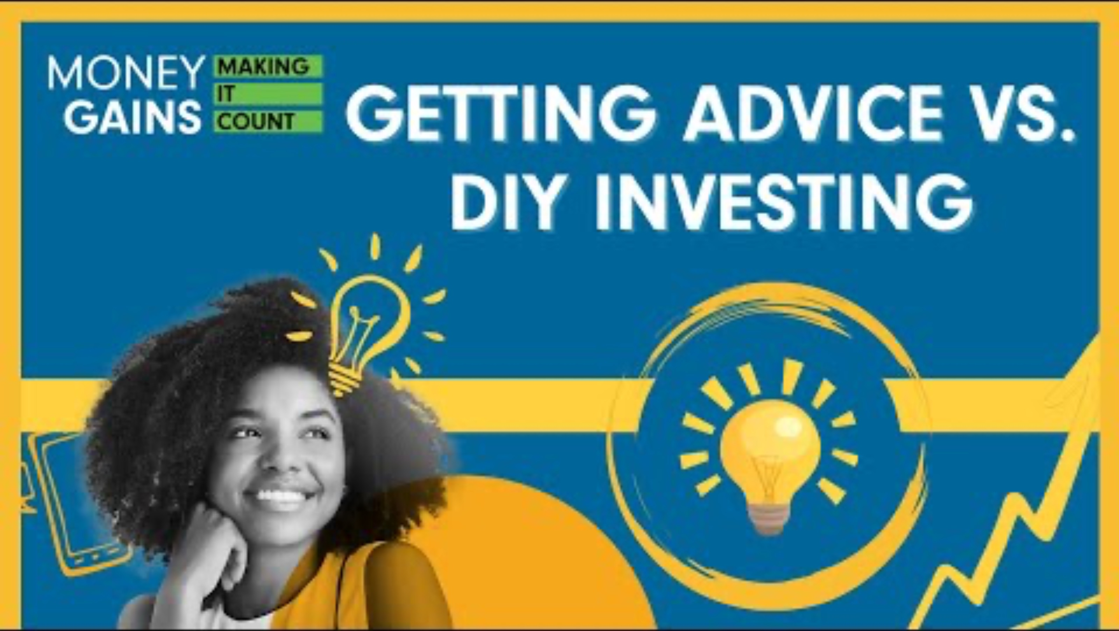
Getting advice versus investing yourself

Slide 2
Learning objectives
Compare the key features of DIY investing and investing with a financial advisor, including control, costs, time commitment and risk.
Analyze the advantages and disadvantages of both investing strategies using relevant financial vocabulary and concepts.
Develop and present a persuasive argument in support of one investment approach (DIY or advisor), using evidence and oral communication skills.
Reflect on personal preferences, financial goals and knowledge to determine which investment method aligns best with a person’s needs.
Collaborate effectively with peers to research, plan and participate in a structured class debate.
Demonstrate understanding of basic financial literacy concepts such as portfolio management, risk tolerance and investment decision-making.

Slide 3
Minds on!
Instructions: Using the template below, or a blank sheet of paper, create a mindmap with the topic “Questions I should ask before investing” in the centre. From the central question, create at least three questions for each category; About me, About investment, About the world. Place a star next to the questions that you could ask yourself (DIY Investing) and a square next to the questions you would need to ask a financial advisor.
Then the class will take up their ideas!

Slide 4
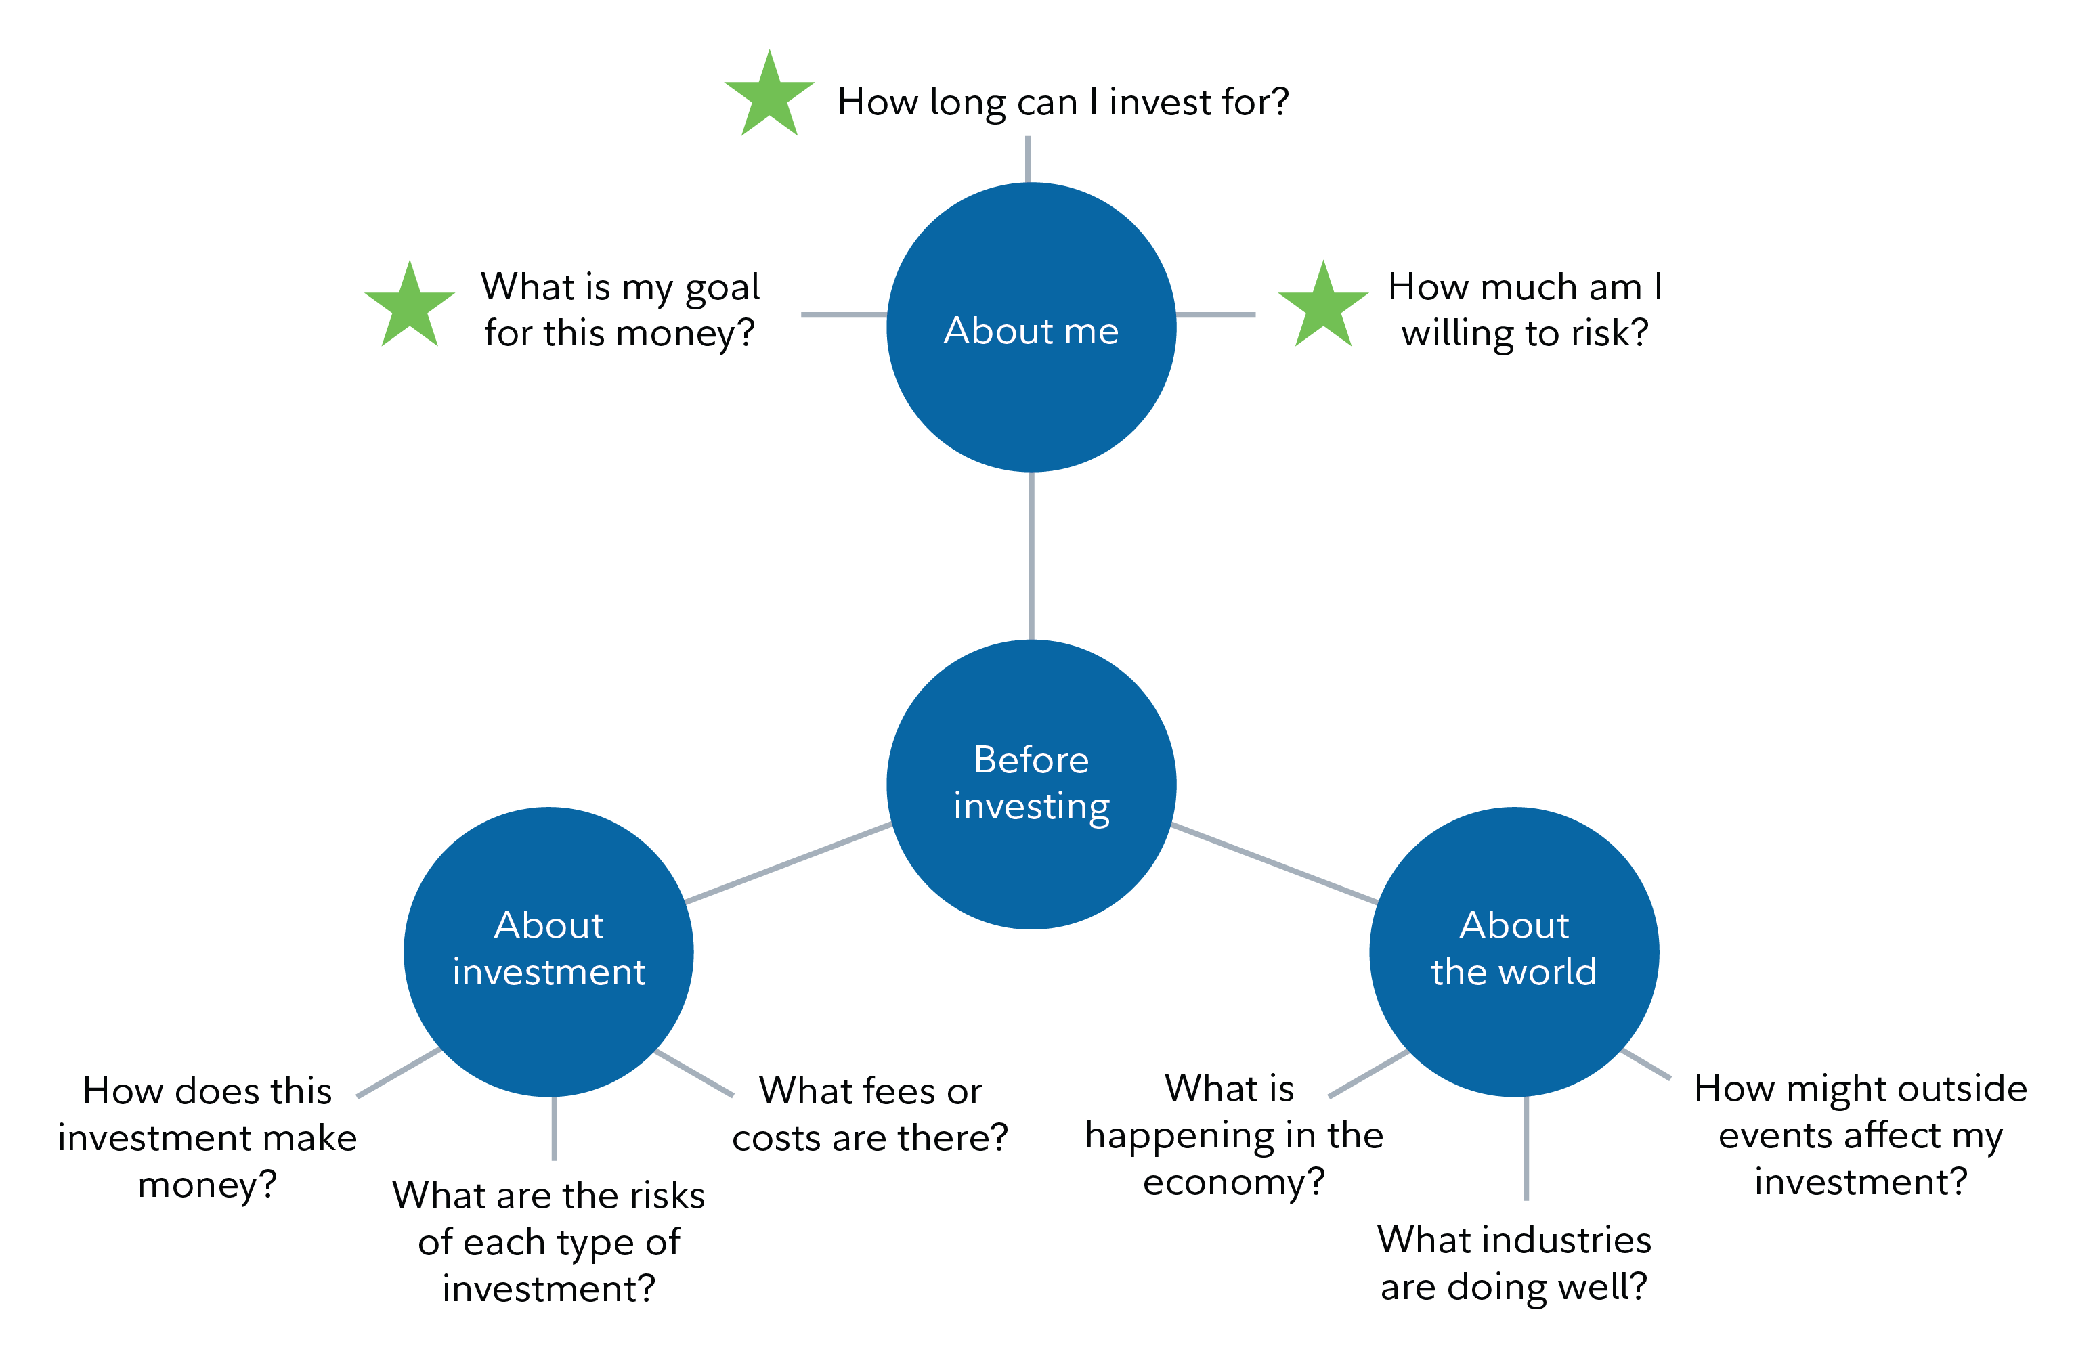
Sample mind map

Slide 5
Questions to consider when investing
What is my time horizon? (When will I need to use this money?)
What is my risk tolerance? (Am I comfortable with big ups and downs, or do I prefer stability?)
What are my personal goals? (Am I saving for retirement, a home, education, a trip?)
What is my level of investment knowledge? (Do I fully understand what I’m investing in?)
What types of investments fit my goals and comfort level? (Stocks, bonds, mutual funds, real estate, ETFs?)
How much money am I willing to invest – and possibly lose? (Am I prepared emotionally and financially for potential losses?)
Do I prefer to manage my investments myself or get help from a professional? (Do I have the time and experience to manage my investments on my own?)
Am I making this investment decision emotionally or logically? (Am I chasing a trend, or following a sound plan?)

Slide 6
Lesson time!
Lets watch the “Getting advice vs. DIY investing” video and take notes as you watch.
Then we will answer questions and see how much we remembered.

Slide 7
Fidelity video: Getting advice vs. DIY investing

Slide 8
What is DIY investing?
Which of the following best describes DIY (do-it-yourself) investing?
A) Investing only in government bonds and savings accounts with the help of a
bank advisor.
B) Using an online platform to choose and manage your own investments without a financial advisor.
C) Hiring a professional to create and monitor your investment portfolio.
D) Buying stocks recommended by your friends or family without doing any research.

Slide 9
What is DIY investing?
Which of the following best describes DIY (do-it-yourself) investing?
A) Investing only in government bonds and savings accounts with the help of a
bank advisor.
B) Using an online platform to choose and manage your own investments without a financial advisor.
C) Hiring a professional to create and monitor your investment portfolio.
D) Buying stocks recommended by your friends or family without doing any research.

Slide 10

What is DIY investing?
DIY = do it yourself.
Choose your own investments.
Control the investments.
Build and manage your own portfolio.

Slide 11
What is a portfolio?
A) A certificate you receive when you invest money.
B) A list of people you consult before making financial decisions.
C) A document that tracks your spending and saving habits.
D) A collection of different investments, like stocks, bonds and real estate, owned by an investor.

Slide 12
What is a portfolio?
A) A certificate you receive when you invest money.
B) A list of people you consult before making financial decisions.
C) A document that tracks your spending and saving habits.
D) A collection of different investments, like stocks, bonds and real estate, owned by an investor.

Slide 13

What is a portfolio?
A collection of investments (stocks, funds, real estate) that is based on
Time horizon: how long an investor plans to keep their money invested before they need to use it.
Risk tolerance: how comfortable an investor is with the possibility of losing money or experiencing big ups and downs in their investments.
Personal preferences: an investor’s individual choices about what they want to invest in, based on their interests, values or comfort with different types of investments.
Investment knowledge: how much an investor understands about financial markets, investment products and how investing works.
Example: Someone saving for retirement vs. someone saving for a vacation.

Slide 14
Discount brokerages
What is the main purpose of a discount brokerage?
A) To allow investors to buy and sell stocks, bonds and ETFs at a lower fee.
B) To guarantee investment returns for DIY investors.
C) To provide free financial advice and investment management.
D) To connect investors with professional money managers.

Slide 15
Discount brokerages
What is the main purpose of a discount brokerage?
A) To allow investors to buy and sell stocks, bonds and ETFs at a lower fee.
B) To guarantee investment returns for DIY investors.
C) To provide free financial advice and investment management.
D) To connect investors with professional money managers.

Slide 16

Discount brokerages
Online platform.
Buy and sell investments and exchange-traded funds (ETFs).
Use tools:
Stock screeners.
Financial news sites.
Common platforms (Questrade, Wealthsimple, Robinhood).

Slide 17
Pros of DIY investing
Which of the following is an advantage (pro) of DIY investing?
A) You must commit more time to researching and monitoring your investments.
B) You can potentially save money by avoiding advisor fees.
C) All the responsibility is on you as the investor.
D) There is a steep learning curve for understanding markets and strategies.

Slide 18
Pros of DIY investing
Which of the following is an advantage (pro) of DIY investing?
A) You must commit more time to researching and monitoring your investments.
B) You can potentially save money by avoiding advisor fees.
C) All the responsibility is on you as the investor.
D) There is a steep learning curve for understanding markets and strategies.

Slide 19

Pros of DIY investing
More direct control over investments.
Save money by avoiding advisor fees.
Flexibility to change your strategy at any time.

Slide 20
Cons of DIY investing
Which of the following is a challenge (con) of DIY investing?
A) Being able to change your strategy at any time.
B) Saving money by avoiding advisor fees.
C) Having total control over your investments.
D) Needing to spend time researching and monitoring your investments.

Slide 21
Cons of DIY investing
Which of the following is a challenge (con) of DIY investing?
A) Being able to change your strategy at any time.
B) Saving money by avoiding advisor fees.
C) Having total control over your investments.
D) Needing to spend time researching and monitoring your investments.

Slide 22

Cons of DIY investing
Commit more time to researching and monitoring your investments.
Full responsibility is on you as the investor.
Learning curve, as understanding markets takes time.
Less experienced individuals have a higher potential for mistakes.
May face emotional and psychological stress.

Slide 23
What is a financial advisor?
What does a financial advisor do?
A) Offers guidance based on your financial goals and risk tolerance.
B) Guarantees high returns with no risk.
C) Only helps with filing taxes.
D) Sells you stocks without offering any advice.

Slide 24
What is a financial advisor?
What does a financial advisor do?
A) Offers guidance based on your financial goals and risk tolerance.
B) Guarantees high returns with no risk.
C) Only helps with filing taxes.
D) Sells you stocks without offering any advice.

Slide 25
What are the pros of a financial advisor?
One benefit of working with a financial advisor is
A) They remove all risks from investing.
B) They help you stay calm during market ups and downs.
C) They control all your financial decisions without your input.
D) They offer their services free of charge.

Slide 26
What are the pros of a financial advisor?
One benefit of working with a financial advisor is
A) They remove all risks from investing.
B) They help you stay calm during market ups and downs.
C) They control all your financial decisions without your input.
D) They offer their services free of charge.

Slide 27

What is a financial advisor?
Provides personalized guidance based on your goals.
Helps with
learning investing principles
making complex financial decisions
building and monitoring your portfolio
staying calm during market ups and downs

Slide 28
What are the cons of a financial advisor?
What is one disadvantage of working with a financial advisor?
A) They offer personalized guidance based on your goals.
B) They charge fees that can reduce your investment returns.
C) They help you stay calm during market ups and downs.
D) They guarantee higher returns than DIY investing.

Slide 29
What are the cons of a financial advisor?
What is one disadvantage of working with a financial advisor?
A) They offer personalized guidance based on your goals.
B) They charge fees that can reduce your investment returns.
C) They help you stay calm during market ups and downs.
D) They guarantee higher returns than DIY investing.

Slide 30
True or false?
True or false: It doesn't matter which financial advisor
you use

Slide 31
True or false?
False: It's important to find an advisor you trust and that understands your risk tolerance, goals and market conditions

Slide 32

Cons of financial advisors
Comes with a fee.
Less personal control over investments.
Must find someone trustworthy and qualified.

Slide 33
What are the three factors that help determine which method to use, DIY or financial advising?

Slide 34

Which strategy is best?
Depends on
personal preferences
level of experience
financial goals

Slide 35
When is it good to choose DIY investing? When it is ideal to use a financial advisor?

Slide 36
Which strategy is best?
DIY is good if you want full control.
Advisor is good if you want support and to save time.

Slide 37
Activity time!
Debate: DIY vs. financial advising

Slide 38
Instructions
Students are split randomly into three groups:
  Team DIY investing
  Team financial advisor
  Team judges (3-4 students)
Objective: “Today, you’re going to defend one of these approaches in a friendly battle. Your mission: Convince the judges your approach is the smartest way to invest!”
Students have ten minutes to prepare their debate using the debate handout.

Slide 39
Debate time!
Students have 15 minutes to debate. Remember to be respectful: evidence-based debate, with no interruptions or personal attacks!
  Opening statements: Each team presents its statements (one minute each).
  Arguments: Each team will present one argument at a time, two arguments total (two minutes each).
  Rebuttals: Each team responds to the other’s points, two total (two minutes each).
  Closing Statements: Each team summarizes why its method wins (one minute each).
Judges will use their scoring sheet to see which team will win the debate!

Slide 40
Judges: Pick a winner!
Judges will choose a winner based on the scoring sheet and share feedback with each group to explain their scoring.

Slide 41
Reflection time!

Slide 42
Was there a “perfect” option?

Slide 43
What kinds of investors might prefer DIY? Who might prefer advisors?

Slide 44
How important is it to know yourself when choosing?

Slide 45
Self-reflection
Students will now complete a self-assessment using the self-reflection handout.

