Slide 1

Types of stock orders

Slide 2
Minds on!
“Imagine you’ve saved up $500 and want to invest in Kicks Unlimited stock. The price is jumping around between $48 and $55. Would you buy now, wait, or protect yourself in some way?”
“How would you make sure you don’t pay too much?”
“What if the price drops suddenly after you buy?”

Slide 3
Today we’re going to explore five stock order types using a price chart, and you’ll get to visually map out how they work.

Slide 4
Types of stock orders: fill in your Handout as you watch!

Slide 5
Quiz Time!
What does a market order do?
A) Buys or sells stock only if a specific price is reached
B) Buys or sells stock immediately at the next available price
C) Automatically cancels if the price fluctuates too quickly
D) Waits until the market closes before executing

Slide 6
Quiz Time!
What does a market order do?
A) Buys or sells stock only if a specific price is reached
B) Buys or sells stock immediately at the next available price
C) Automatically cancels if the price fluctuates too quickly
D) Waits until the market closes before executing

Slide 7

Market orders
Buy/sell immediately at next available price
Fast execution, guaranteed fill
Price uncertain (depends on bid/ask)
Example: Buy Kicks Unlimited at ~$50/share

Slide 8
Quiz Time!
When does a limit order execute?
A) Buys or sells stock only if a specific price is reached
B) Buys or sells stock immediately at the next available price
C) Automatically cancels if the price fluctuates too quickly
D) Waits until the market closes before executing

Slide 9
Quiz Time!
When does a limit order execute?
A) Buys or sells stock only if a specific price is reached
B) Buys or sells stock immediately at the next available price
C) Automatically cancels if the price fluctuates too quickly
D) Waits until the market closes before executing

Slide 10
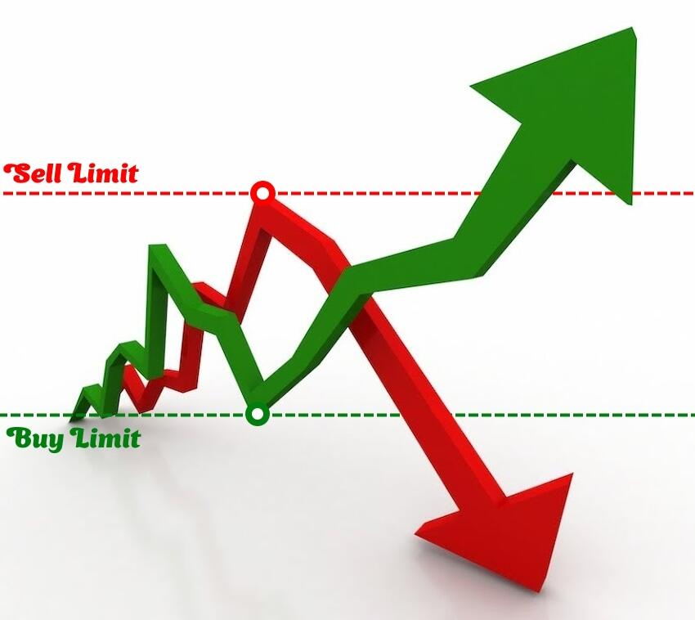
Limit orders
Set max buy price or minimum sell price
Only execute if price hits limit or better
Control over price, no guarantee of fill
Example: Buy Kicks Unlimited only if ≤ $45

Slide 11
What are broker fees?
A) Discounts given by brokers on stock prices
B) Charges for placing orders
C) The difference between buying and selling prices
D) The time your order remains active

Slide 12
What are broker fees?
A) Discounts given by brokers on stock prices
B) Charges for placing orders
C) The difference between buying and selling prices
D) The time your order remains active

Slide 13
What is the bid-ask spread?
A) The difference between the highest price buyers will pay and the lowest price sellers will accept
B) The fee brokers charge for each trade
C) The time limit on how long an order is valid
D) The total number of shares available for trading

Slide 14
What is the bid-ask spread?
A) The difference between the highest price buyers will pay and the lowest price sellers will accept
B) The fee brokers charge for each trade
C) The time limit on how long an order is valid
D) The total number of shares available for trading

Slide 15
How can the order duration affect your trade?
A) It changes the stock’s price on the market
B) It guarantees a market order will be filled immediately
C) It determines how many shares you can buy
D) It influences fees and the chance your order gets executed

Slide 16
How can the order duration affect your trade?
A) It changes the stock’s price on the market
B) It guarantees a market order will be filled immediately
C) It determines how many shares you can buy
D) It influences fees and the chance your order gets executed

Slide 17

Considerations for market & limit orders
Broker fees
Bid-ask spread affects final cost
Order duration affects fees and execution

Slide 18
Quiz Time!
What is the main purpose of a stop order (stop-loss)?
A) To delay the order for 24 hours
B) To buy shares only when they are increasing
C) To limit a loss or protect a profit
D) To buy stock in multiple companies at once

Slide 19
Quiz Time!
What is the main purpose of a stop order (stop-loss)?
A) To delay the order for 24 hours
B) To buy shares only when they are increasing
C) To limit a loss or protect a profit
D) To buy stock in multiple companies at once

Slide 20
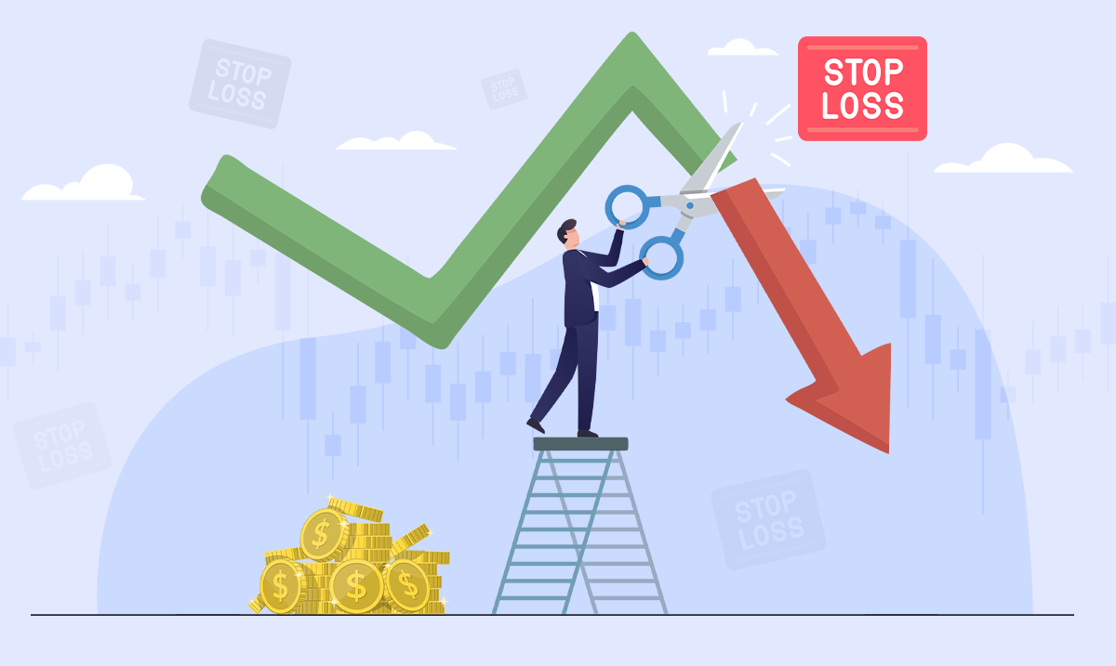
Stop orders (stop loss)
Turns into market order once stop price reached
Used to limit losses or protect profits
Example: Sell Kicks Unlimited if price falls to $45

Slide 21
What makes a stop-limit order different from a regular stop order?
A) It only works during market open hours
B) It triggers a market order when your limit is met
C) It cancels if the price moves too quickly
D) It has both a stop price and a limit price

Slide 22
What makes a stop-limit order different from a regular stop order?
A) It only works during market open hours
B) It triggers a market order when your limit is met
C) It cancels if the price moves too quickly
D) It has both a stop price and a limit price

Slide 23
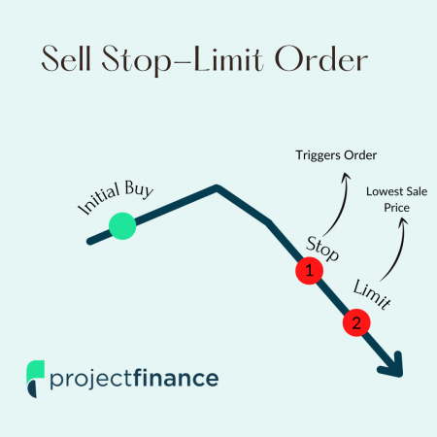
Stop limit orders
Combination: stop triggers a
limit order
Two prices: stop price and limit price
Only sells at limit price or better after stop triggered
Example: Stop at $45, limit at $44

Slide 24
Trailing stop
How does a trailing stop order work?
A) It freezes the stock price for 10 minutes
B) It moves up or down with the stock by a set amount
C) It follows the stock down but not up
D) It sets a fixed buy price, no matter the market

Slide 25
Trailing stop
How does a trailing stop order work?
A) It freezes the stock price for 10 minutes
B) It moves up or down with the stock by a set amount
C) It follows the stock down but not up
D) It sets a fixed buy price, no matter the market

Slide 26
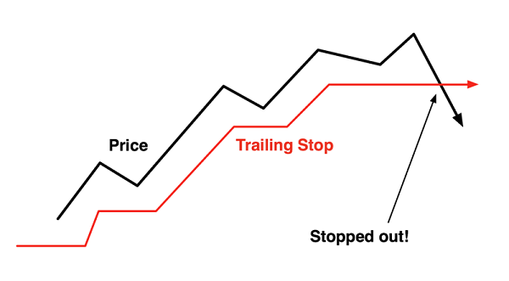
Trailing stop orders
Stop price trails market price by fixed $ or %
Adjusts as stock price moves
Locks in profit, sells if price falls by trail amount
Example: $2 trail; stock rises $50→$55, stop moves $48→$53, sells if drops to $53

Slide 27
Summary
Order type | Key feature | Example (Kicks Unlimited)
Market | Immediate execution | Buy at $50 market price
Limit | Price control | Buy only if ≤ $45
Stop | Protect loss | Sell if drops to $45
Stop Limit | Stop and limit price | Sell if hits $45, at ≥ $44
Trailing | Adjustable stop | Sell if drops $2 from high

Slide 28
In the Kicks Unlimited example, what would happen if you set a stop order at $45 and the stock dropped to $45?
A) It freezes the stock price for 10 minutes
B) It moves up or down with the stock by a set amount
C) It follows the stock down but not up
D) It sets a fixed buy price, no matter the market

Slide 29
In the Kicks Unlimited example, what would happen if you set a stop order at $45 and the stock dropped to $45?
A) It freezes the stock price for 10 minutes
B) It moves up or down with the stock by a set amount
C) It follows the stock down but not up
D) It sets a fixed buy price, no matter the market

Slide 30
Which order type gives you the highest chance of your trade being filled, even if the price isn’t ideal?
A) Market order
B) Limit order
C) Stop-limit order
D) Trailing stop order

Slide 31
Which order type gives you the highest chance of your trade being filled, even if the price isn’t ideal?
A) Market order
B) Limit order
C) Stop-limit order
D) Trailing stop order

Slide 32
What’s one risk of a limit order?
A) It locks your money for 24 hours
B) It might never get filled
C) The order always executes at a worse price
D) It forces you to buy more shares than you want

Slide 33
What’s one risk of a limit order?
A) It locks your money for 24 hours
B) It might never get filled
C) The order always executes at a worse price
D) It forces you to buy more shares than you want

Slide 34
Stock market game!

Slide 35
Recall the Scenario:
“Imagine you’ve saved up $500 and want to invest in Kicks Unlimited stock. The price is jumping around between $48 and $55. Would you buy now, wait, or protect yourself in some way?”
Give your order type and trigger price, see what happens!

Slide 36
Class Example!
Question | Your response
Assigned order type | Market Order: Buy or sell Kicks Unlimited shares immediately at the next available price shown on the chart.
What is your target or trigger price? | Whatever the price is on Day 1.
Does the order get triggered during the 10 intervals? If yes, at what price and at which time interval?
What were the advantages of this decision?
What were the disadvantages of this decision?

Slide 37
Class Example (Answer Key)
Time | Price
1 | $50
2 | $48
3 | $55
4 | $53
5 | $54
6 | $56
7 | $58
8 | $59
9 | $57
10 | $60
Question | Your response
Assigned order type | Market Order: Buy or sell Kicks Unlimited shares immediately at the next available price shown on the chart.
What is your target or trigger price? | Whatever the price is on Day 1.
Does the order get triggered during the 10 intervals? If yes, at what price and at which time interval? | Day 1 at $50
What were the advantages of this decision? | Because my order was filled right away, I didn’t miss out. The price rose by Day 10, so I got it at a good price.
What were the disadvantages of this decision? | I could have bought at a cheaper price on Day 1.

Slide 38
Time to fill out your assigned order type and target price!
Question | Your response
Assigned order type
What is your target or trigger price?
Does the order get triggered during the 10 intervals? If yes, at what price and at which time interval?
What were the advantages of this decision?
What were the disadvantages of this decision?

Slide 39
Let the Game Begin!
Choose trigger prices based on what you believe will happen to the stock. Use the Day 1 price of $50 as your reference. Don't go too extreme or too safe — think like an investor!

Slide 40
Day 1: $48
Kicks Unlimited launches a new retro sneaker line. Everyone at school is talking about it — excitement builds.

Slide 41
Day 2: $50
A pro skater reposts the teaser — minor excitement builds, and price rises slightly.

Slide 42
Day 3: $47
A popular blog says the shoes look too similar to last year’s model — buzz cools off.

Slide 43
Day 4: $51
A YouTuber posts a sneak peek review saying they're "better than expected" — price jumps again.

Slide 44
Day 5: $49
Pre-order confusion online frustrates some customers — there’s brief dip in demand.

Slide 45
Day 6: $53
A major artist reveals they co-designed the shoes — surprise collab boosts hype.

Slide 46
Day 7: $50
Delay announcement: the shoes won’t ship until next month — price slips slightly again.

Slide 47
Day 8: $54
Surprise giveaway event goes viral — interest surges.

Slide 48
Day 9: $52
Shipping issues cause a brief halt in online orders — investors worry.

Slide 49
Day 10: $56
Collab officially launches in stores and sells out — media praises it as a comeback win!

Slide 50
Time is up! Complete your tracker order as a group!
Question | Your response
Assigned order type
What is your target or trigger price?
Does the order get triggered during the 10 intervals? If yes, at what price and at which time interval?
What were the advantages of this decision?
What were the disadvantages of this decision?

Slide 51
Consolidation
Complete your exit ticket individually!

Slide 52

Final thoughts
Knowing order types helps DIY investors
Choose orders based on goals and risk tolerance

